Slide 1
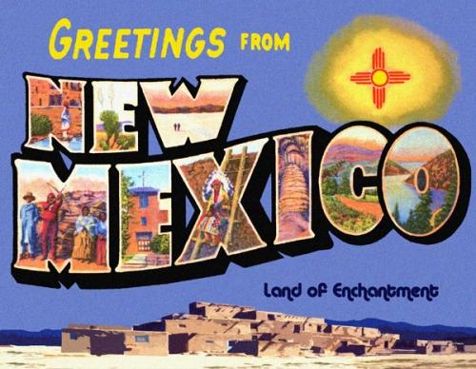

Slide 2
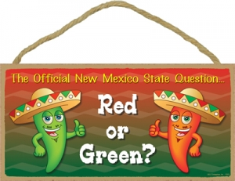
The state official question: red or green?

Slide 3
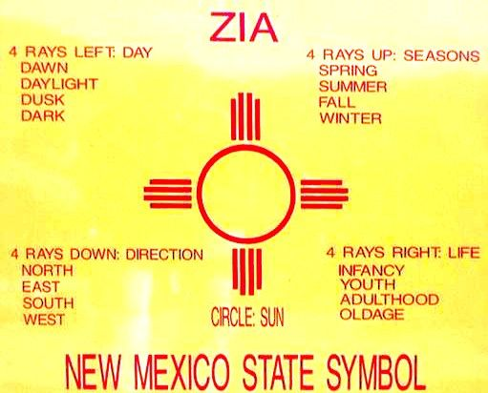
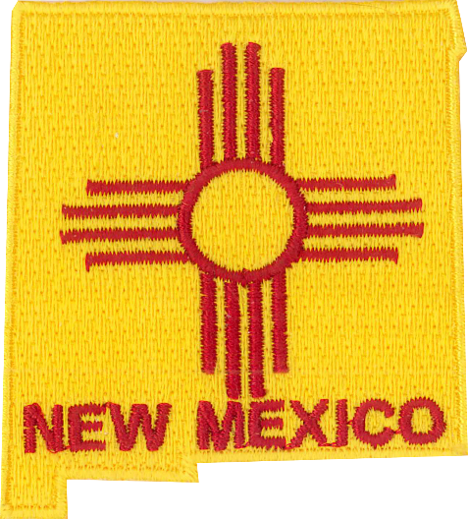
Land of Enchantment

Slide 4
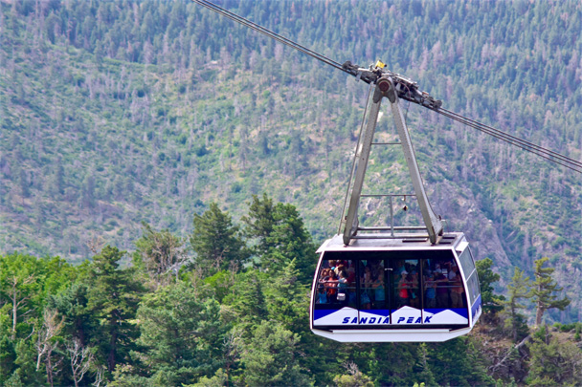
Sandia

Slide 5
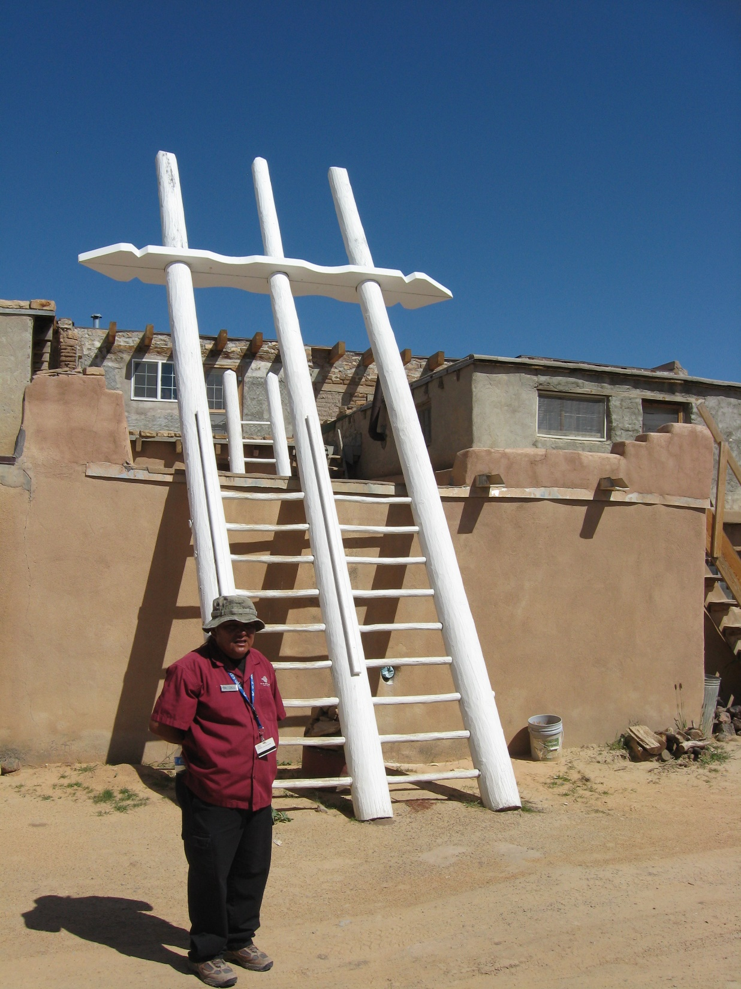
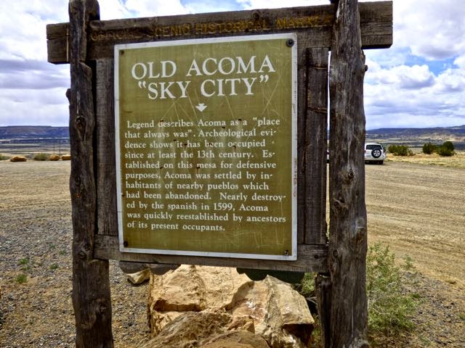
Pueblos, Acoma, Sky City, Isleta,

Slide 6
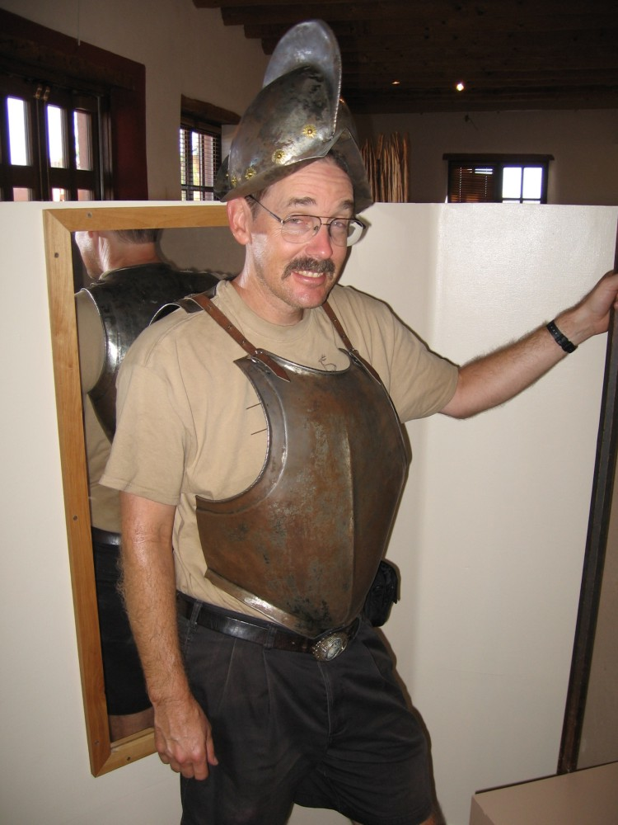
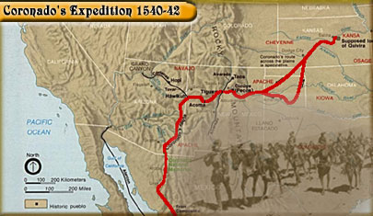
Coronado, Oñate

Slide 7
Meow Wolf,

Slide 8
Georgia O'Keefe, Taos

Slide 9
George R. R. Martin

Slide 10
Game of Thrones

Slide 11
Breaking Bad, Walter White, Heisenberg,

Slide 12
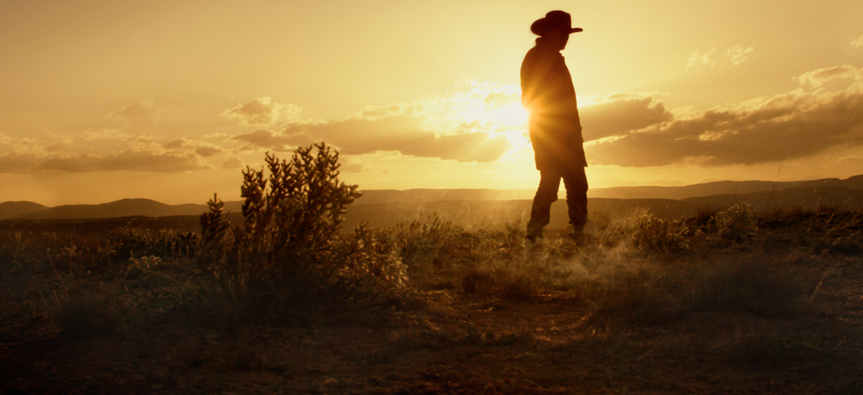
Movies/TV: Better Call Saul, Longmire, TamaleWood

Slide 13
Sunport

Slide 14
military bases (Kirtland, Cannon, and Holloman)

Slide 15
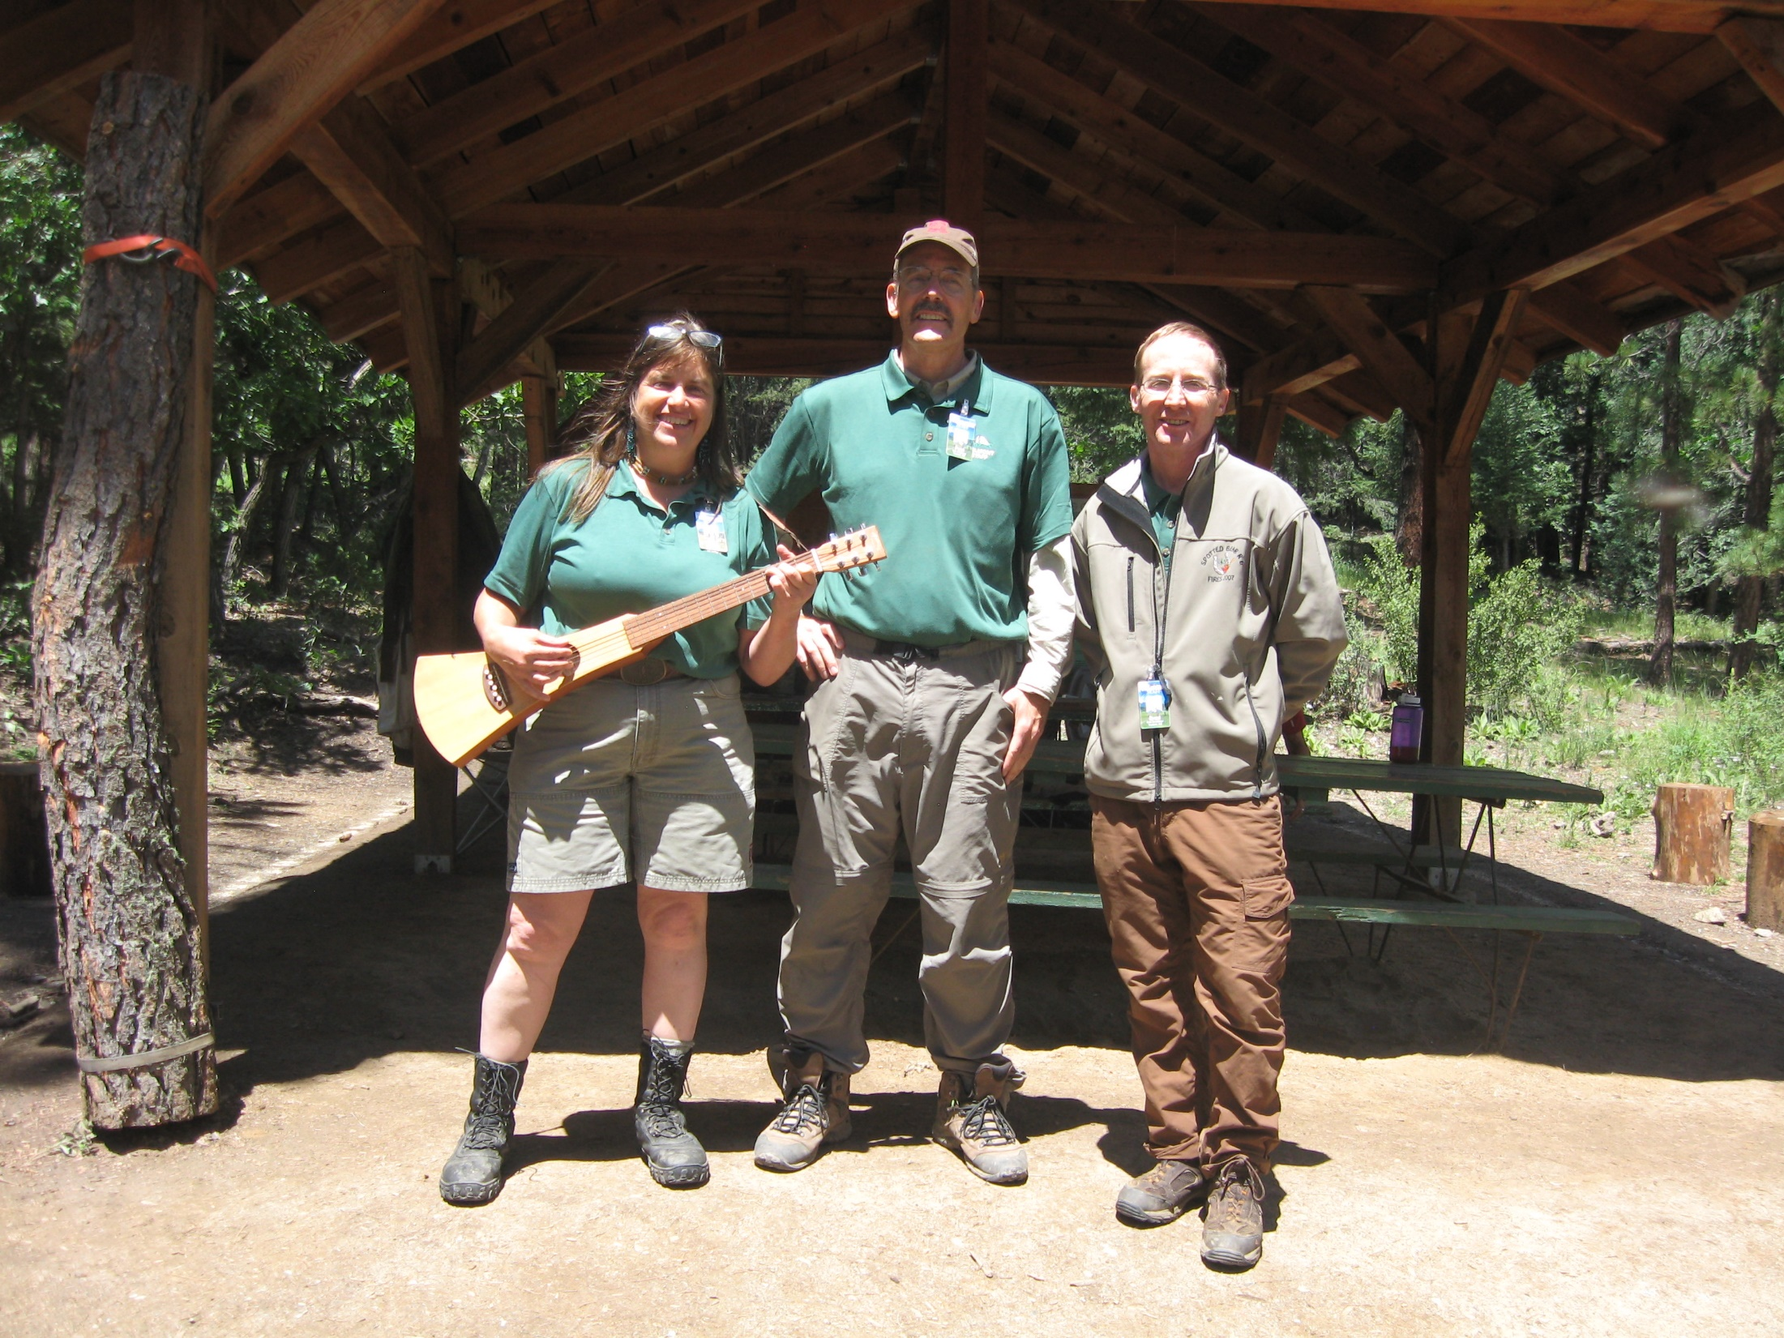
Philmont

Slide 16
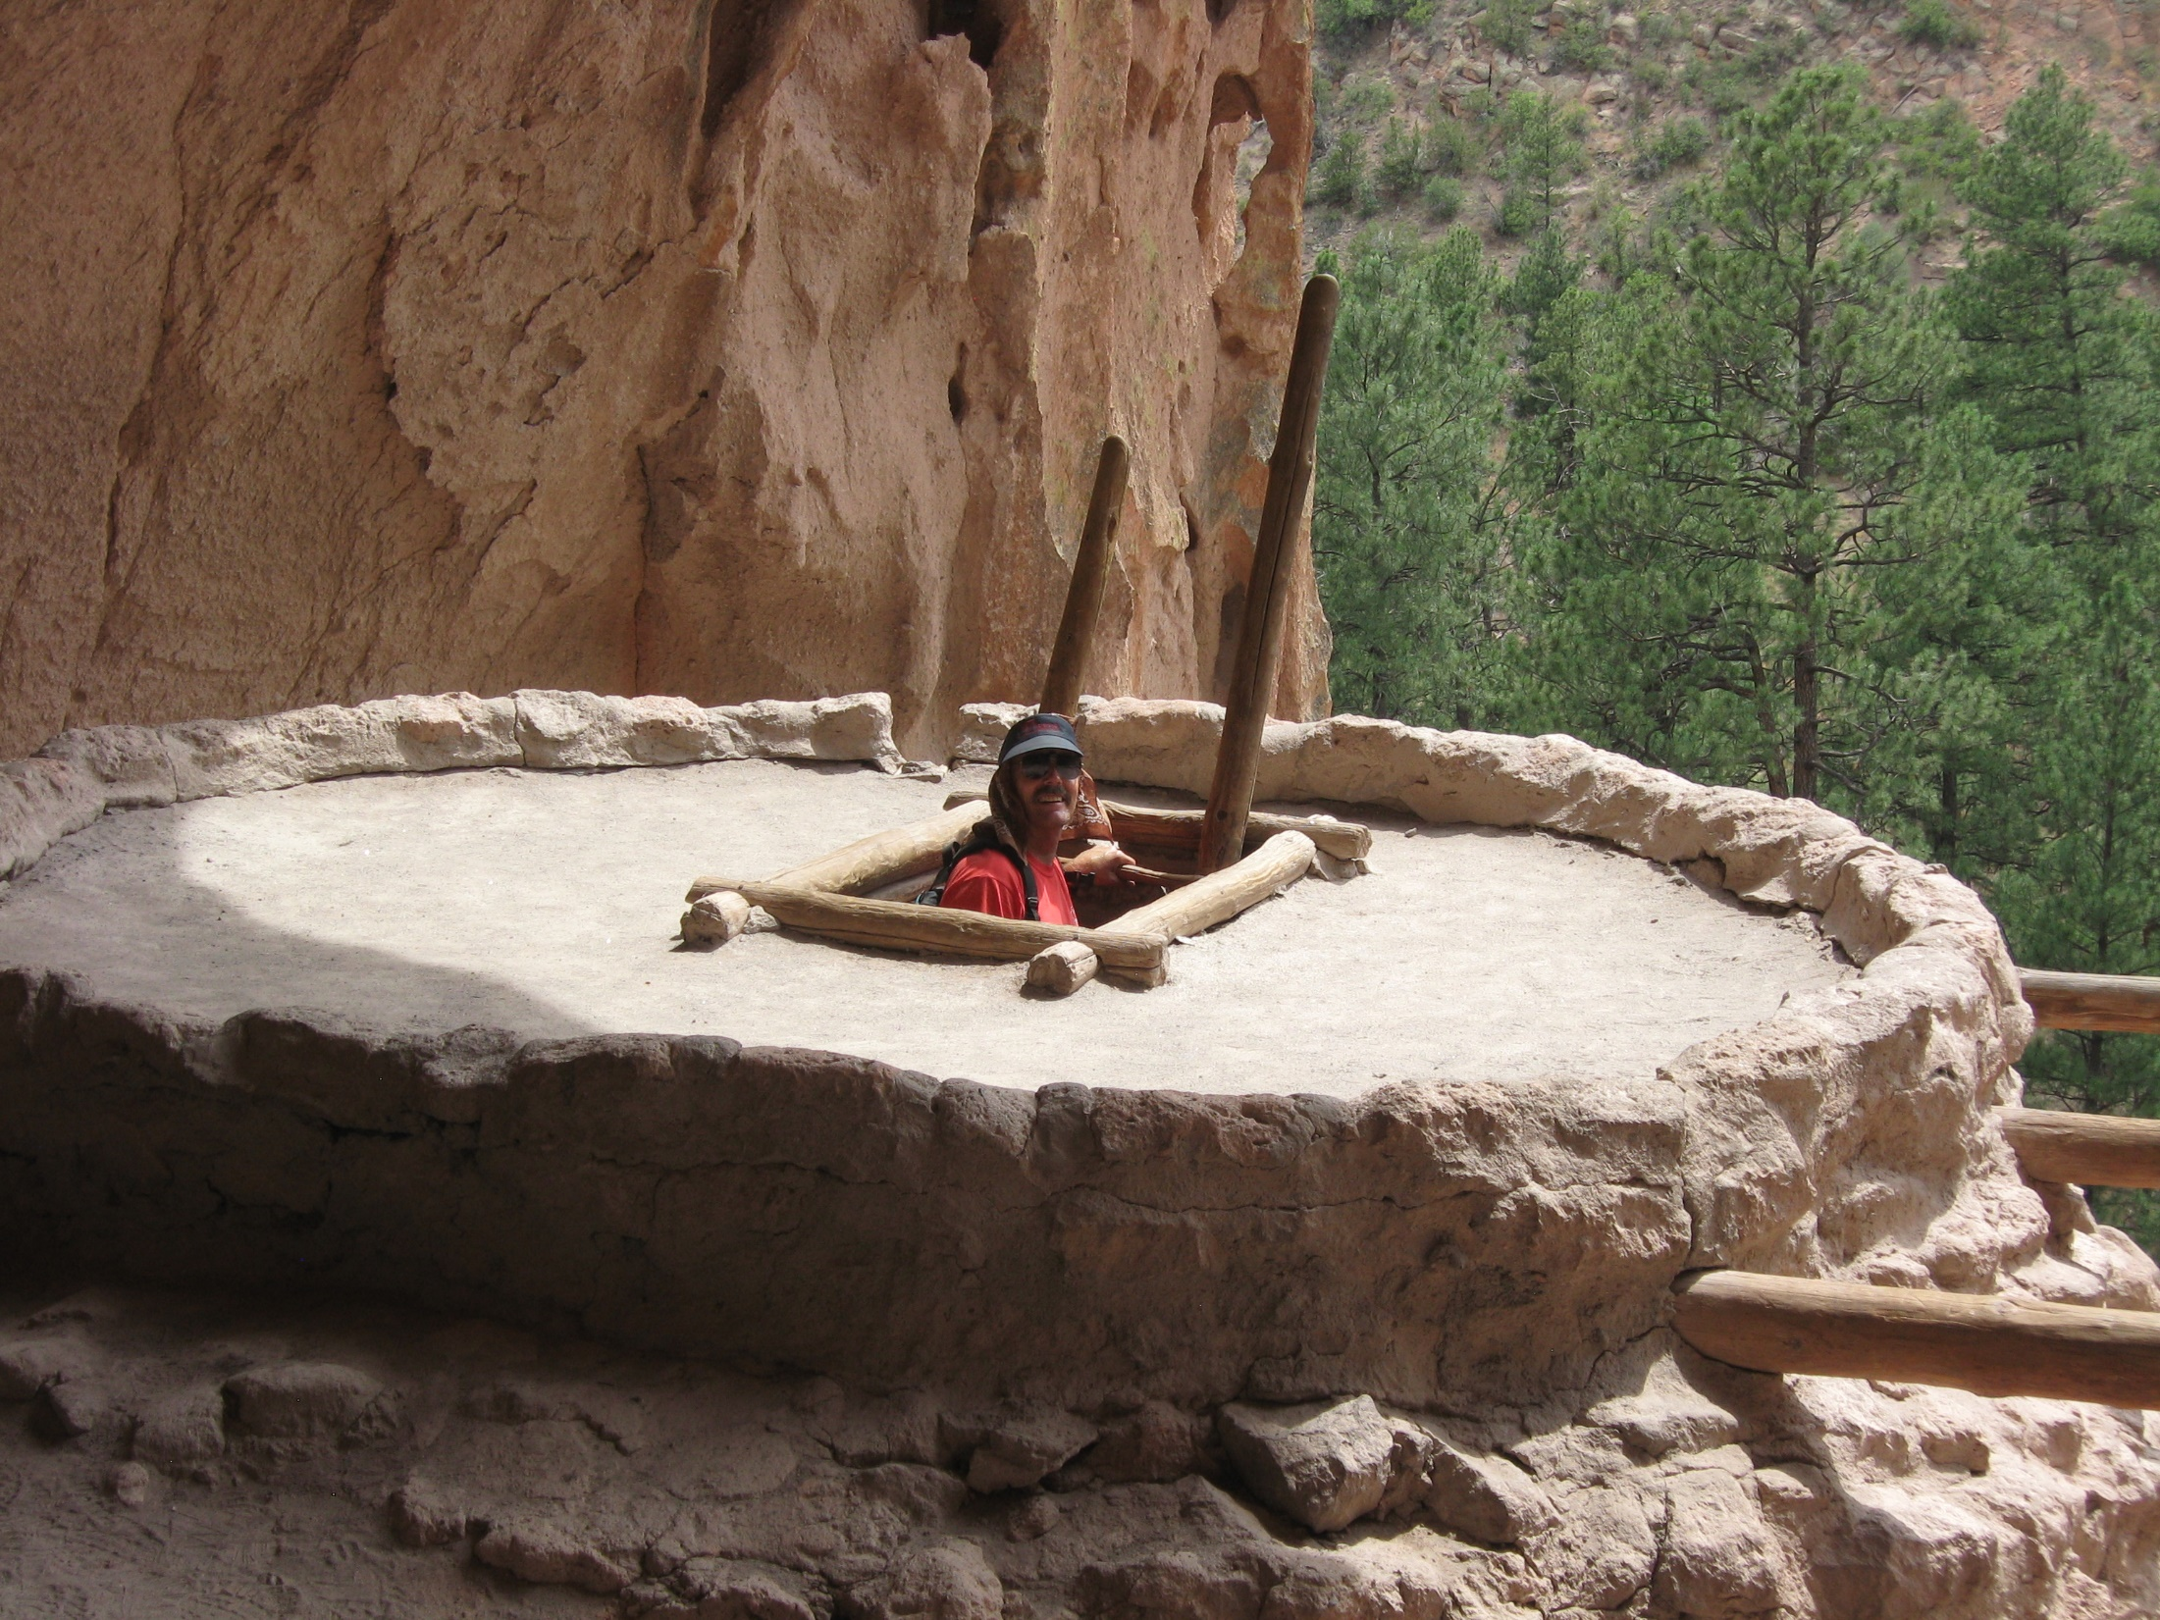
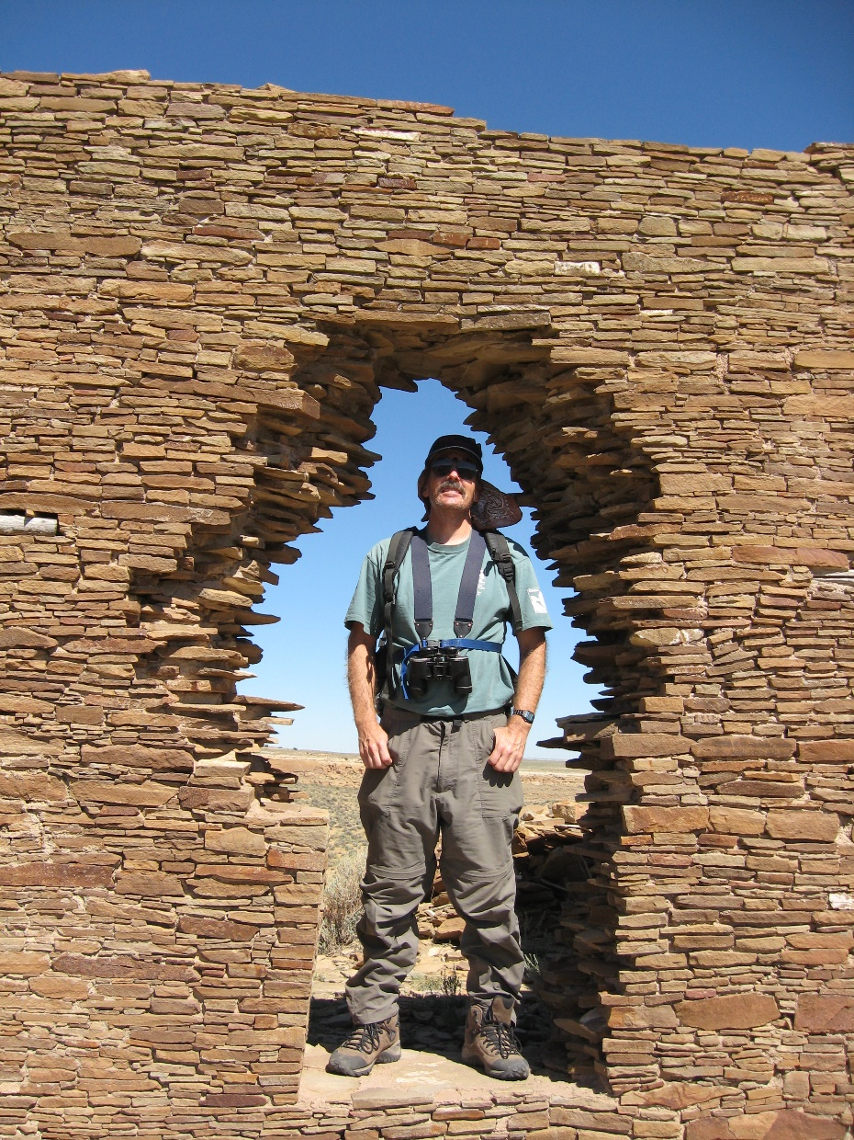
Chaco Canyon, Bandelier

Slide 17
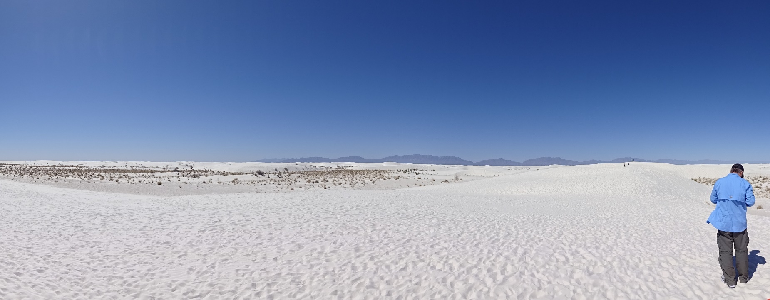
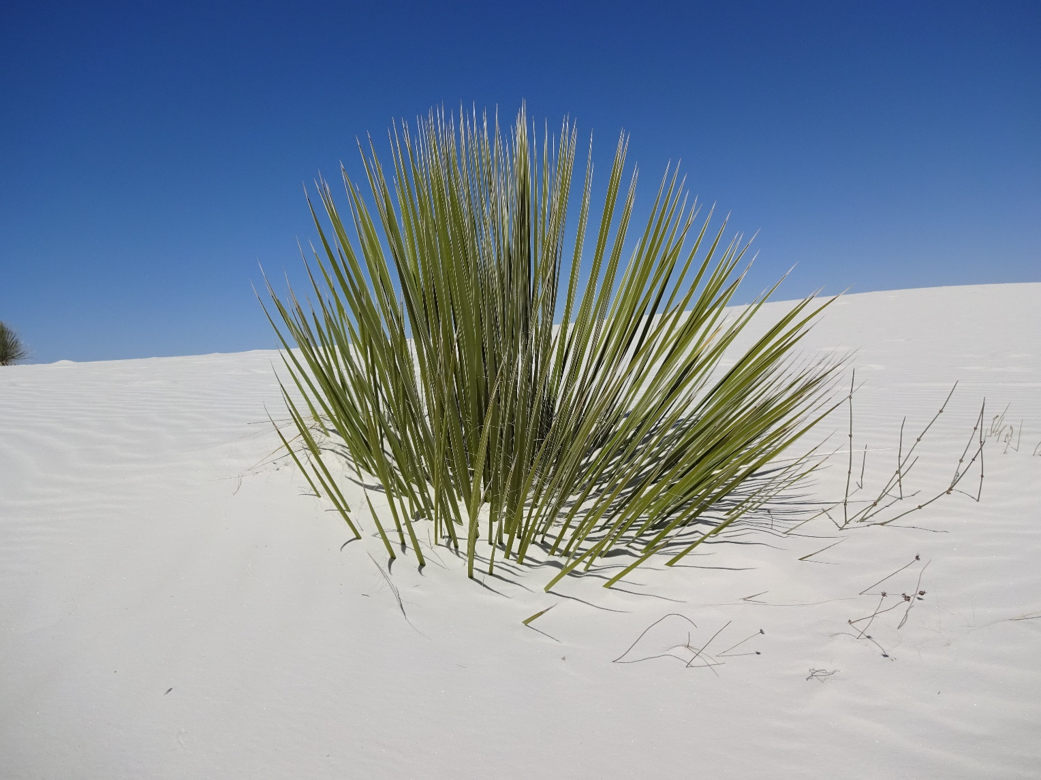
White Sands, Carlsbad Caverns,

Slide 18
Rio Grande,

Slide 19
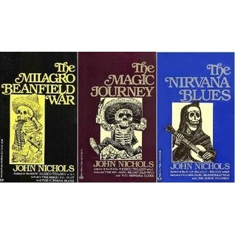
Literature: Milagro Beanfield Trilogy

Slide 20
Los Alamos

Slide 21
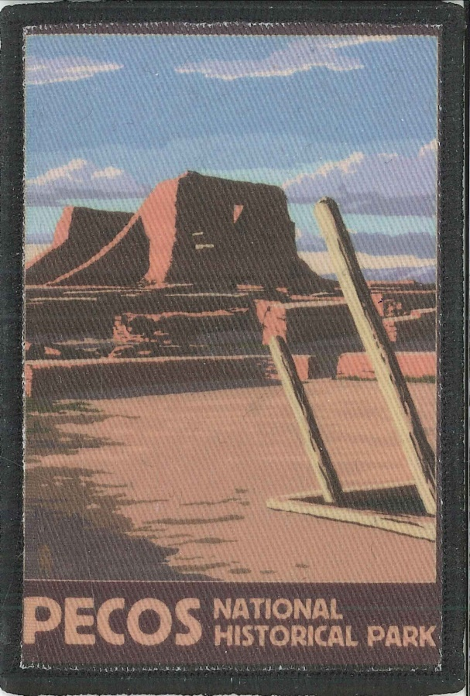
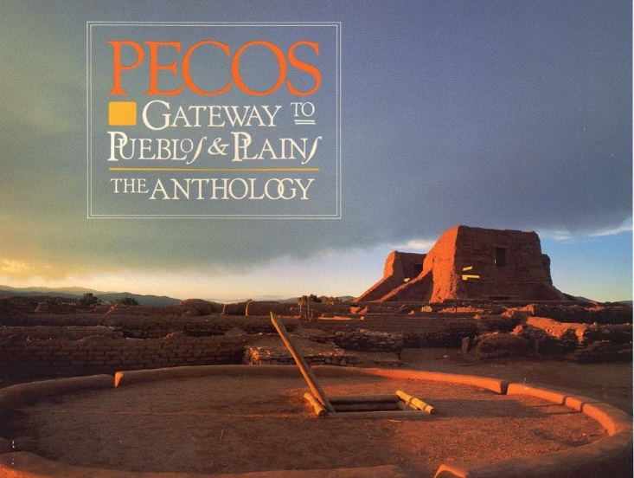
Great Plains, Pecos Pueblo, Billy the Kid,

Slide 22
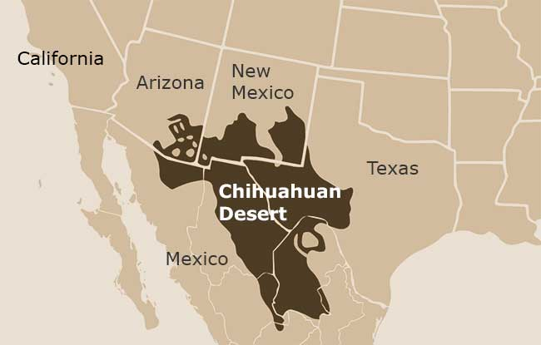
Chihuahuan Desert

Slide 23
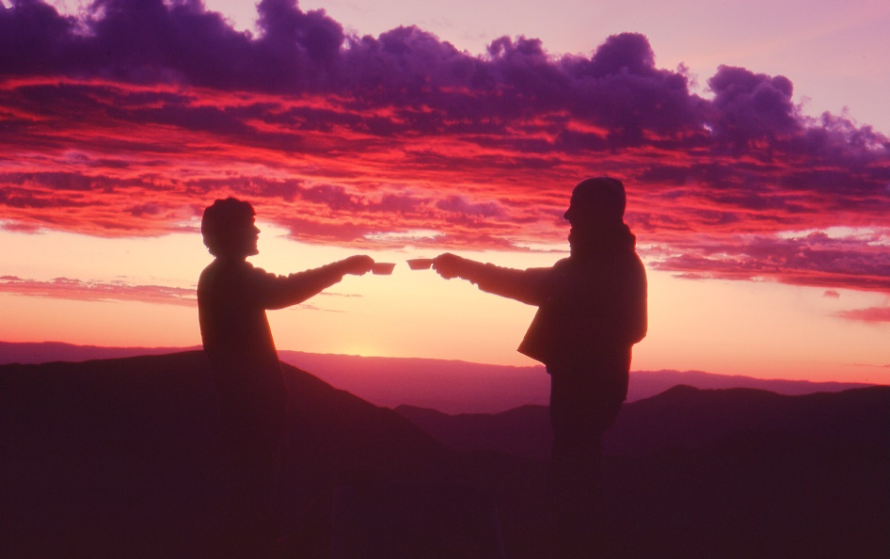
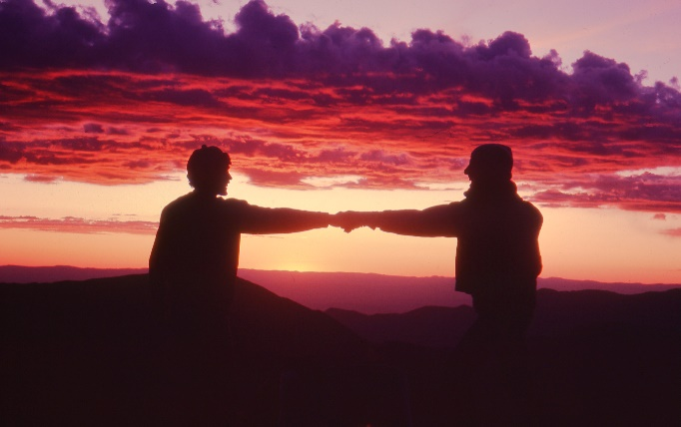
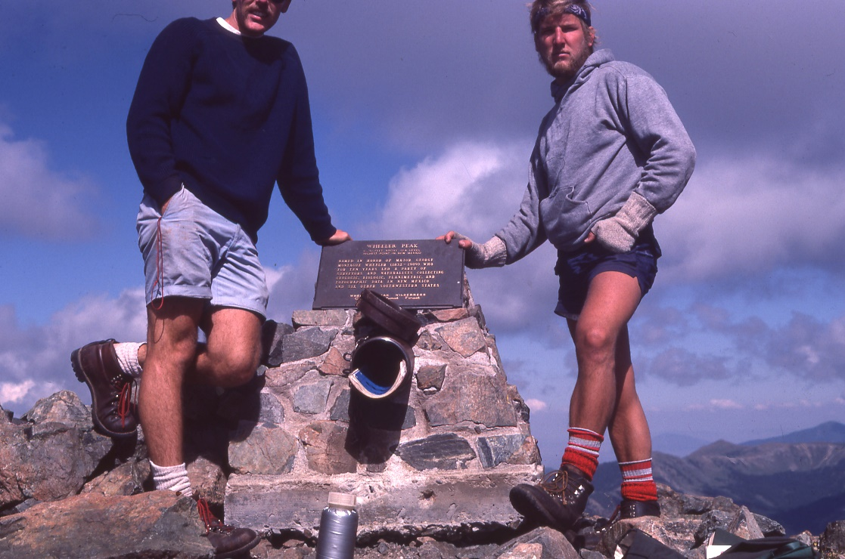
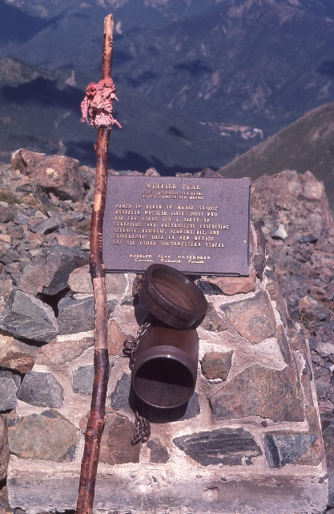
Mt. Wheeler high point,

Slide 24
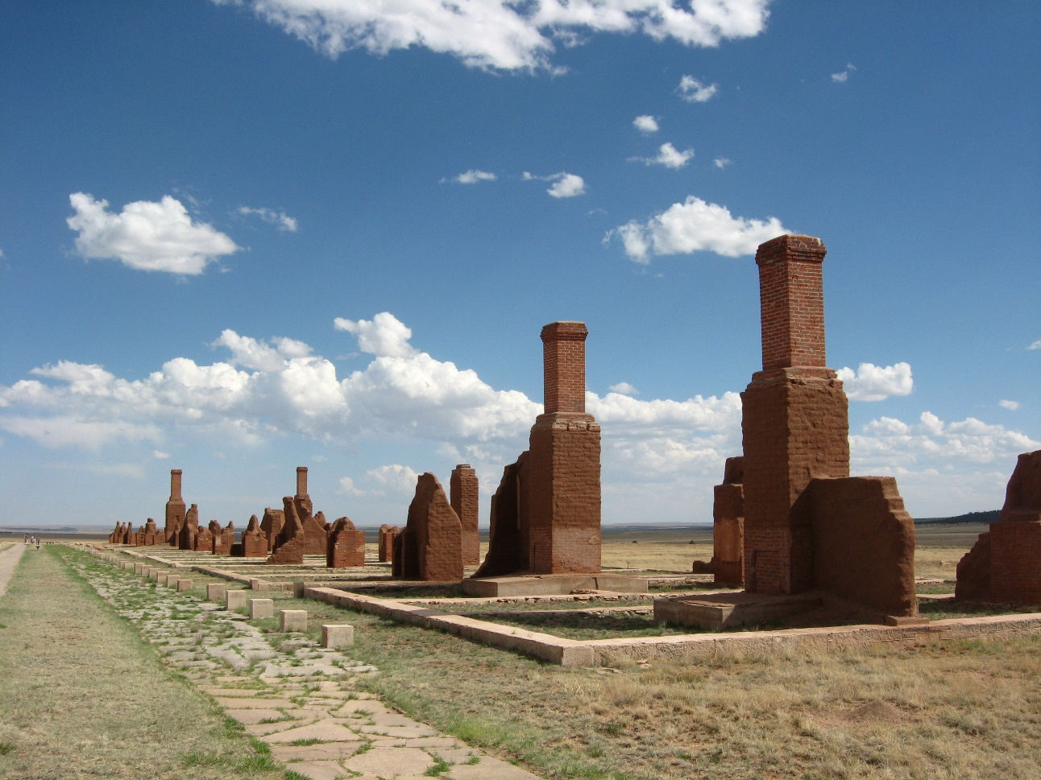
Santa Fe Trail

Slide 25
Bosque del Apache and cranes

Slide 26
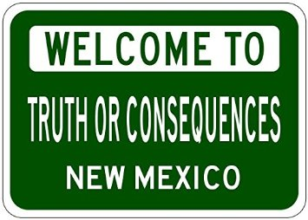
ToC

Slide 27
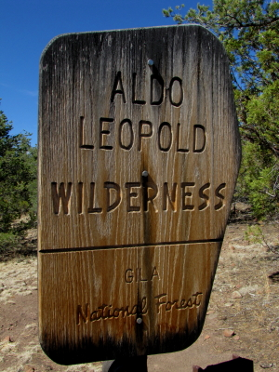
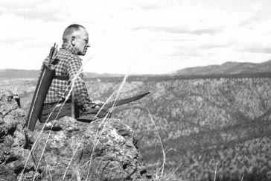
Gila Wilderness, Aldo Leopold

Slide 28
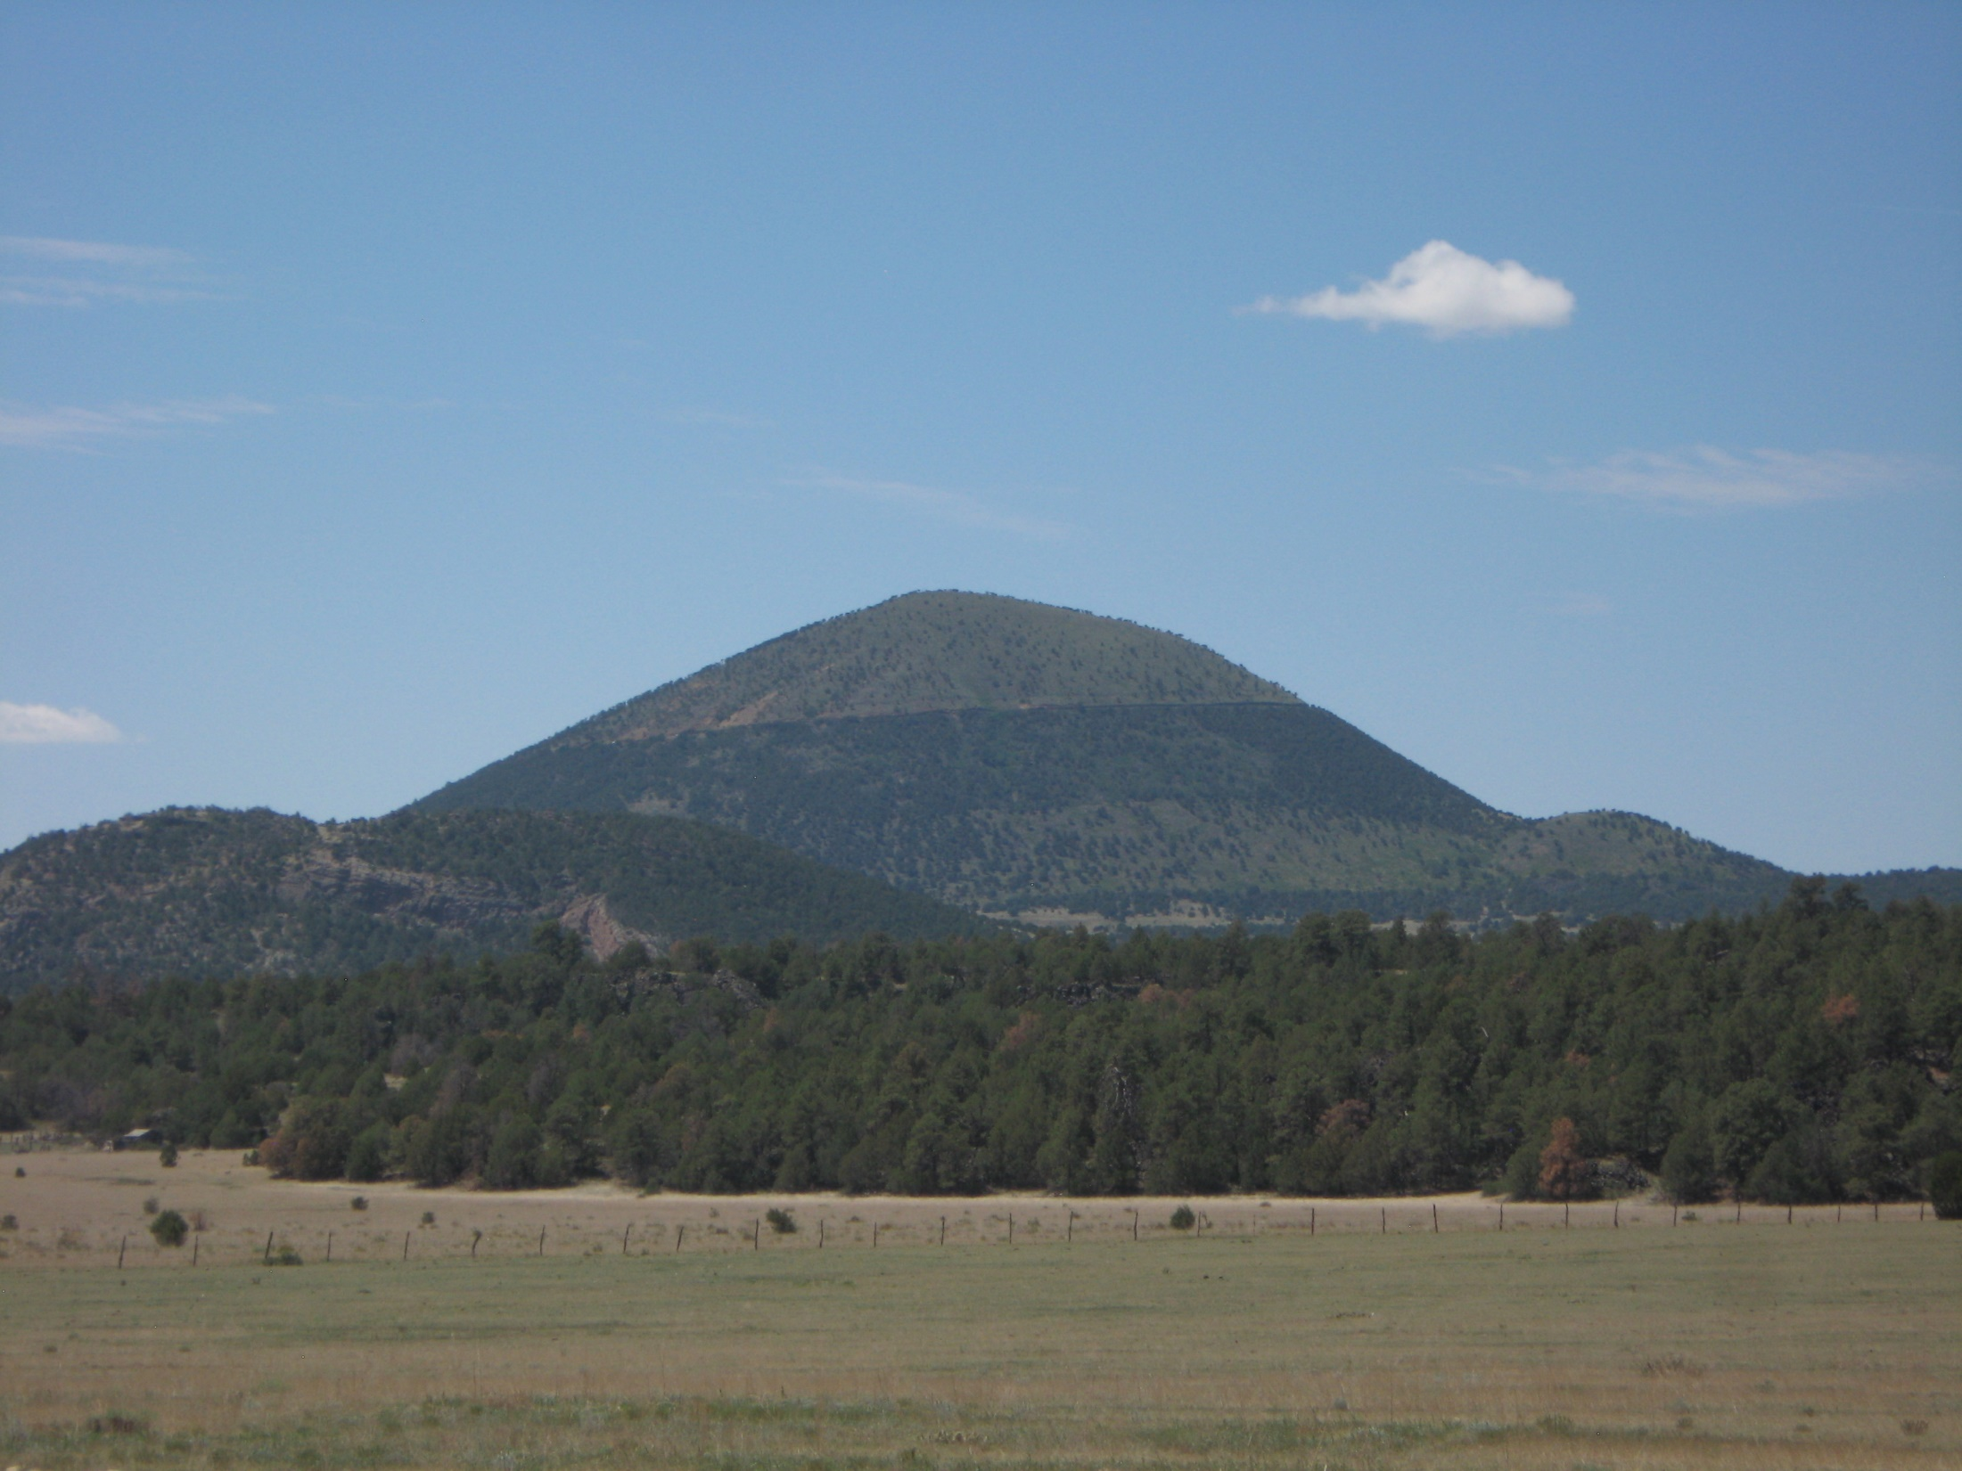
volcanism
Capulin and El Malpais

Slide 29
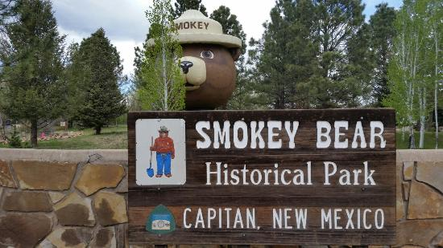
Smokey Bear

Slide 30
Turquoise Trail

Slide 31
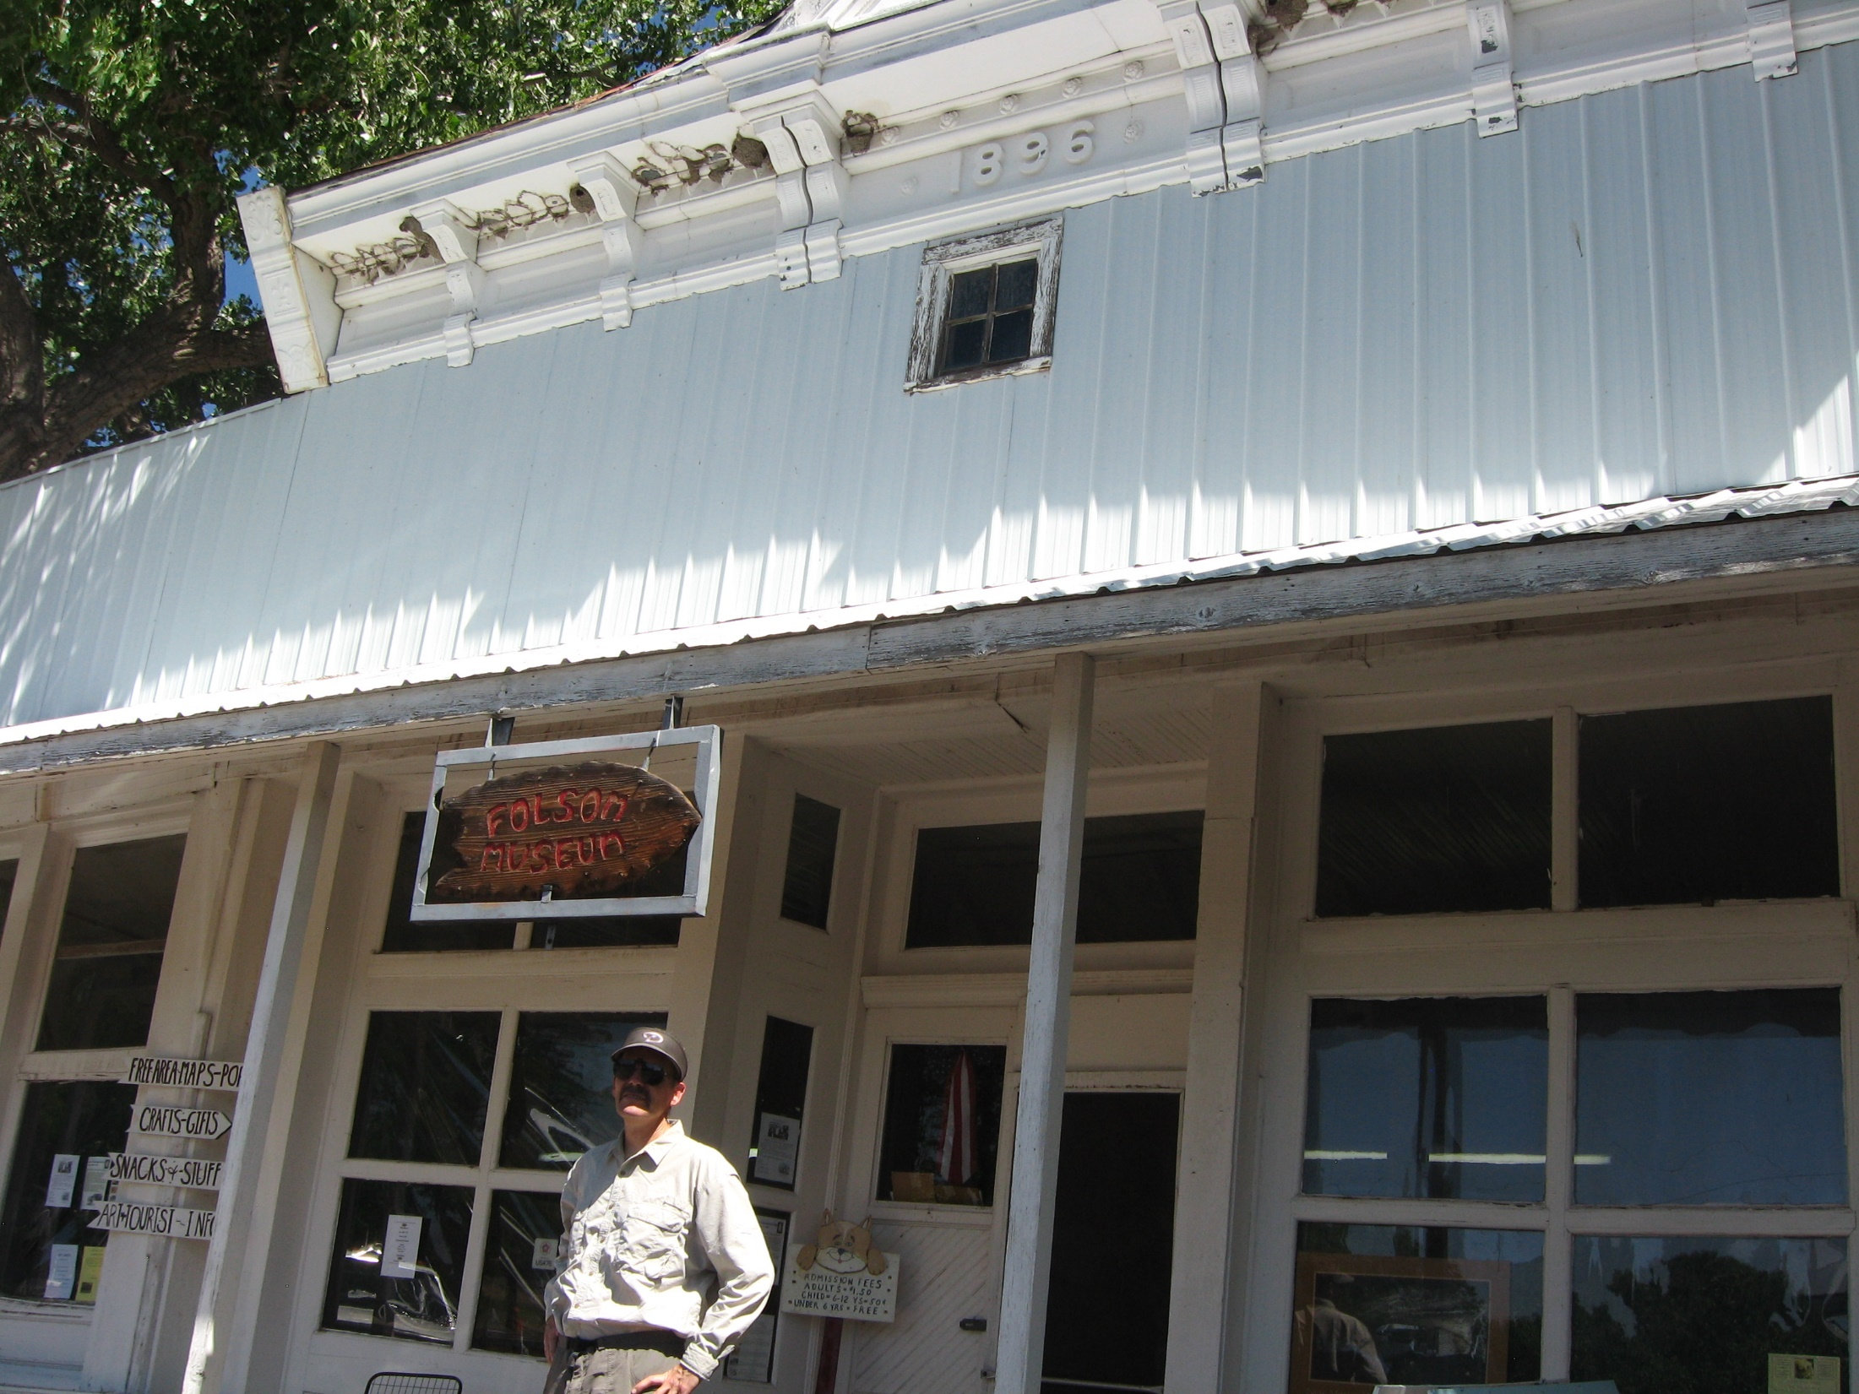
Early North Americans
Clovis and Folsom

