Slide 1
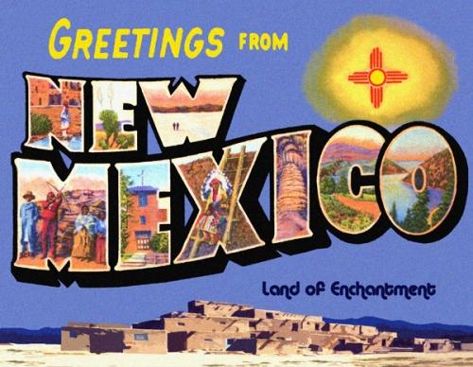

Slide 2
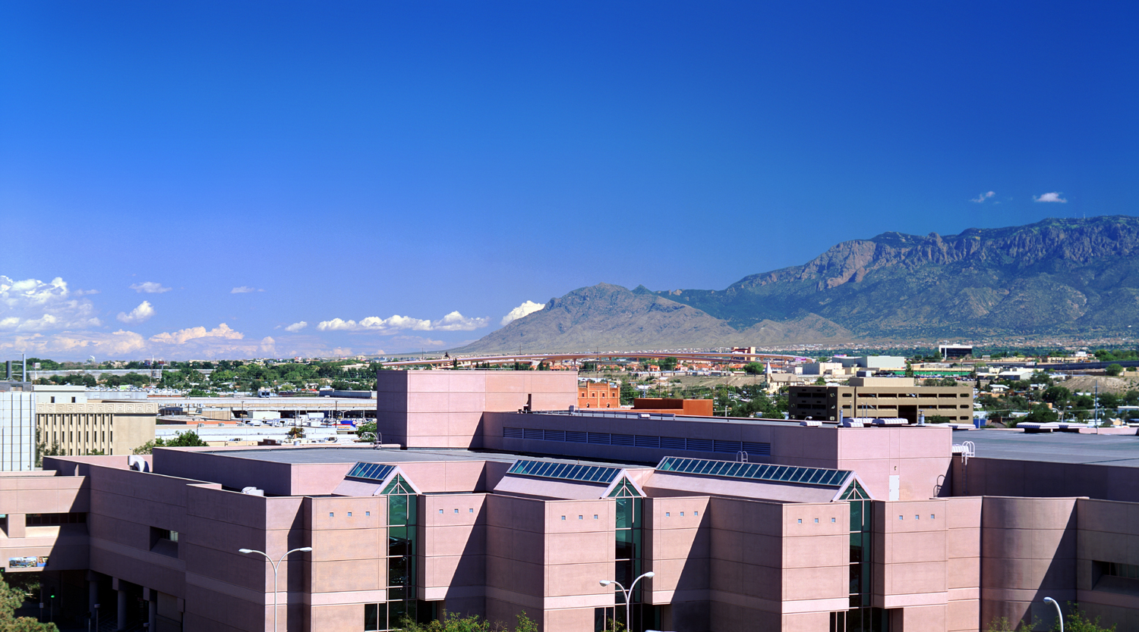
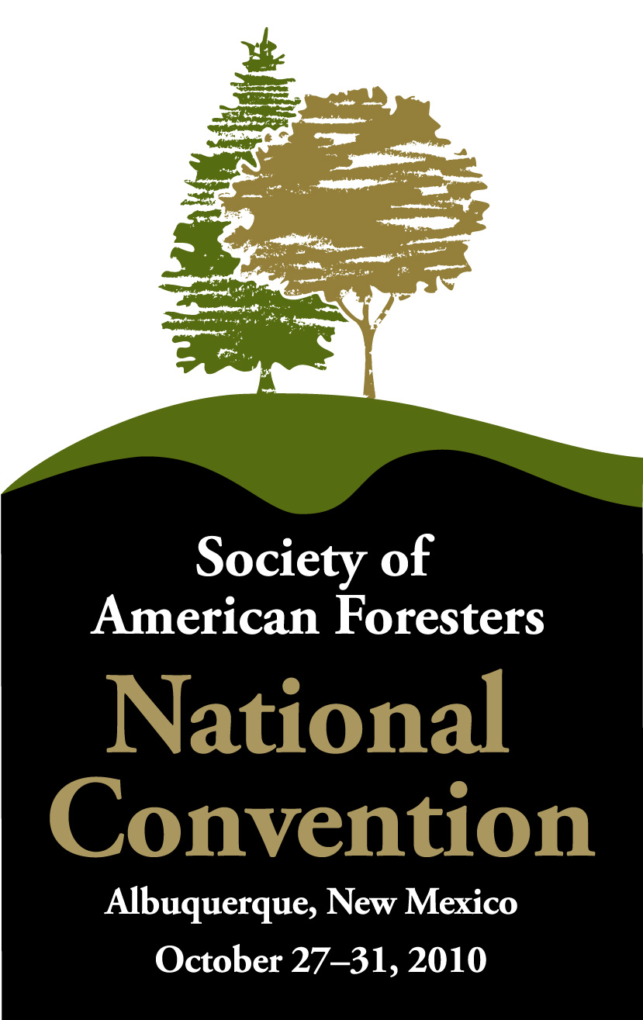
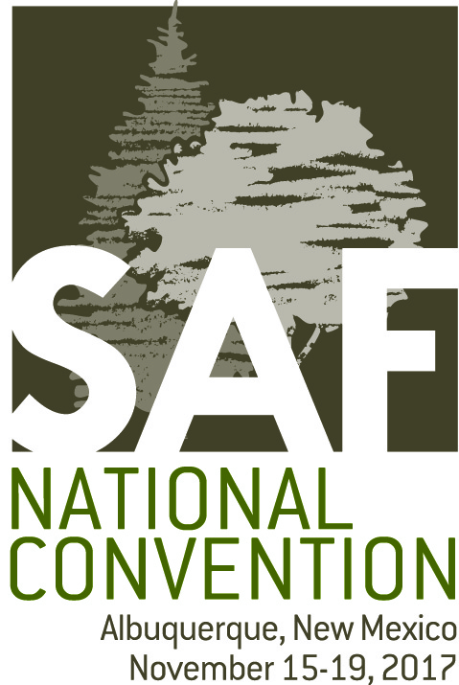
Notes:
1b: Mary: If you were here at the 2010 SAF National Convention, then welcome back.

Slide 3
Notes:
1a: Paul: Welcome to Albuquerque and the 2017 SAF National Convention.

Slide 4
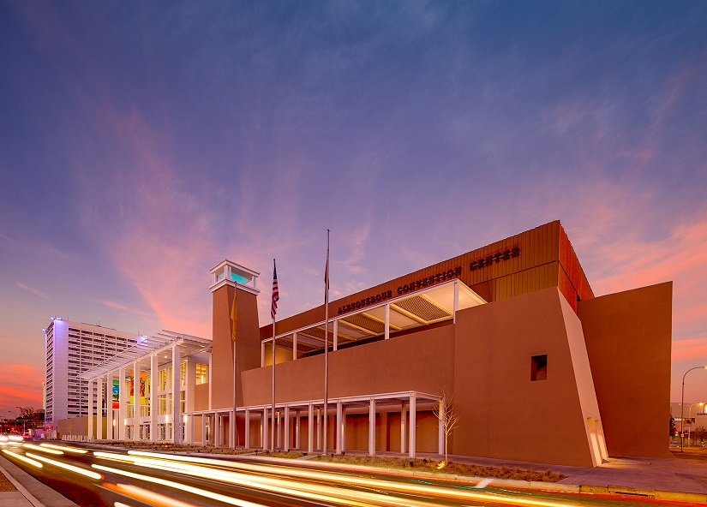
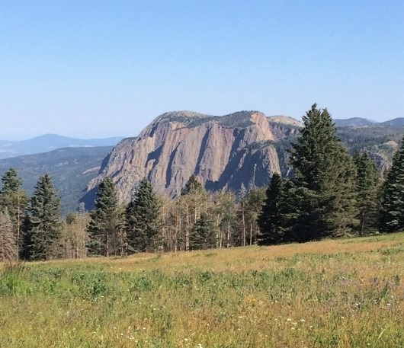
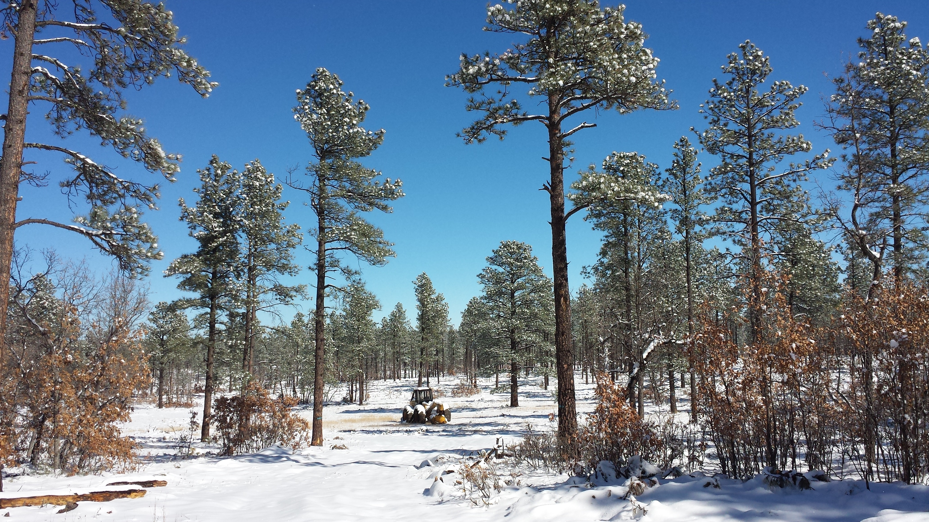
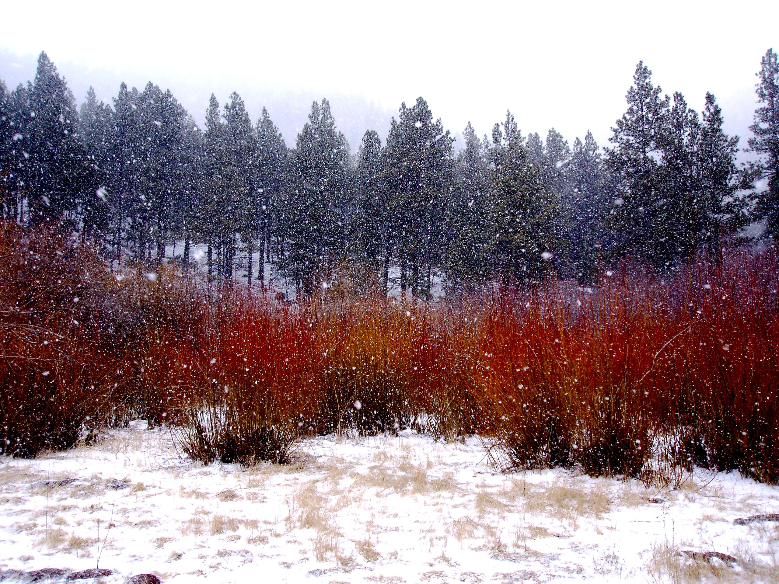
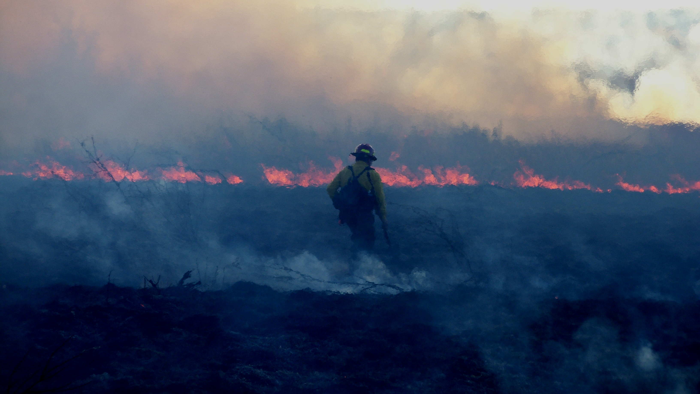
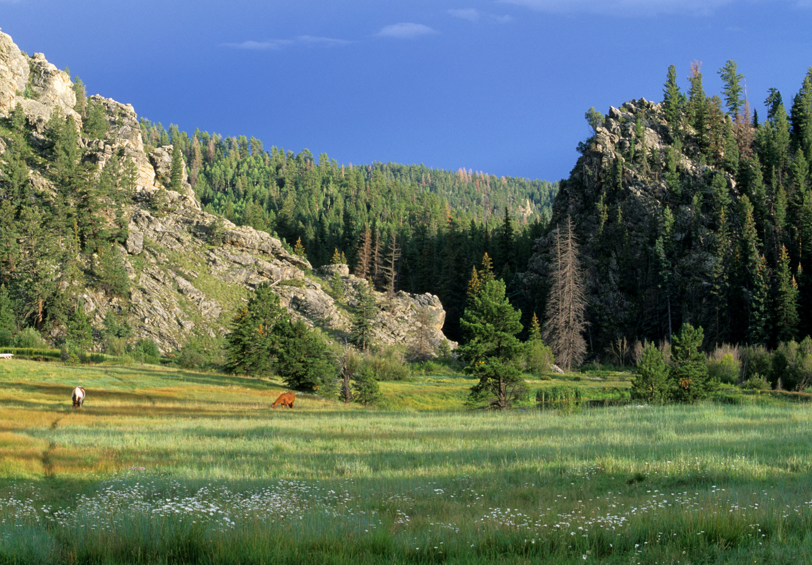
Notes:
1c: Mary: We are honored and humbled by the opportunity to host this amazing gathering twice in the same decade – yet we think you will agree that these conventions are two very different events.

Slide 5
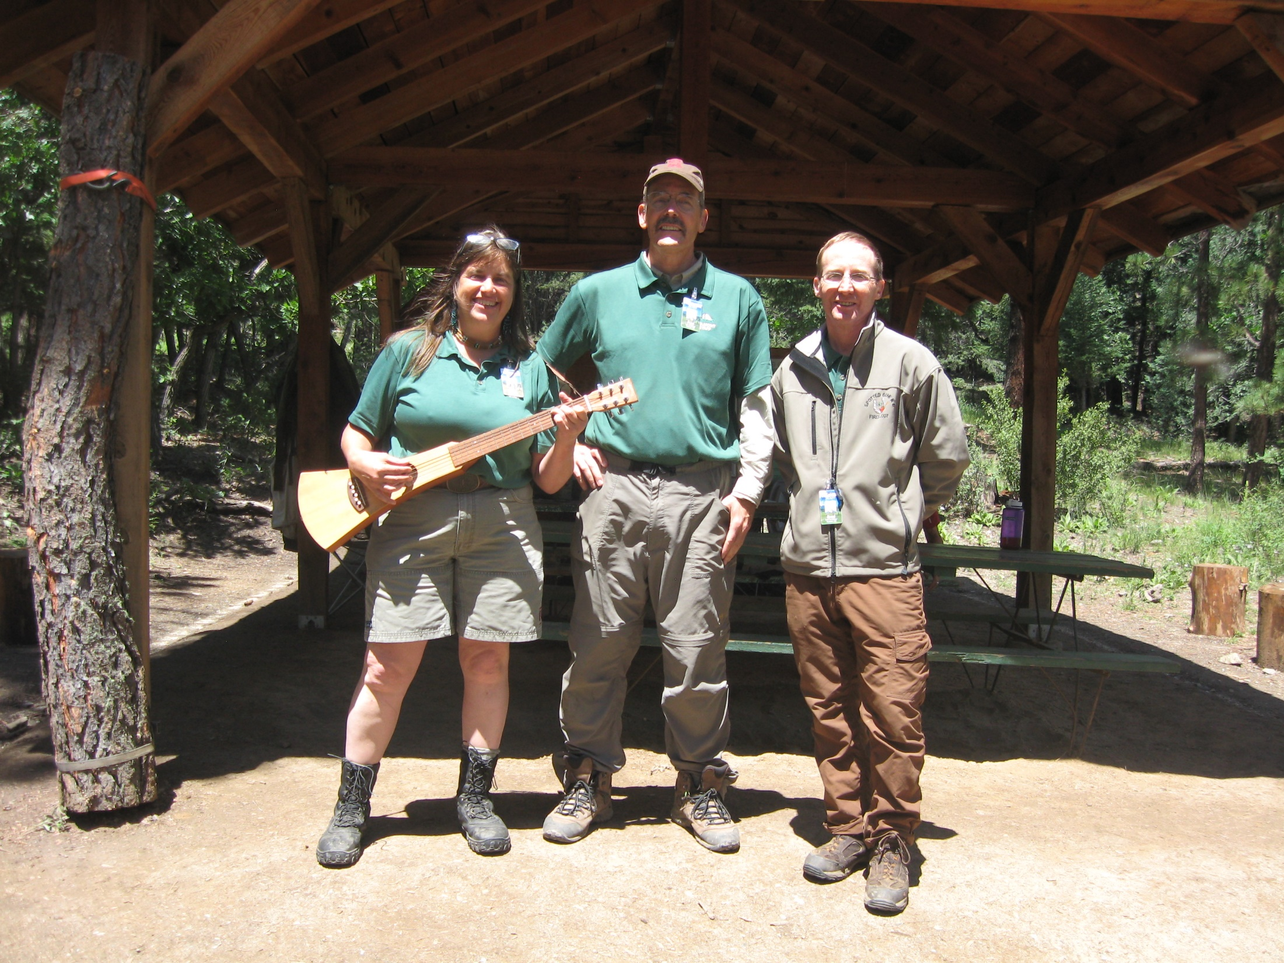
Mary
Paul
Peter?
Notes:
1d: Paul: This film should serve as short primer to truly help you fit in as a forester here in New Mexico and the Southwest.

Slide 6
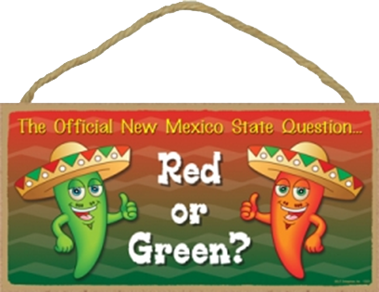
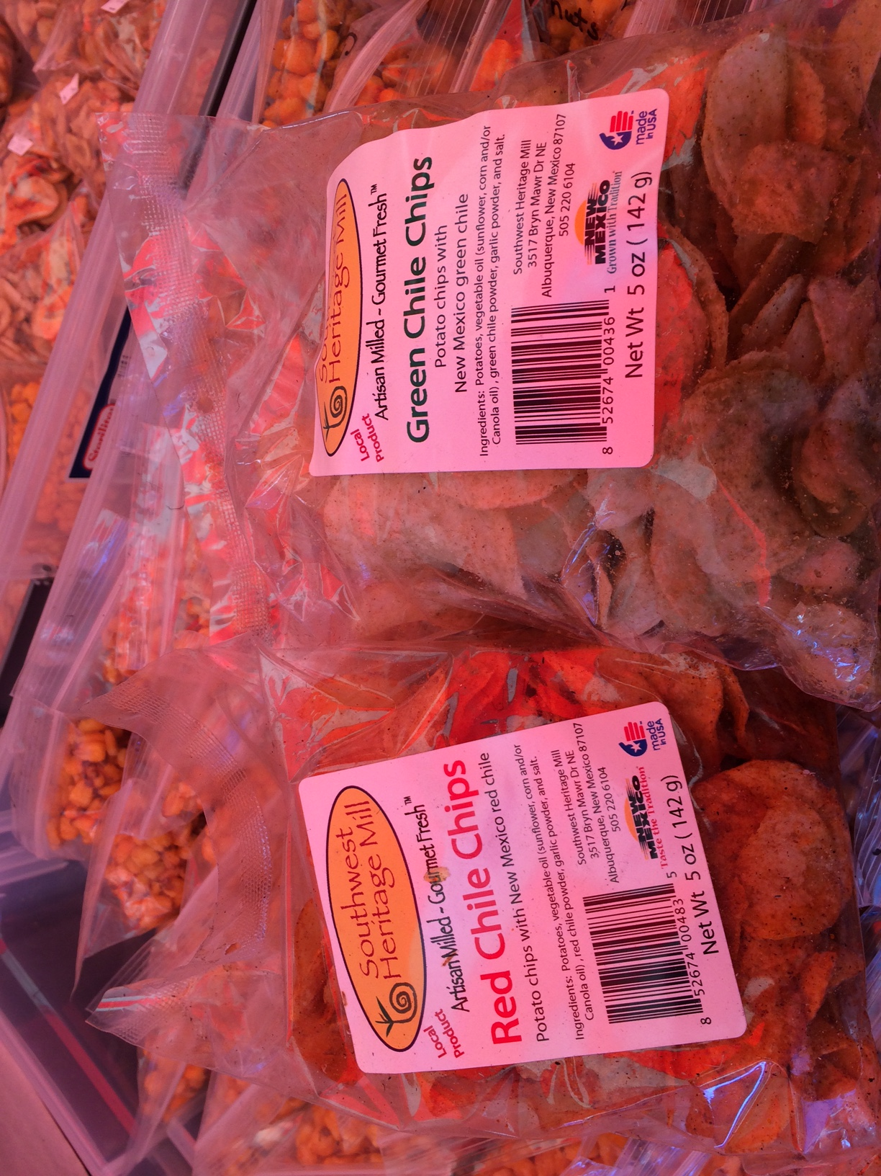
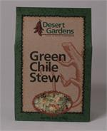
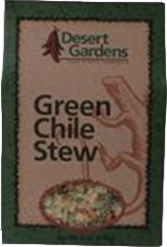
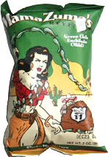

Slide 7
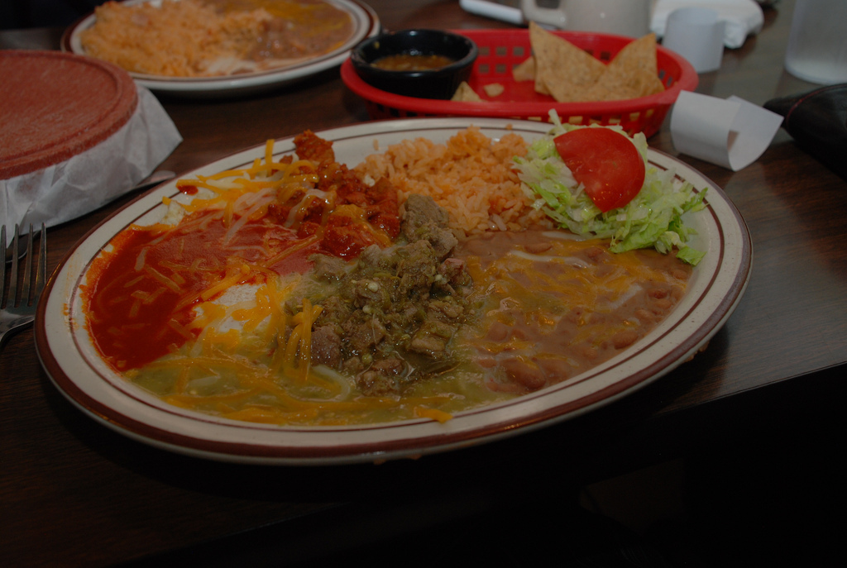
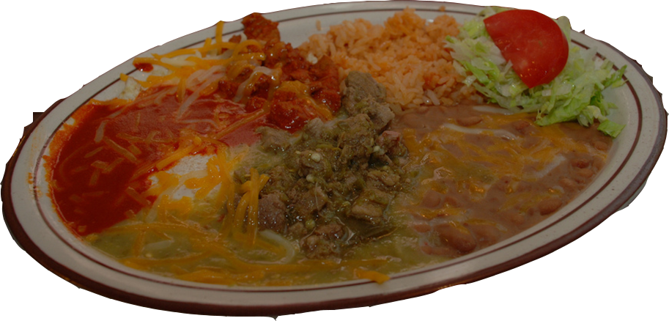

Slide 8
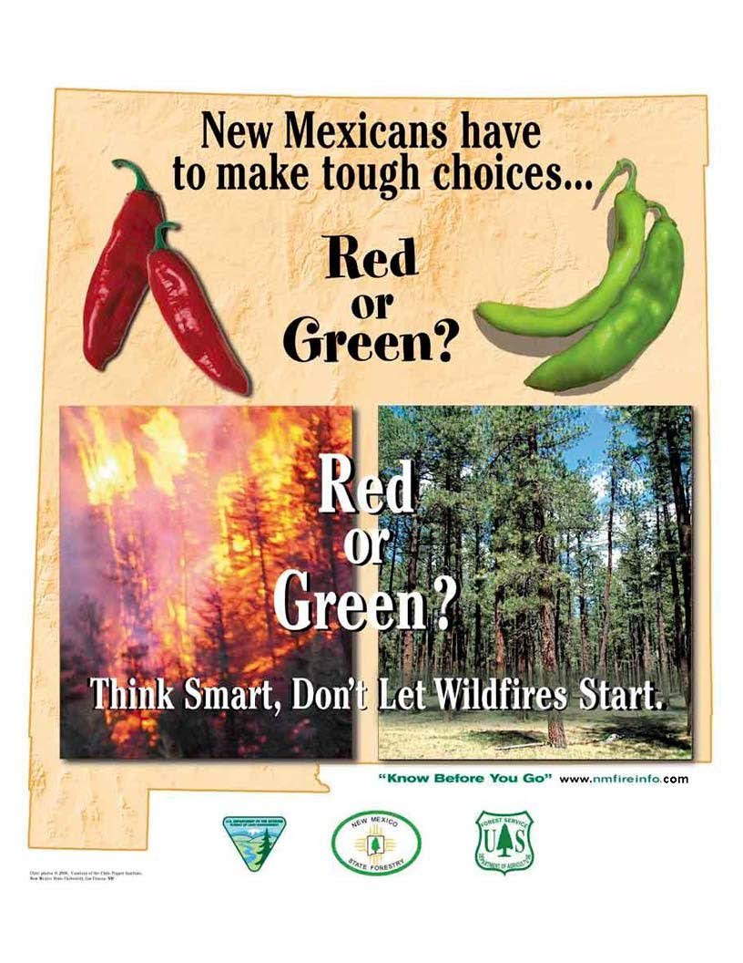

Slide 9
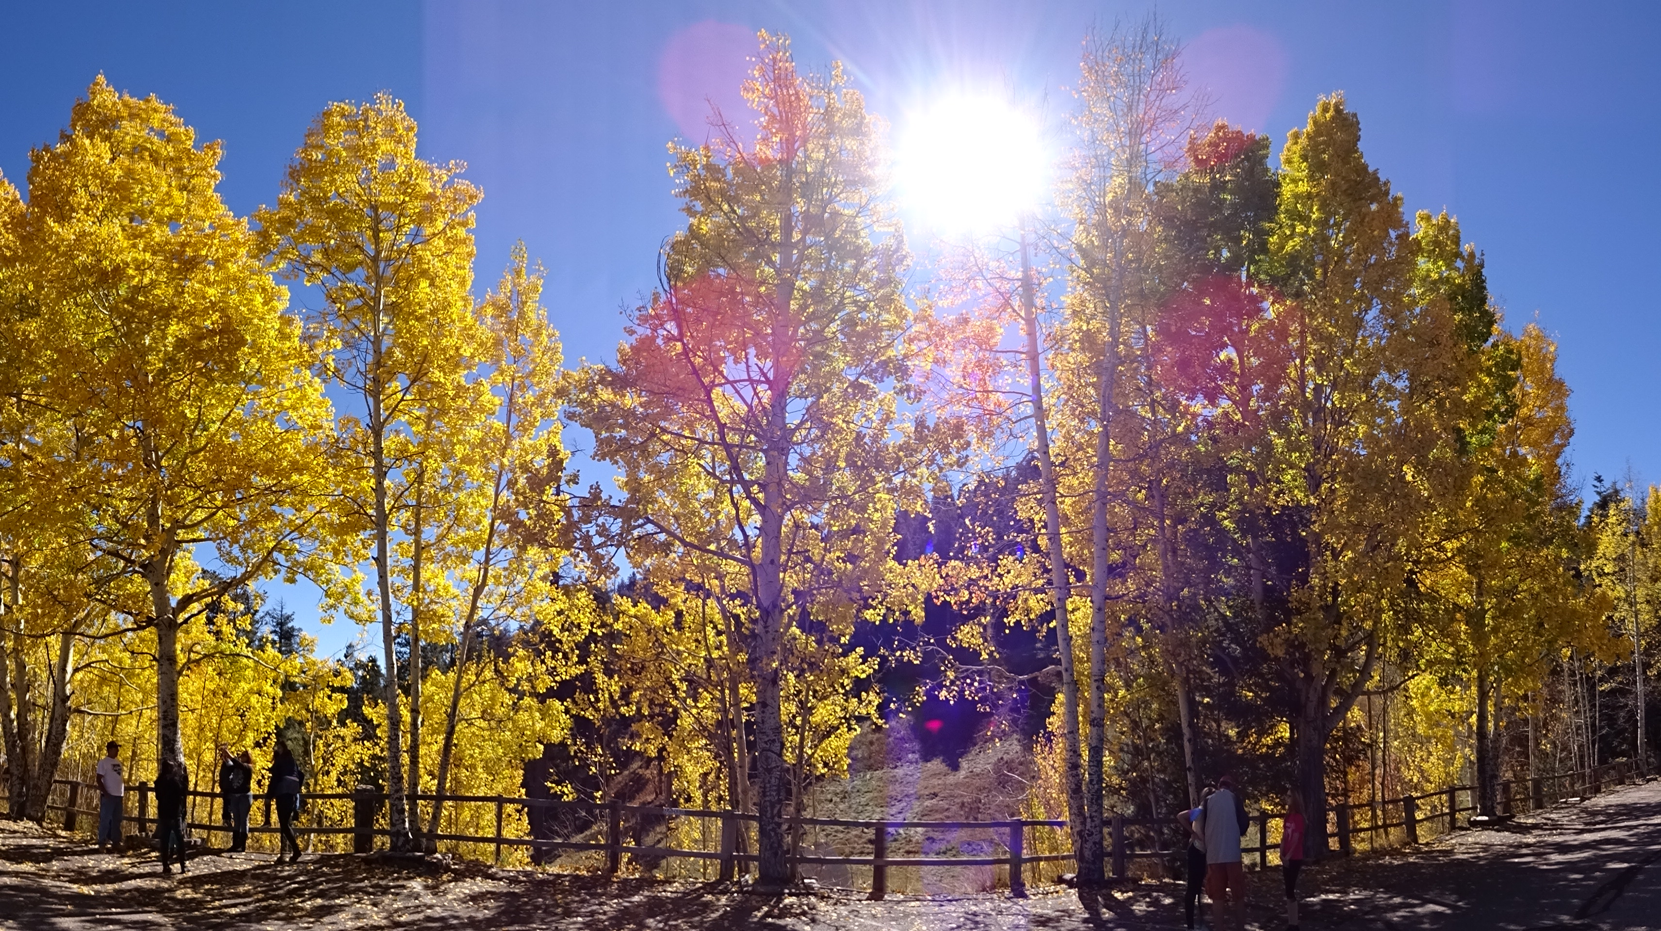
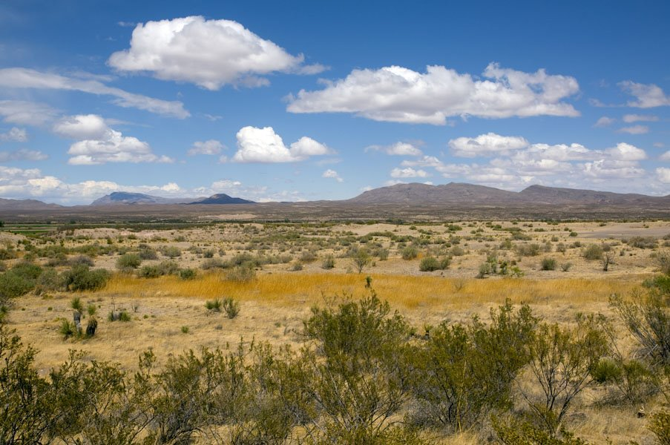
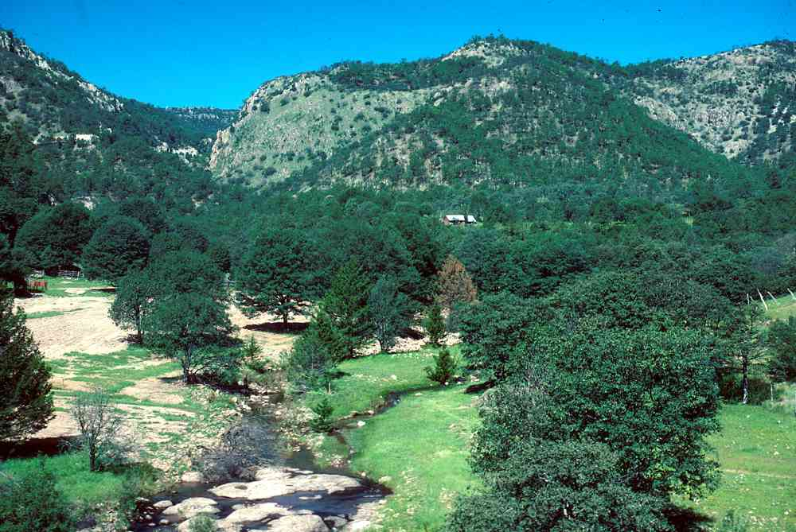
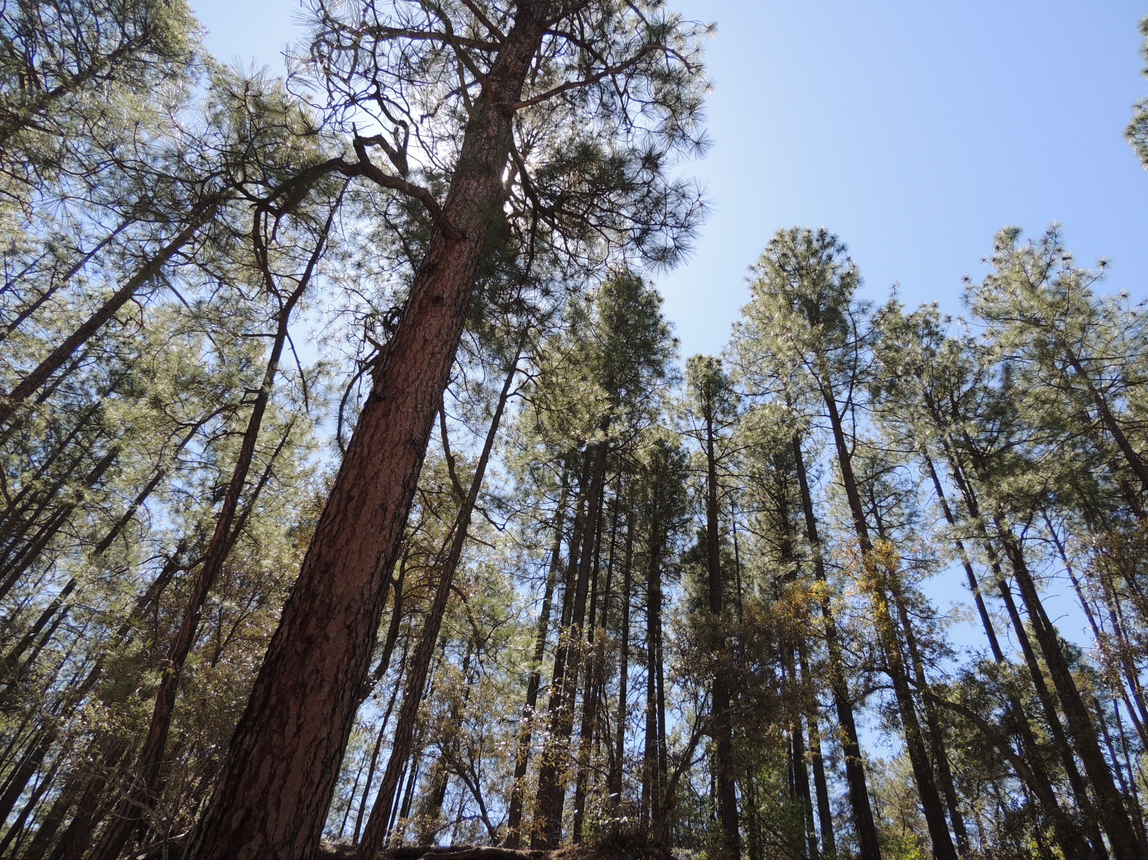
Notes:
http://www.ltrr.arizona.edu/~sheppard/sop/2017photos/2017FisheyeView.JPGPaul: New Mexico is ideal for holding a forestry conference dedicated to the theme of diversity in forestry.
Paul: With an elevational range of over 10,000 feet,.
Paul: ecosystem types range from Chihuahuan Desert
Paul: and mixed Madrean woodland to
Paul: Rocky Mountain mixed conifer and subalpine,
Paul: as well as many true alpine ridges and mountain tops

Slide 10
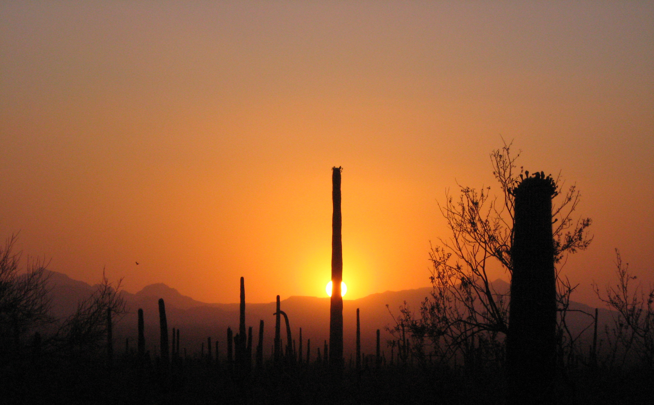
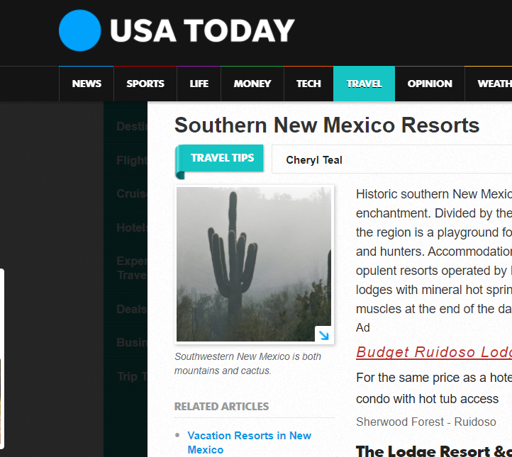
Notes:
Mary: While on the topic of ecosystems, despite numerous attempts to sell the idea, New Mexico does not have any
Mary: Saguaro cacti. But they are in Arizona, and we are the
Mary: Southwestern SAF, so okay with us if buy this scholk.

Slide 11
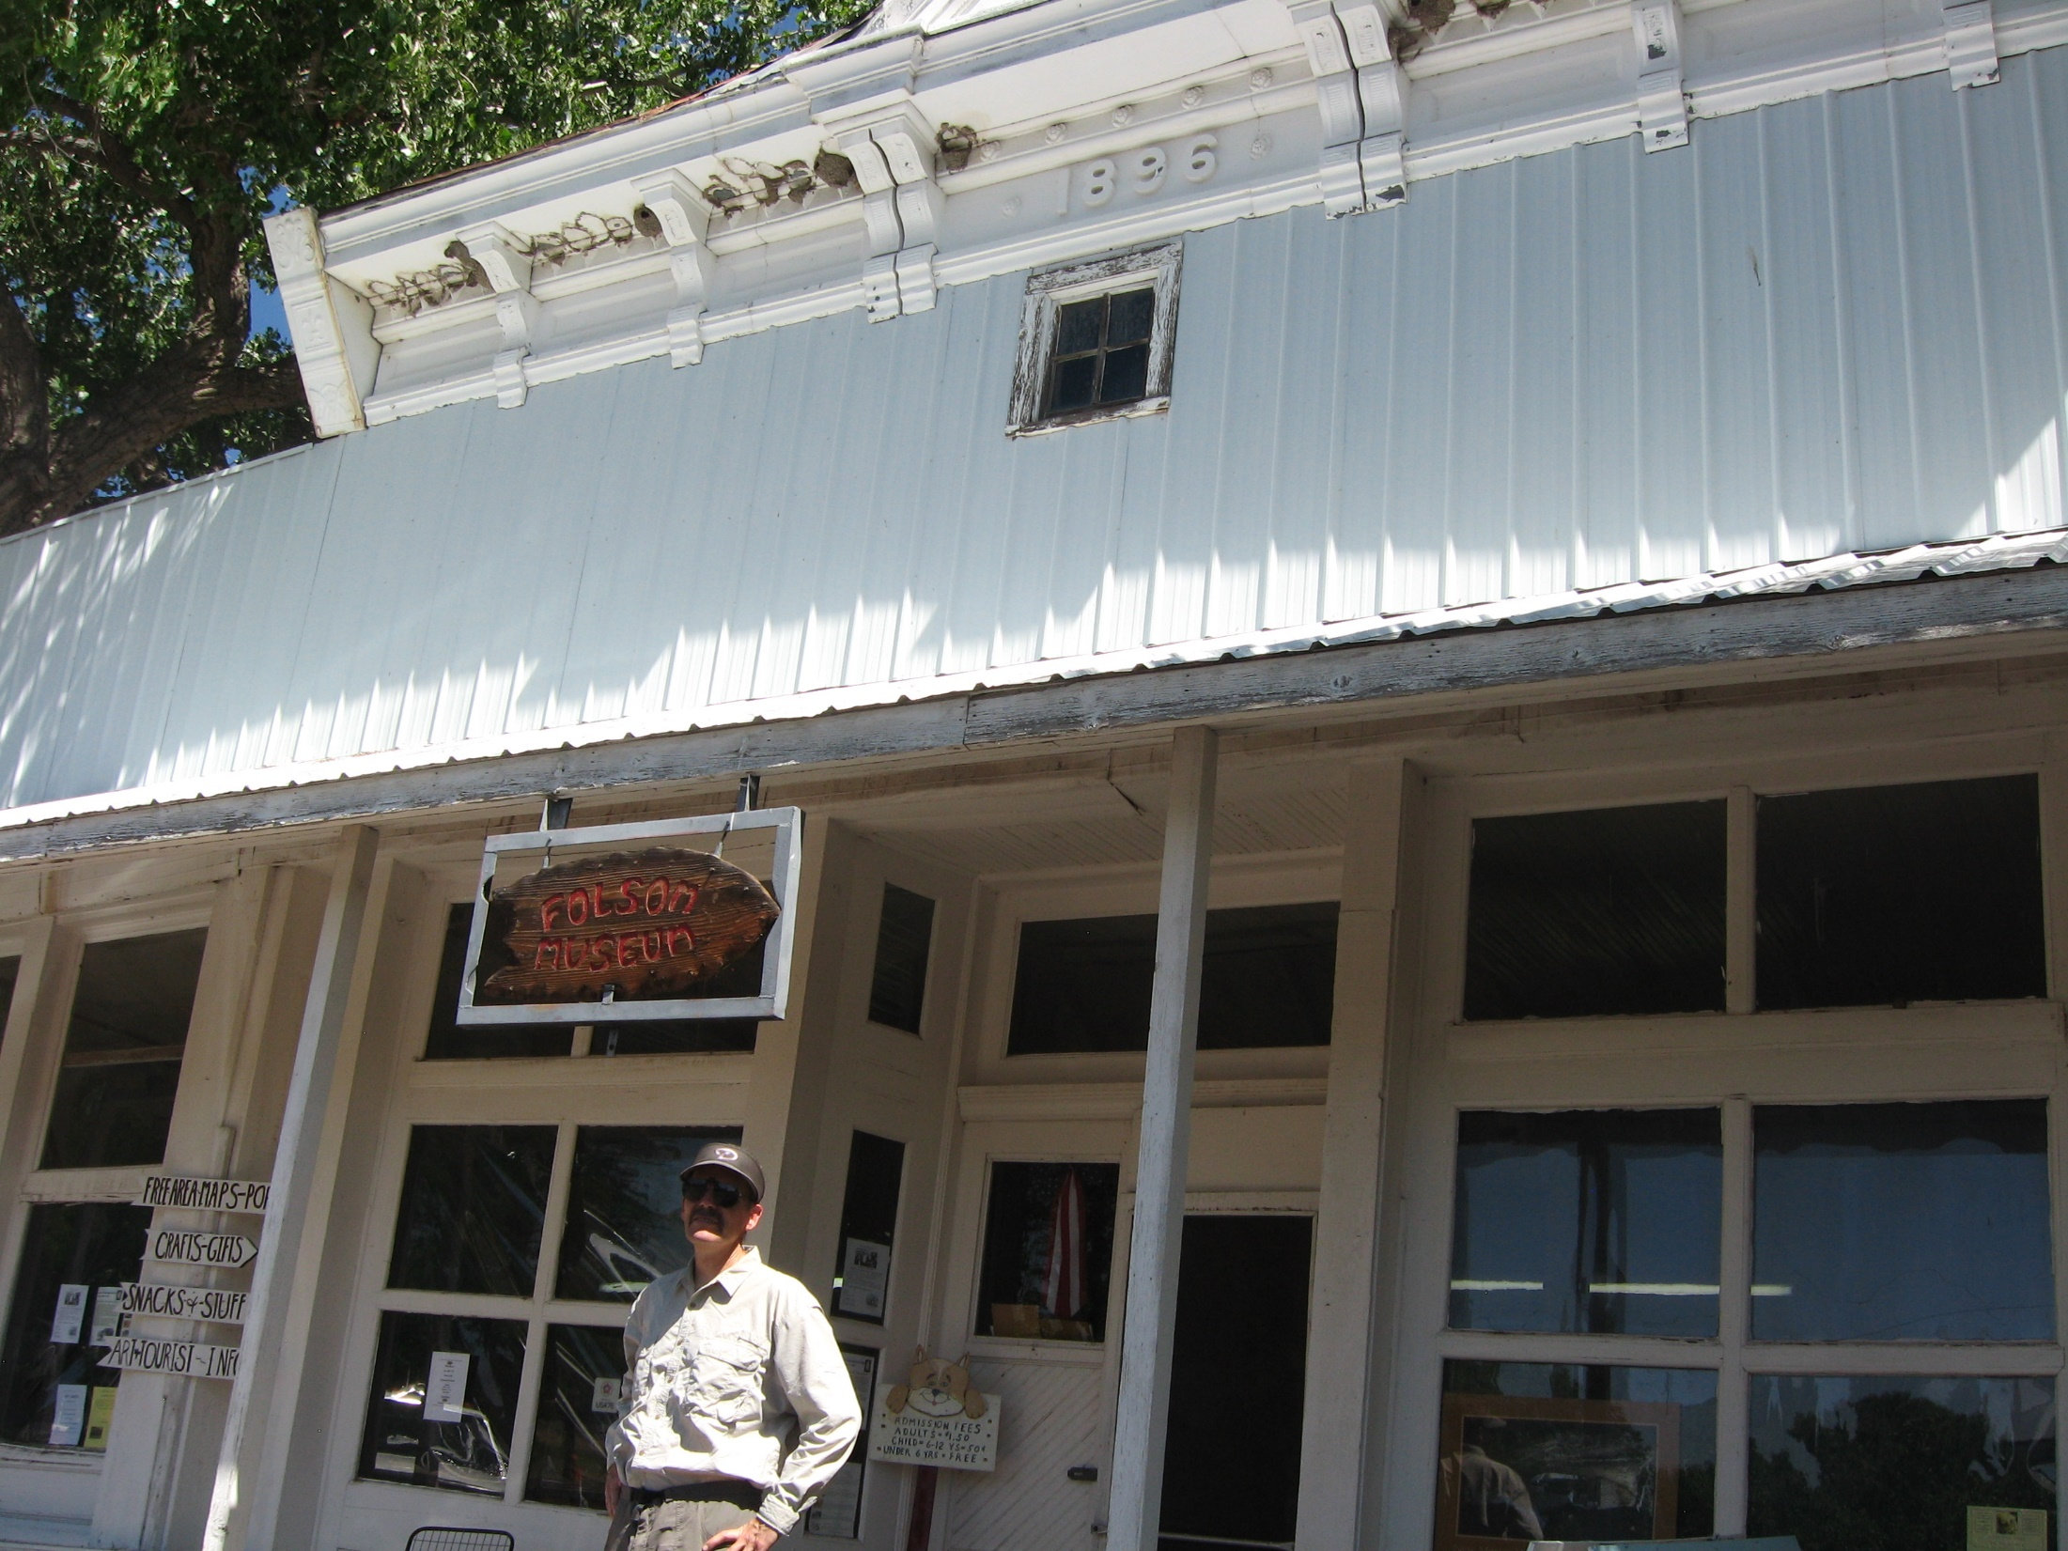
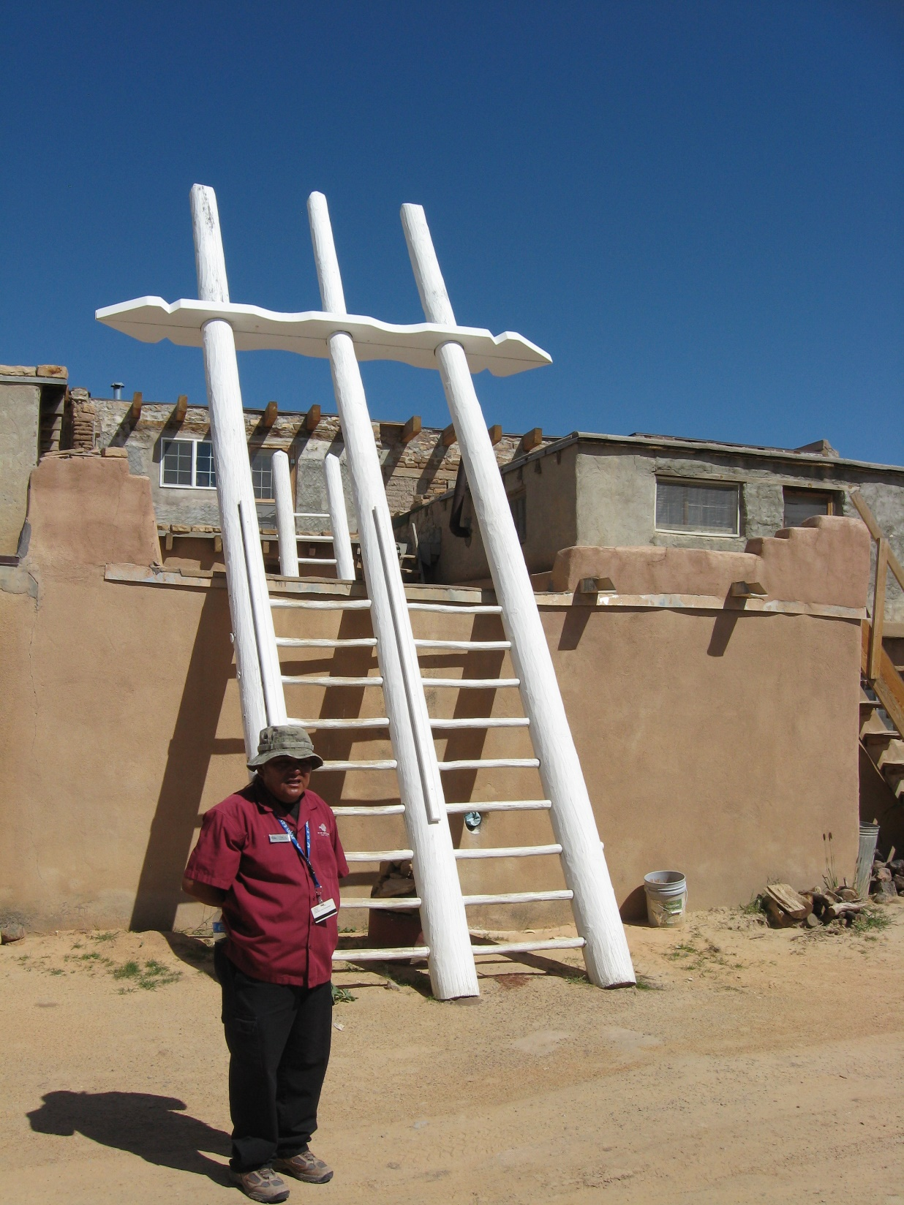
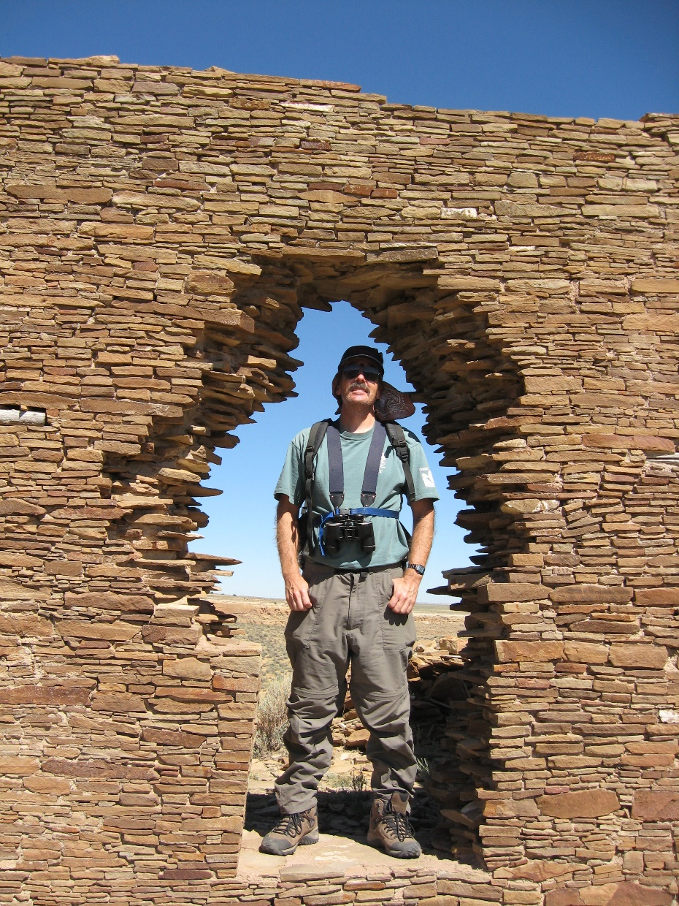
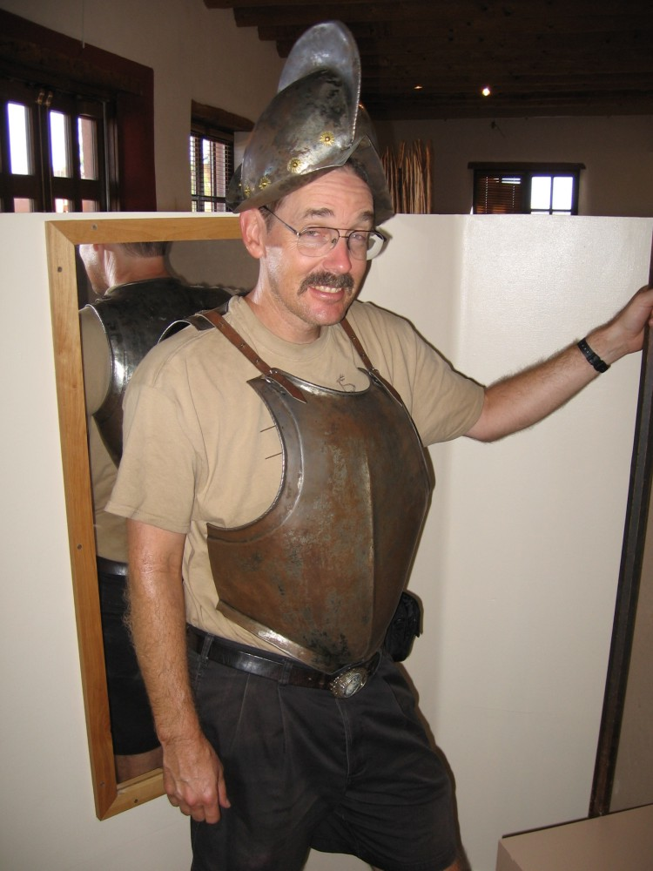
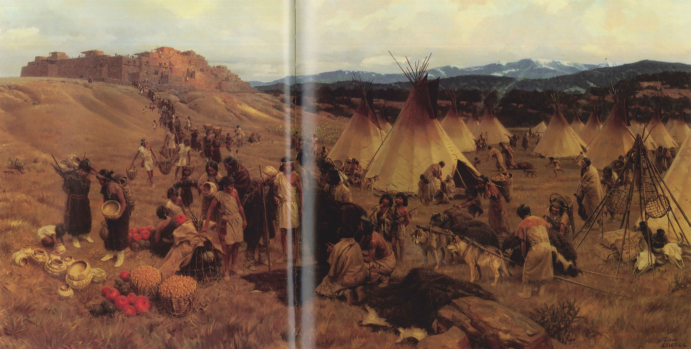
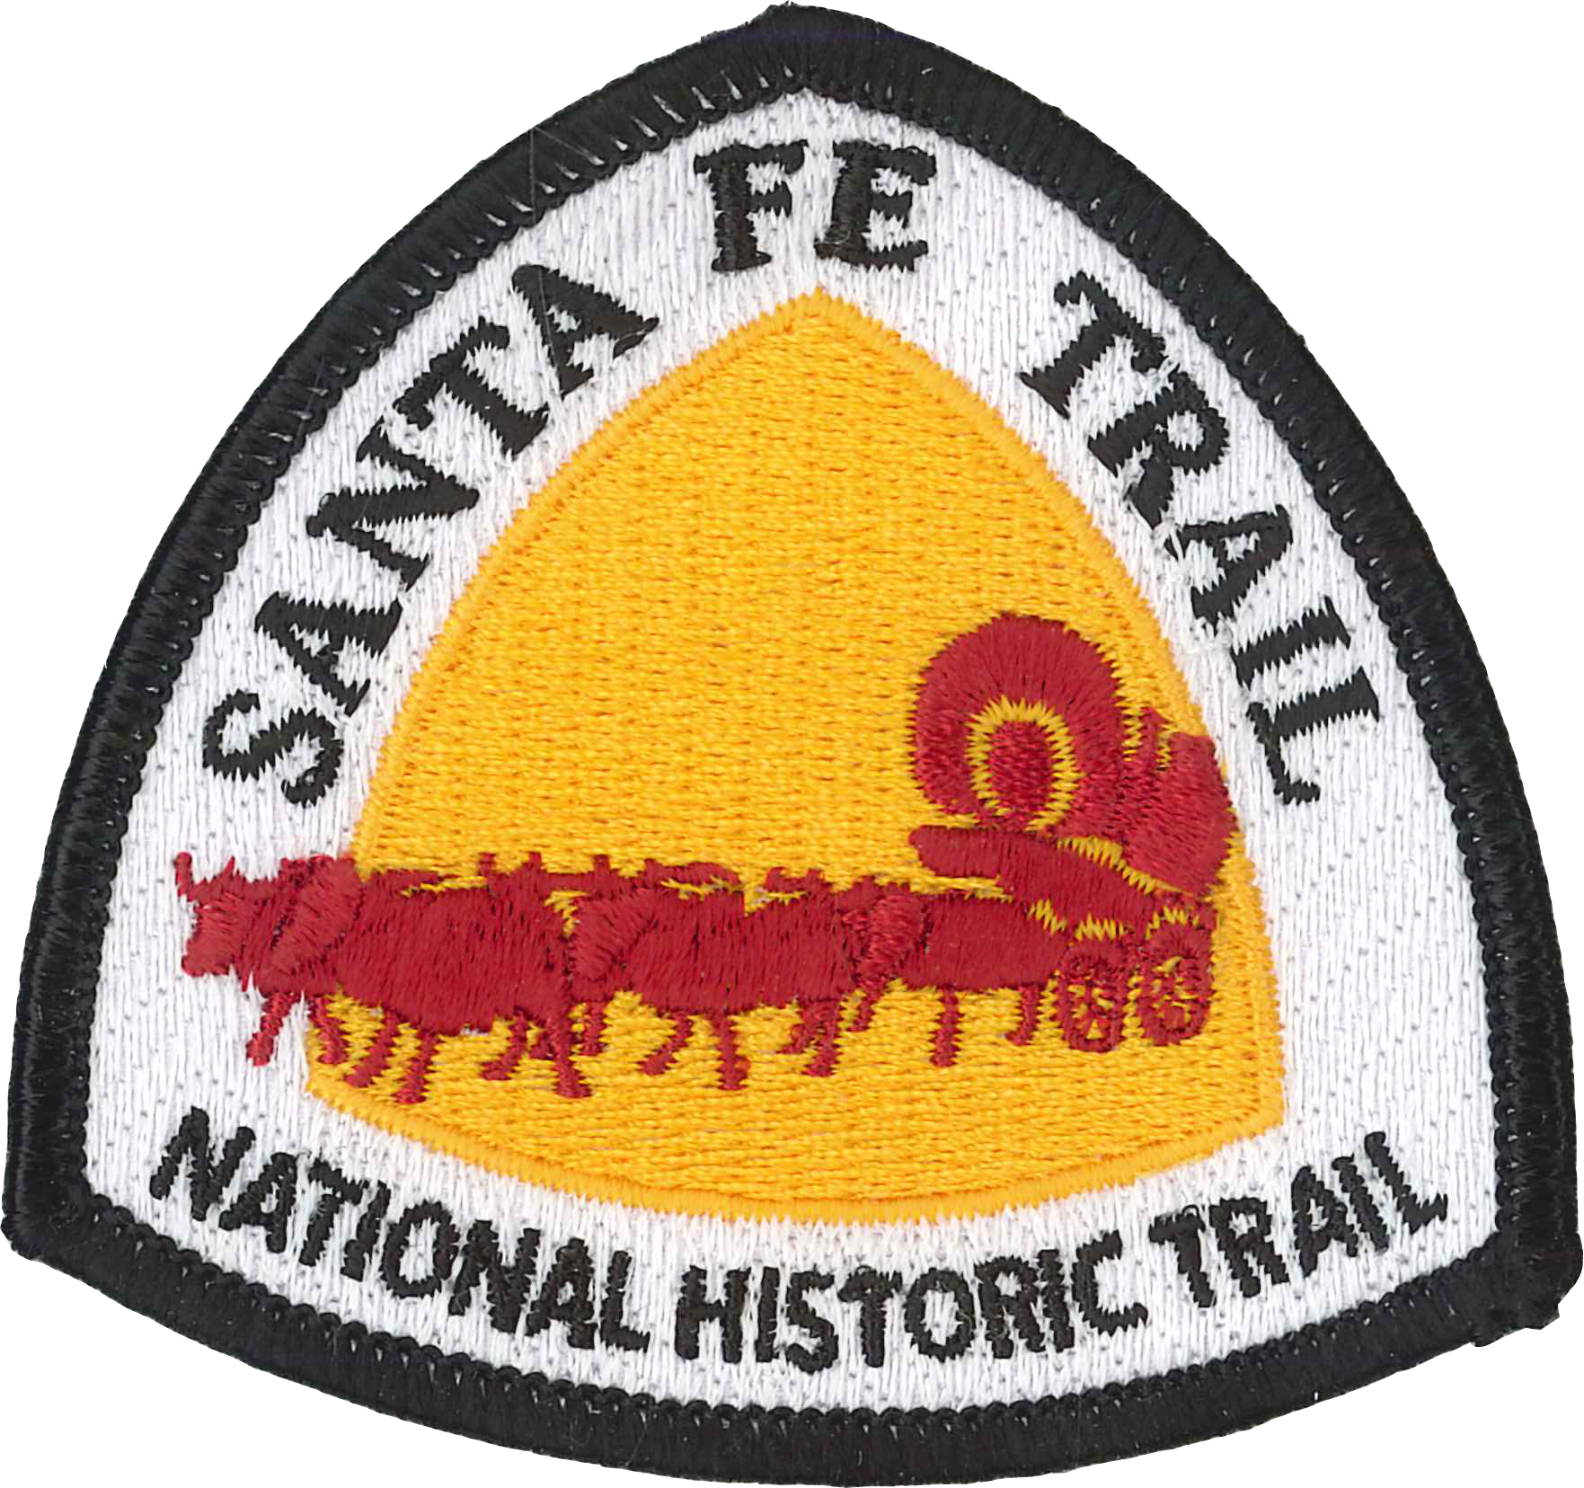
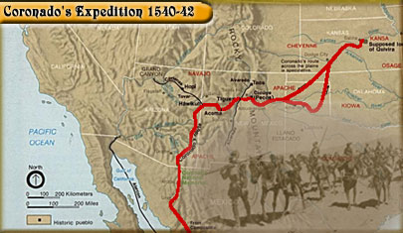
Notes:
Paul: the American Southwest has been inhabited by humans for over 10,000 years,
Paul: beginning with cultures known as Clovis and Folsom,
Paul: followed by a lengthy period known as Archaic,
Paul: which slowly changed into more sedentary communities of Ancestral Puebloans
Paul: and then into the modern Pueblos of today.
Paul: Other indigenous societies, such as Navajo, Apache, and Ute as well as many Plains groups, have lived here for centuries.
Paul: Spanish arrived in 1540, with Mexico assuming jurisdiction in 1823 and then the US in 1848.
Paul: All of these ethnicities still reside in New Mexico, making for rich diversity of cultures and land management philosophies.

Slide 12
Forest products images
Notes:
Mary: Although New Mexico is not known as a large producer of forest products,
Mary: The forest industry is our tool to manage forests for ecosystem health
Mary: Water is one of our most important forest benefits.
Mary: Wildlife is often the key economic driver for forest management activities.
Mary: And fire management is one of our most common forest management activities.

Slide 13
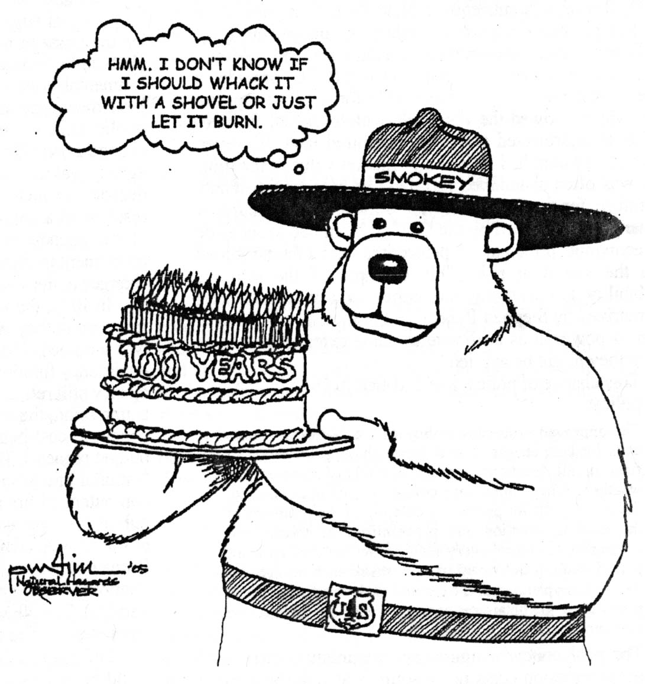
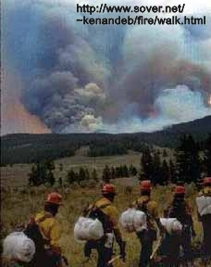
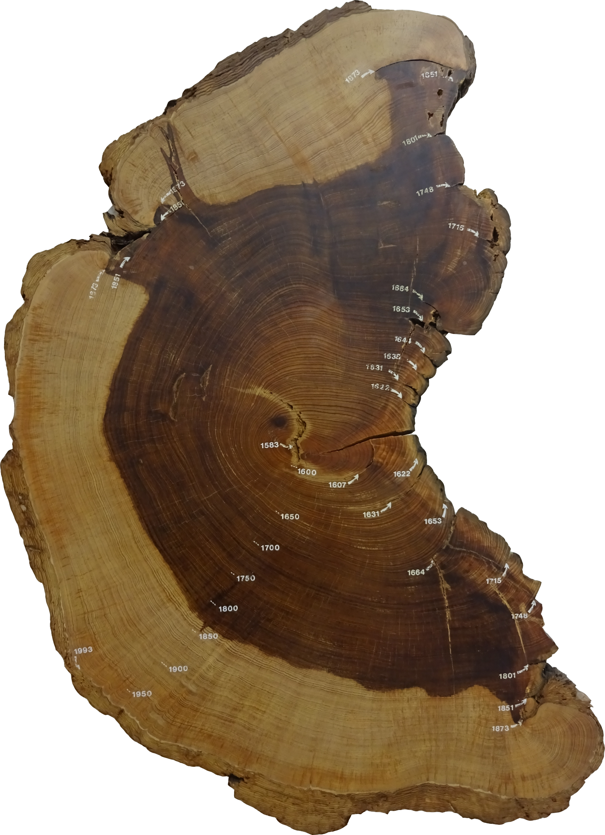
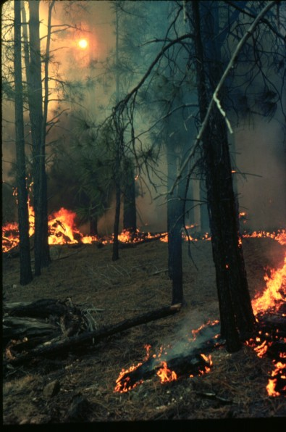
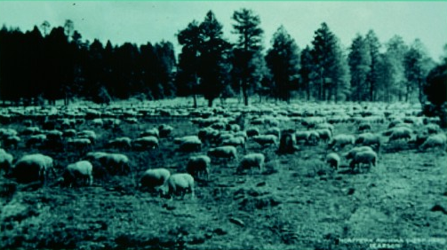
Notes:
Paul: In fact the key to understanding our southwestern forests is understanding the impacts of fire exclusion.
Paul: This story is often told best by the trees themselves speaking in the language of tree rings and fire scars.
Paul: In over xxx,xxx samples studied in the SW, xx% of fire scar samples show 1878 or 1890 as the last fire year.
Paul: This century plus exclusion of fire can roughly be attributed to two major landscape activities…
Paul: Initially it was the introduced of livestock in such large numbers that fine fuels (grasses) were no longer present to carry landscape scale fires.
Paul: Yet, as our technology developed to responsibly manage range lands to retain grasses, our firefighting technology was also becoming more effective.

Slide 15
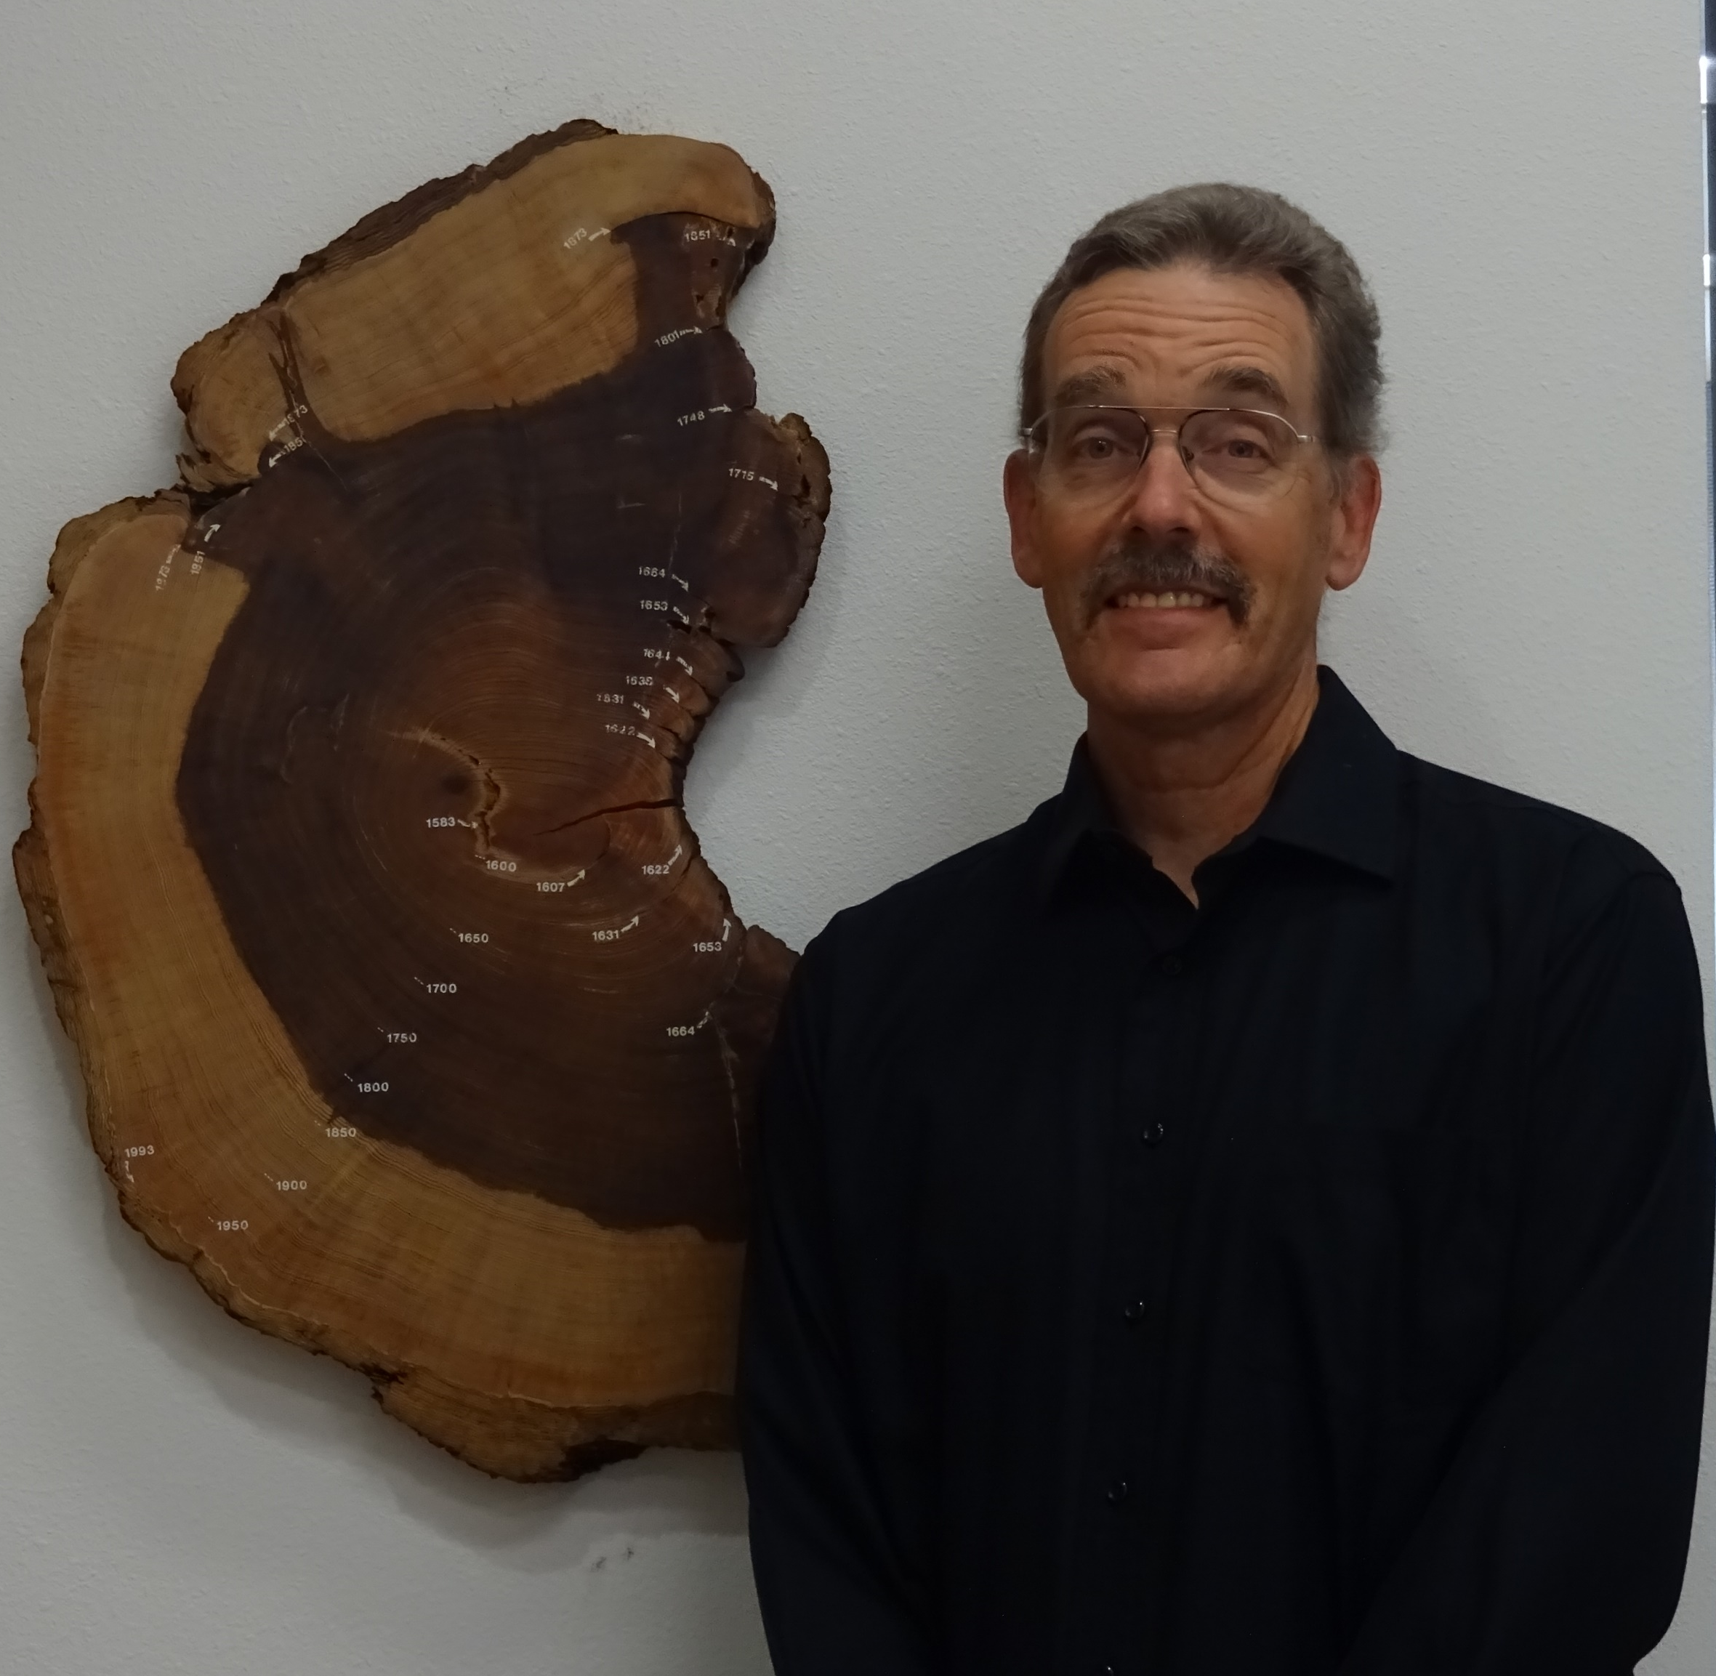
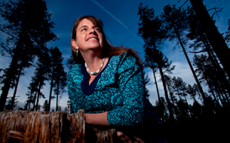
Have a good convention!

