Slide 1
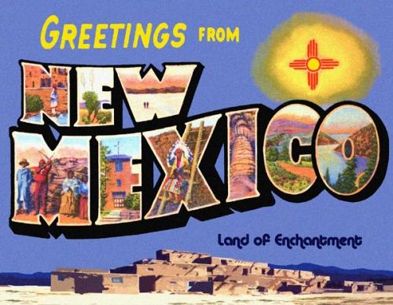

Slide 2
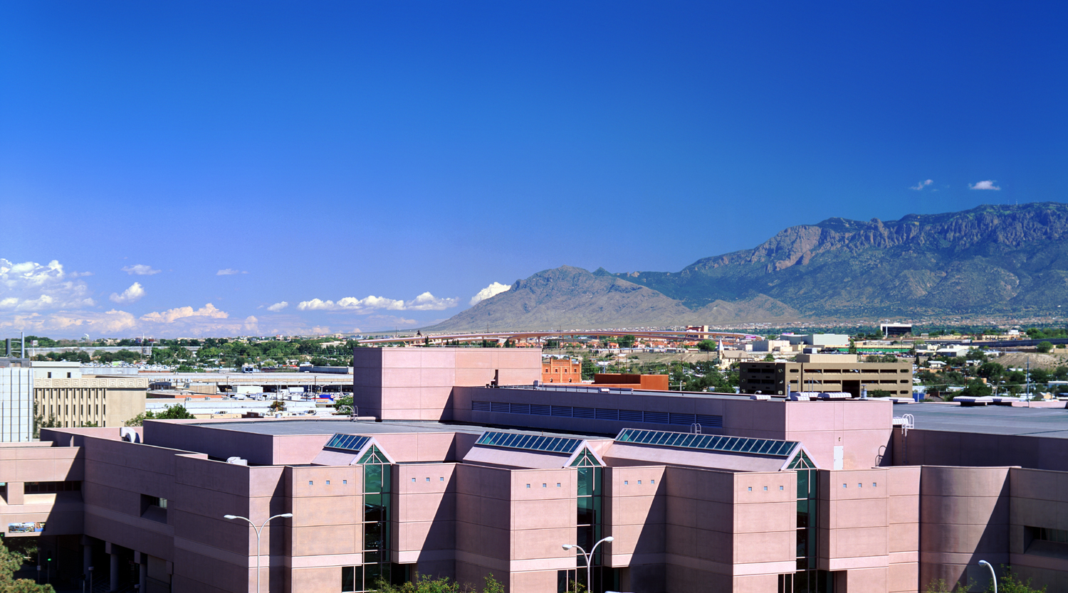
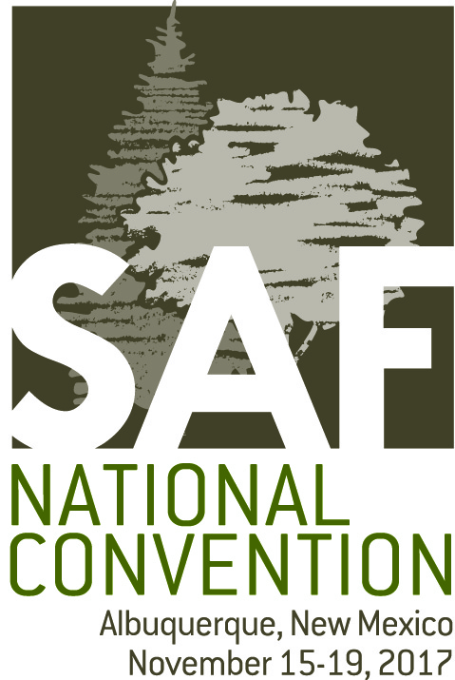
Notes:
1a: Paul: Welcome to Albuquerque and the 2017 SAF National Convention.

Slide 3
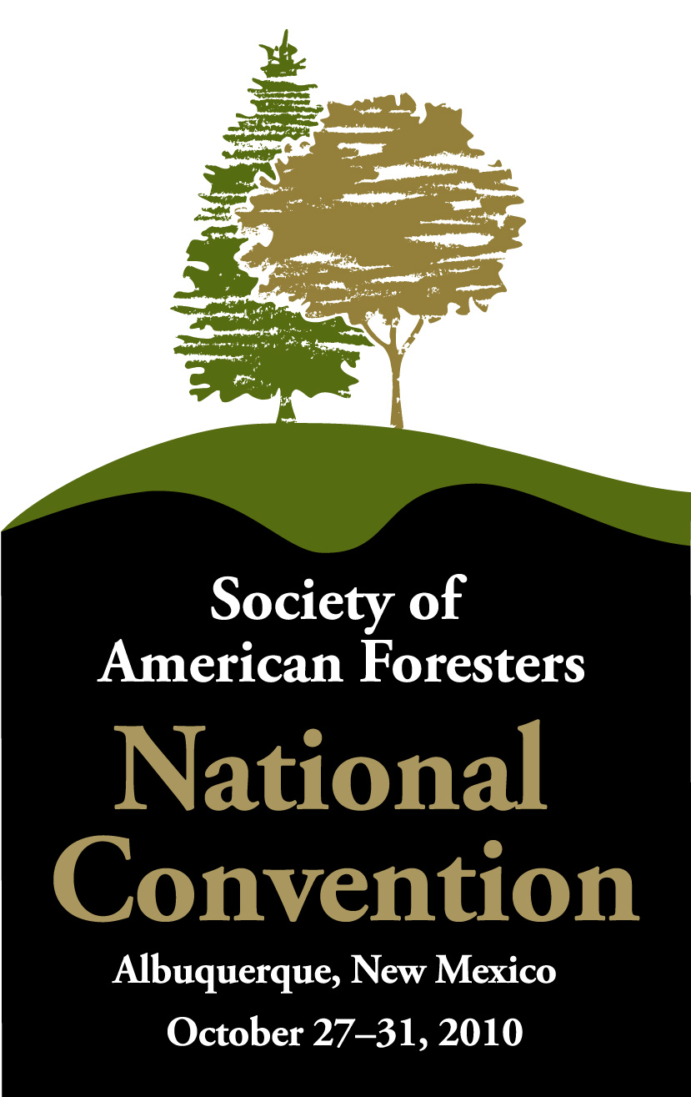
Notes:
1b: Mary: If you were here at the 2010 SAF National Convention, then welcome back.

Slide 4
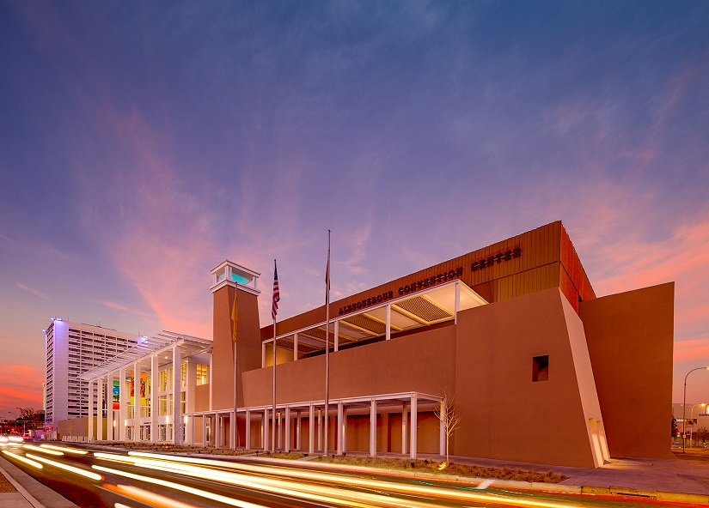
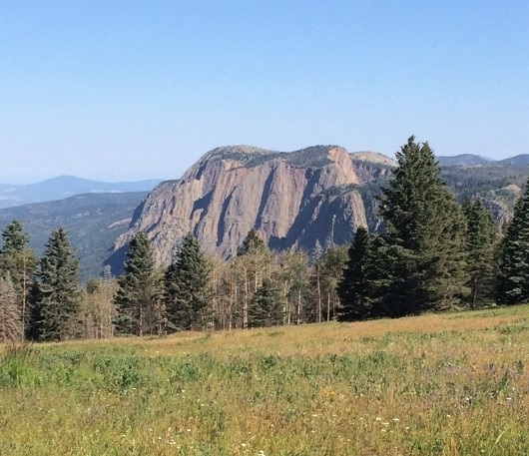
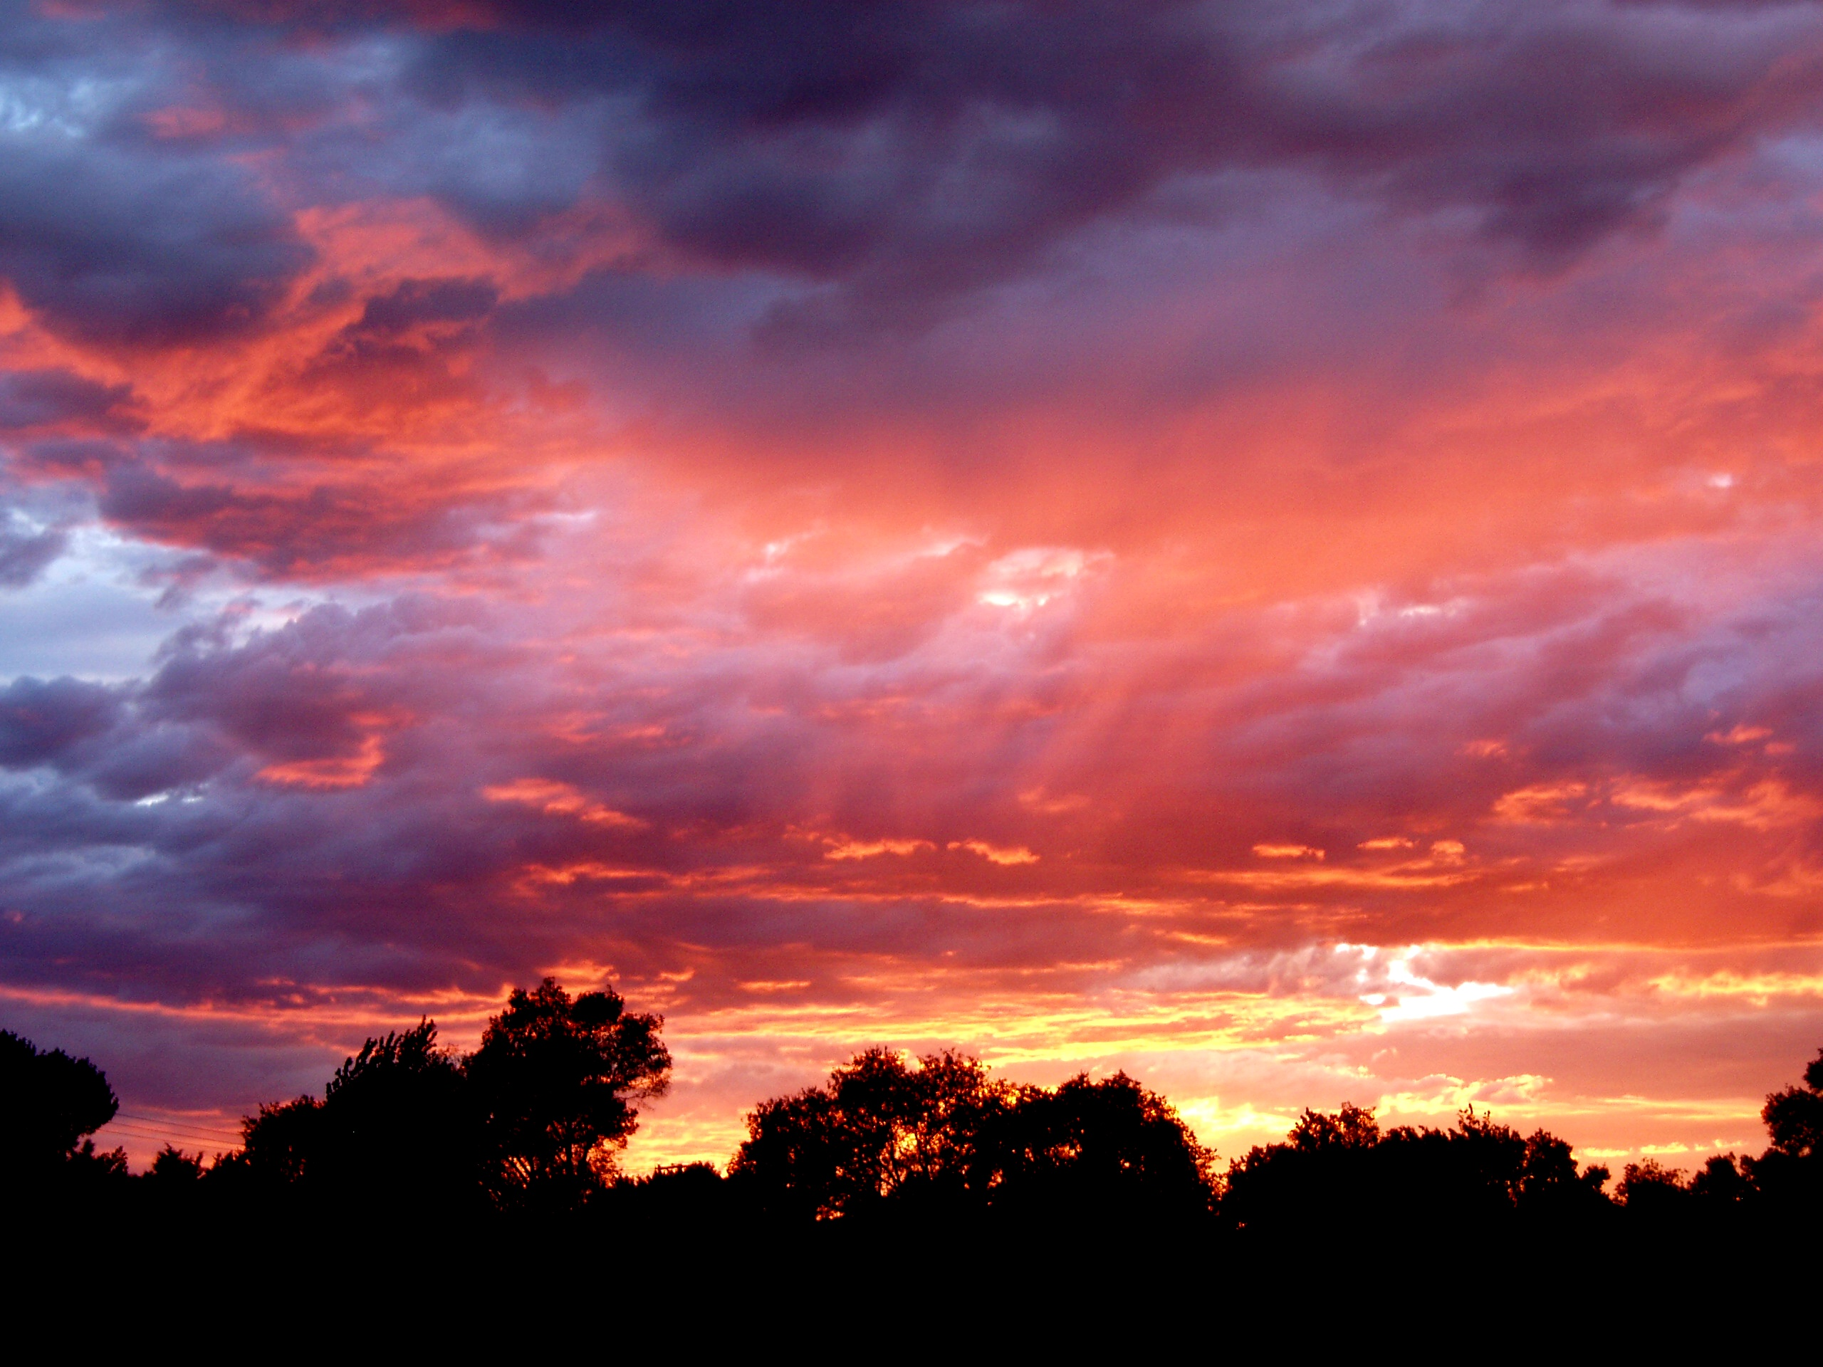
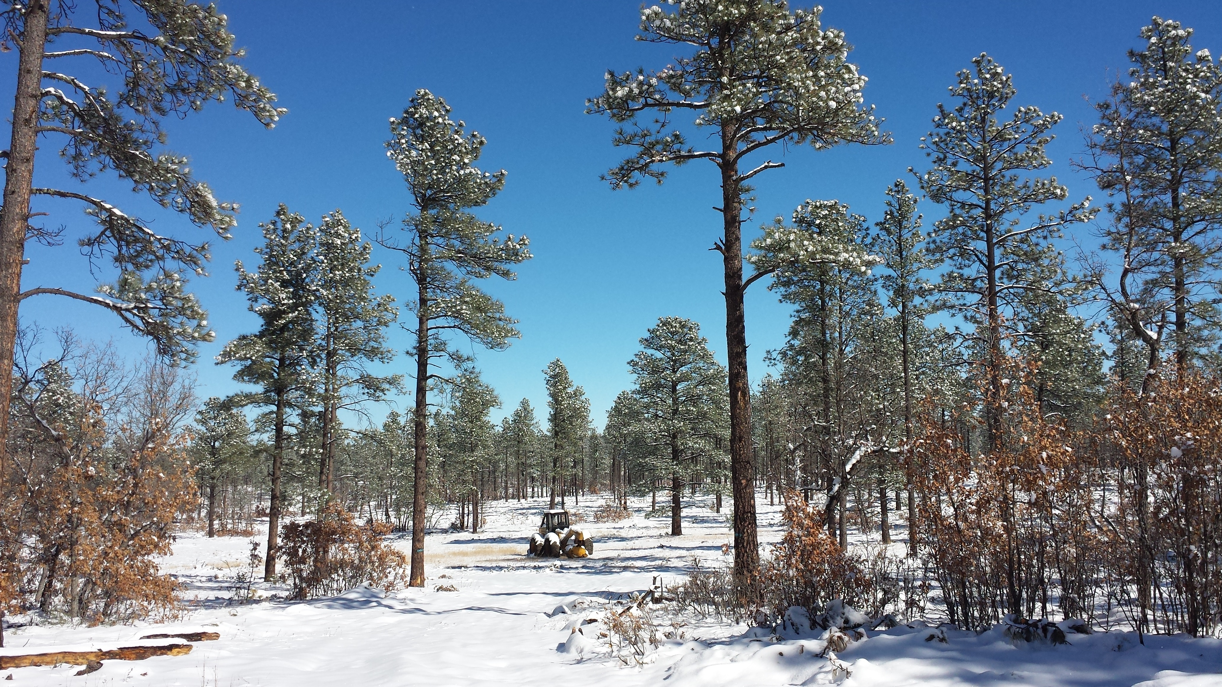
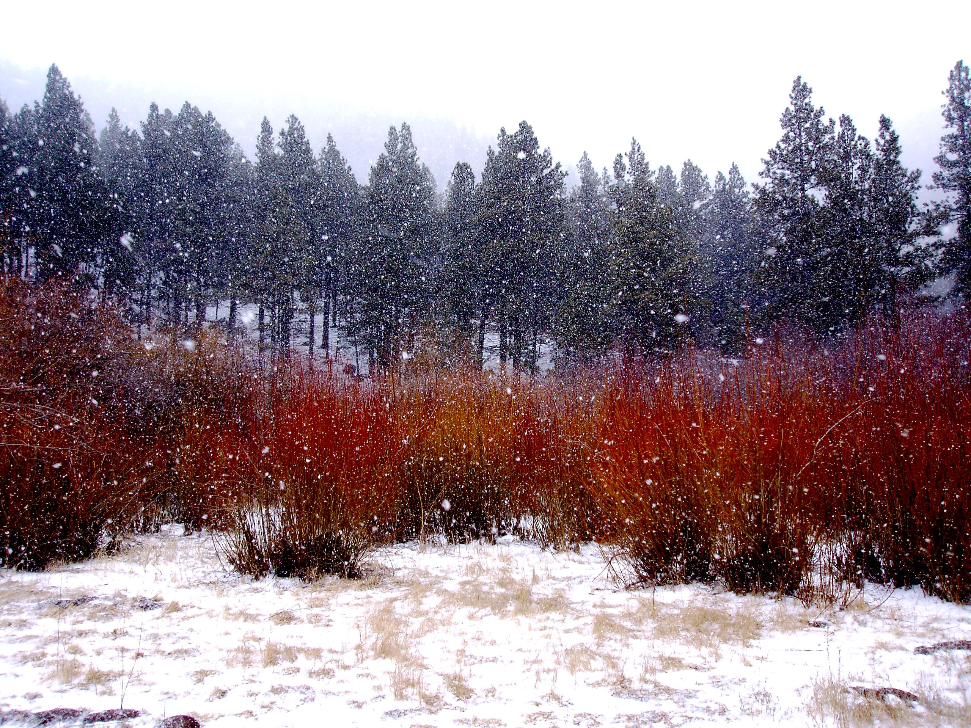
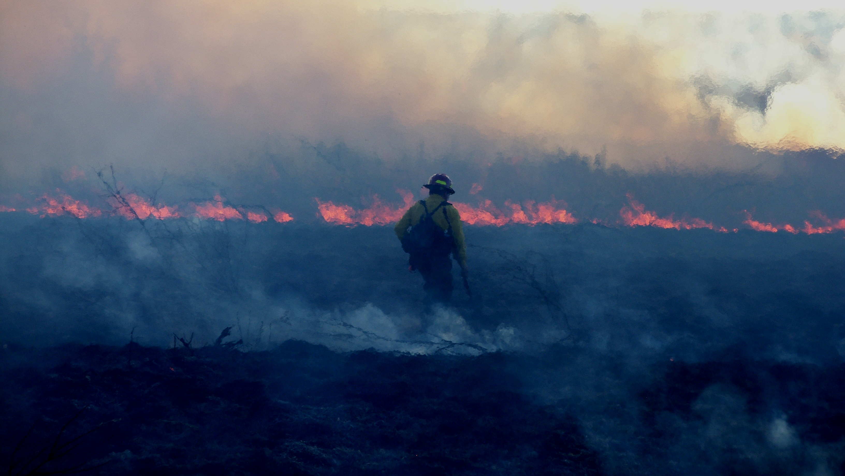
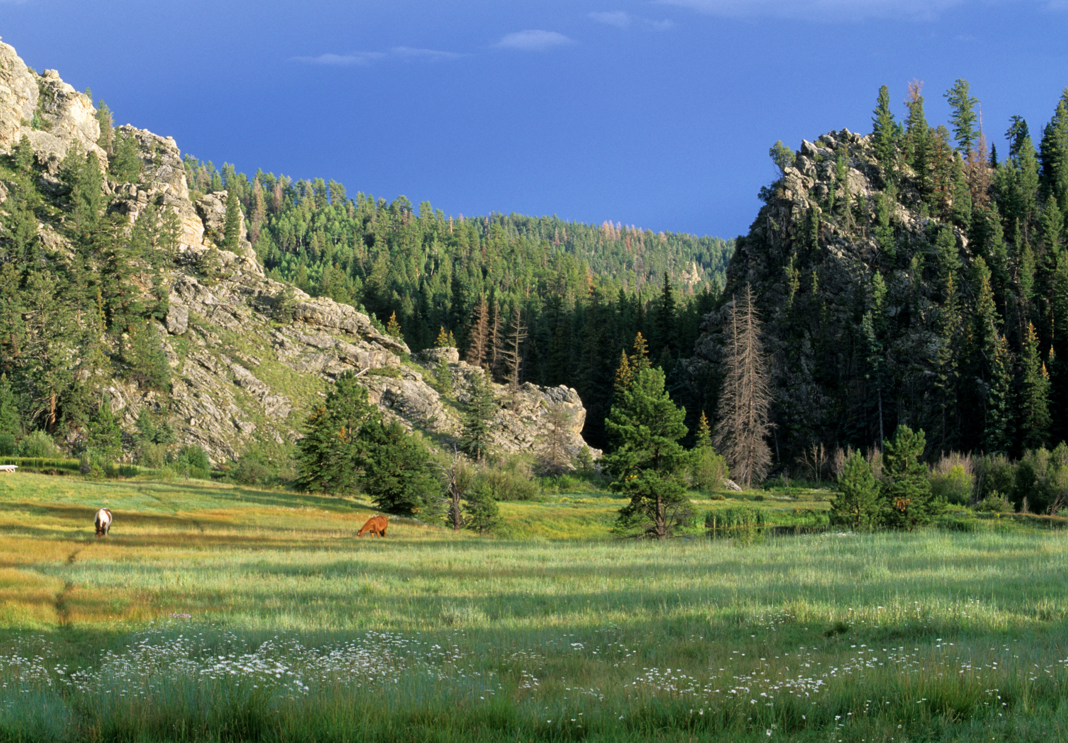
Notes:
1c: Mary: We are honored and humbled by the opportunity to host this amazing gathering twice in the same decade – yet we think you will agree that these conventions are two very different events.

Slide 5
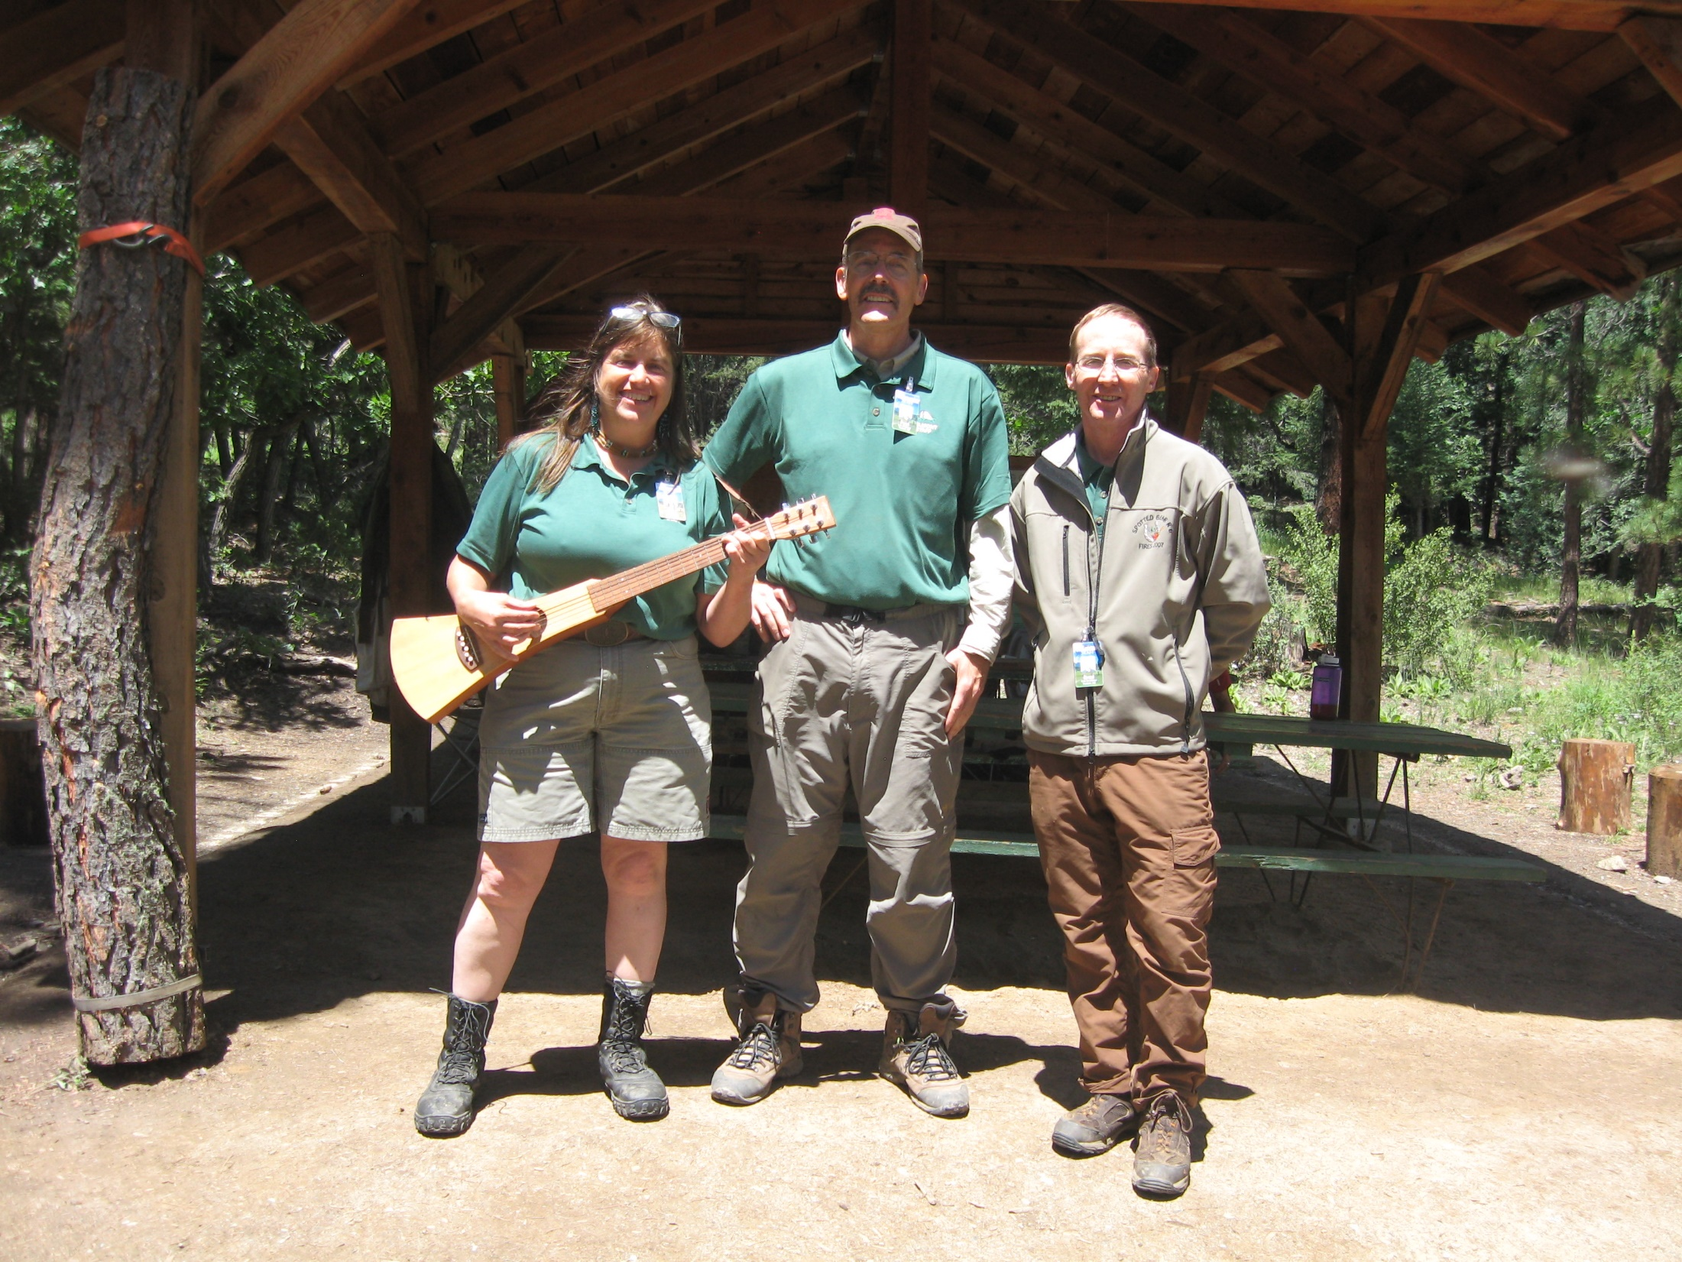
Notes:
1d: Paul: This film should serve as short primer to truly help you fit in as a forester here in New Mexico and the Southwest.

Slide 6
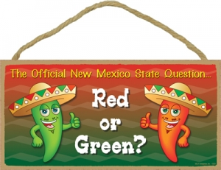
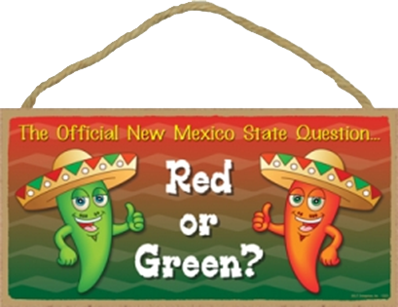
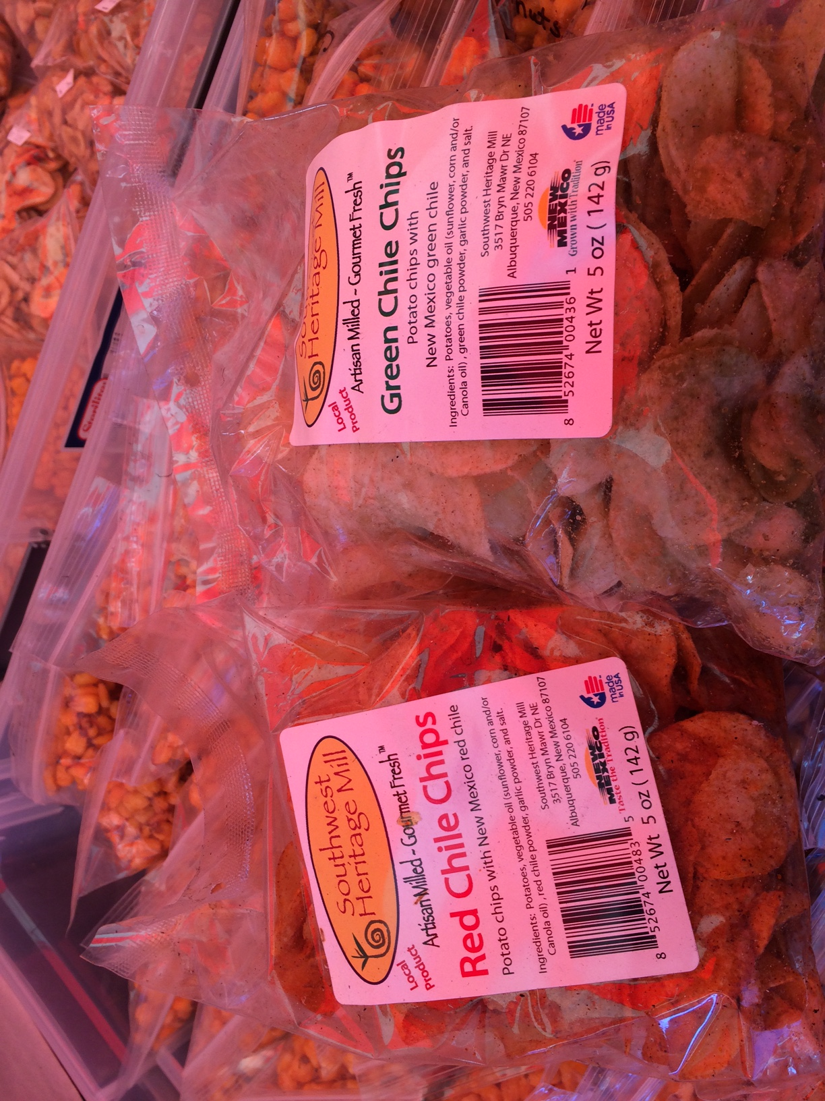
Mary: Here’s a web image I liked, and I made
the background transparent.
Can you hunt down more images for this chile theme?
Notes:
2a: Mary:
First, you must eat. Our state question is “Red or Green” which refers to how you prefer your chile.
We pretty much eat chile on everything.
If you are unsure, you pick a color, and say “on the side”
If you can’t make up your mind you can get both side by side by saying “Christmas, please.”
Foresters have usurped the state question as well to create a fire prevention message.

Slide 7
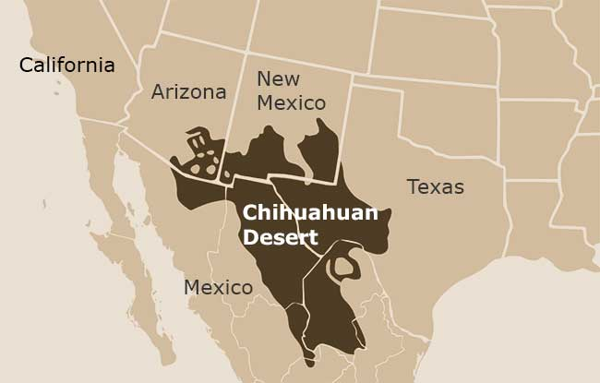
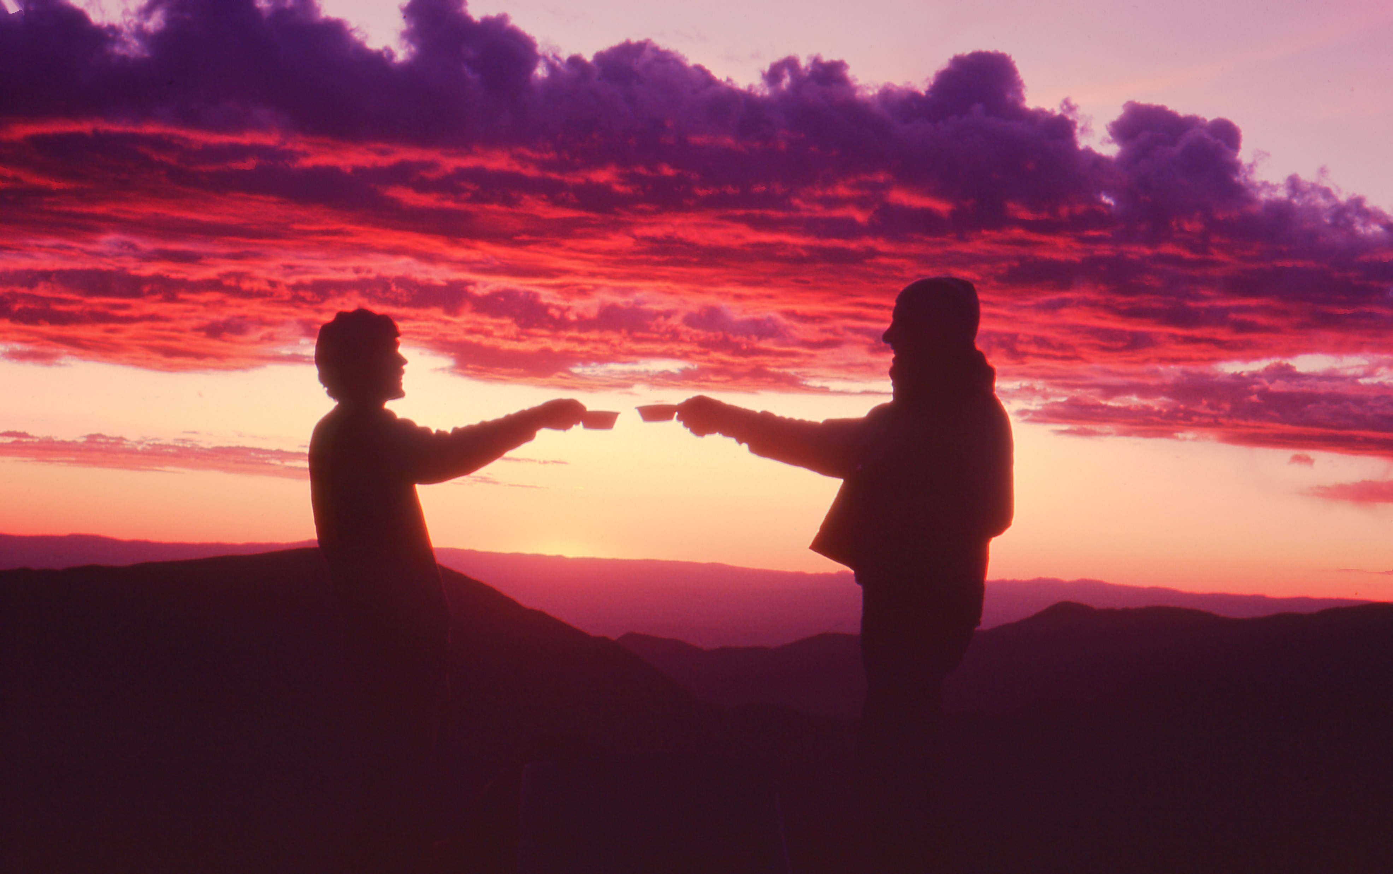
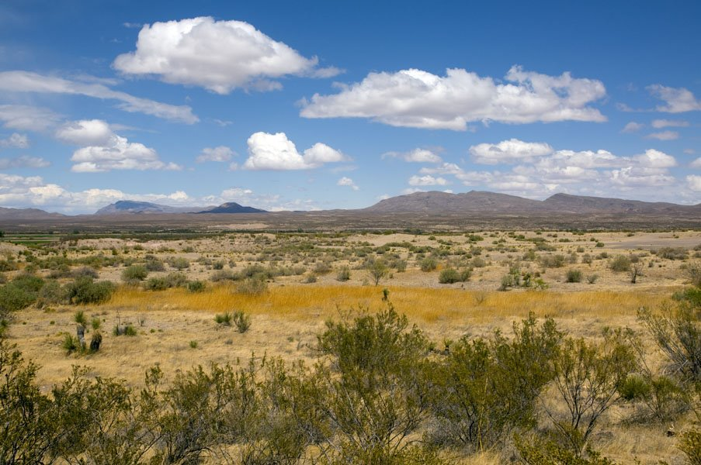
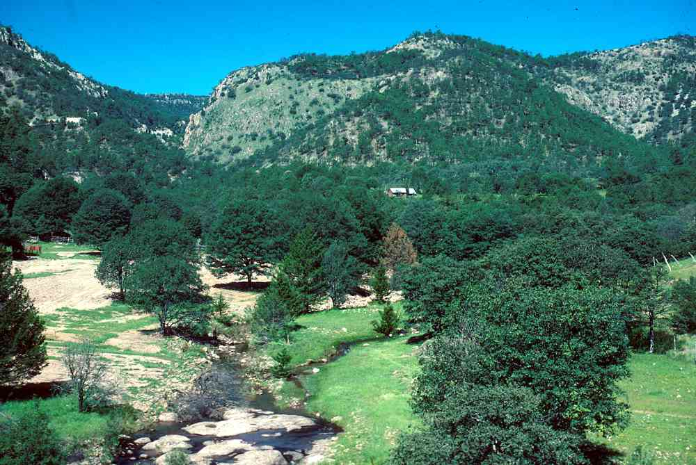
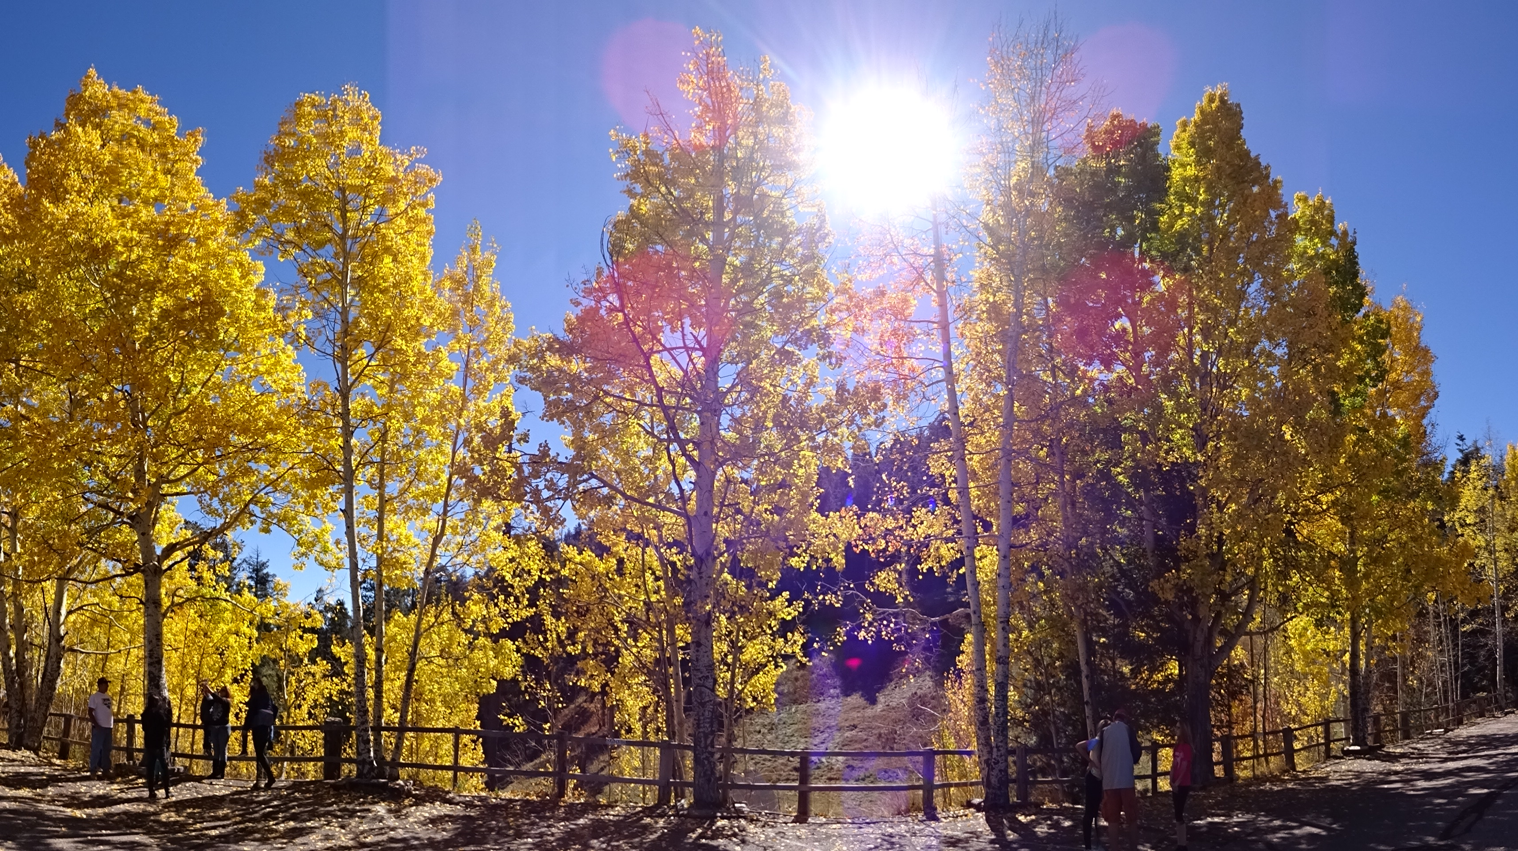
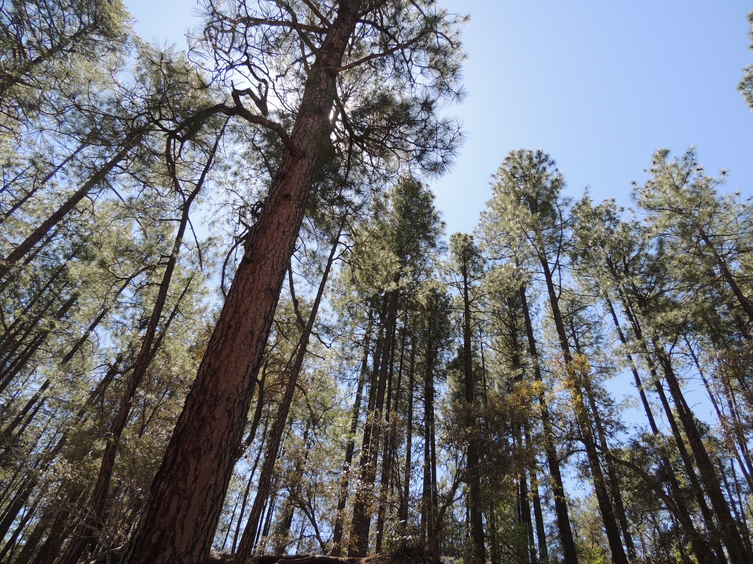
Mary: Do you have a
Chihuahuan Desert photo?
Or these other forest ecosystem types?
We can “borrow” from the internet, of course, but we might as well start with photos of our own.
This pine and aspen forest shots are mine, and the sunset on Wheeler Peak (1983), true alpine.
Notes:
http://www.ltrr.arizona.edu/~sheppard/sop/2017photos/2017FisheyeView.JPGPaul: New Mexico is ideal for holding a forestry conference dedicated to the theme of diversity in forestry.
Paul: With an elevational range of over 10,000 feet,.
Paul: ecosystem types range from Chihuahuan Desert
Paul: and mixed Madrean woodland to
Paul: Rocky Mountain mixed conifer and subalpine,
Paul: as well as many true alpine ridges and mountain tops

Slide 8
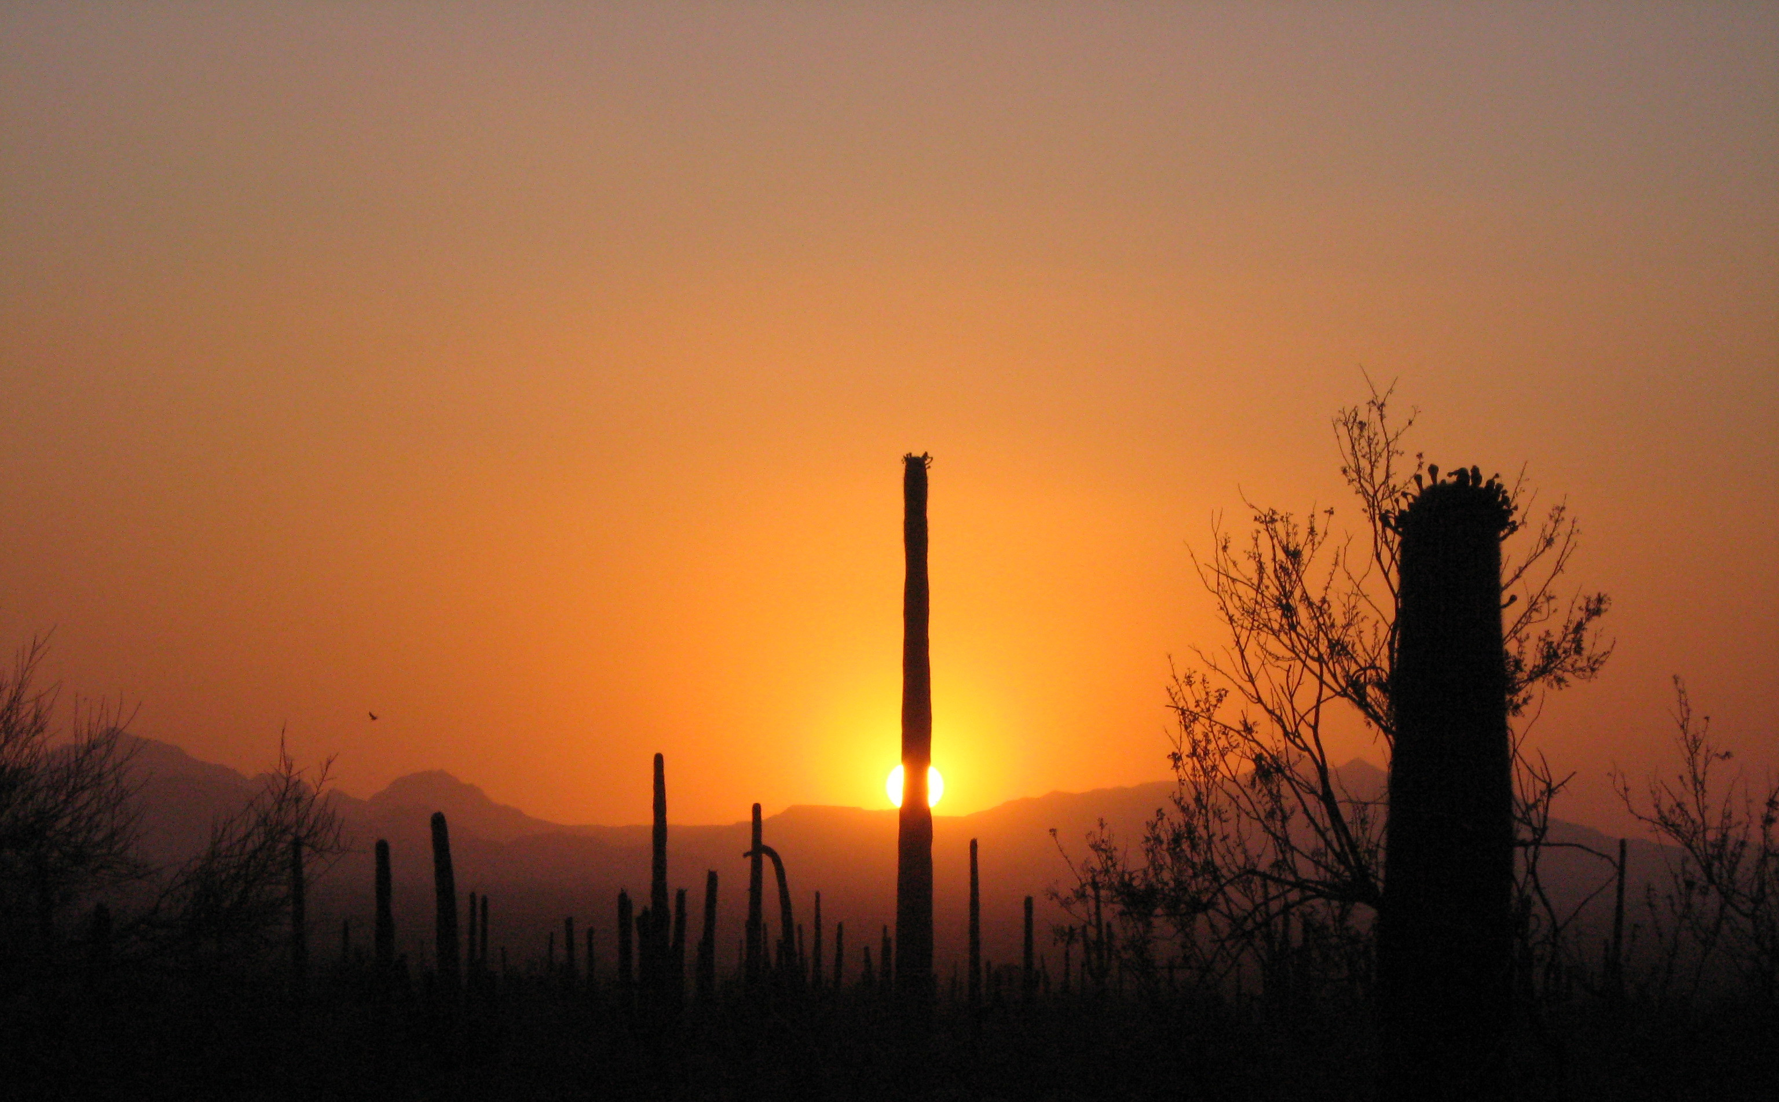
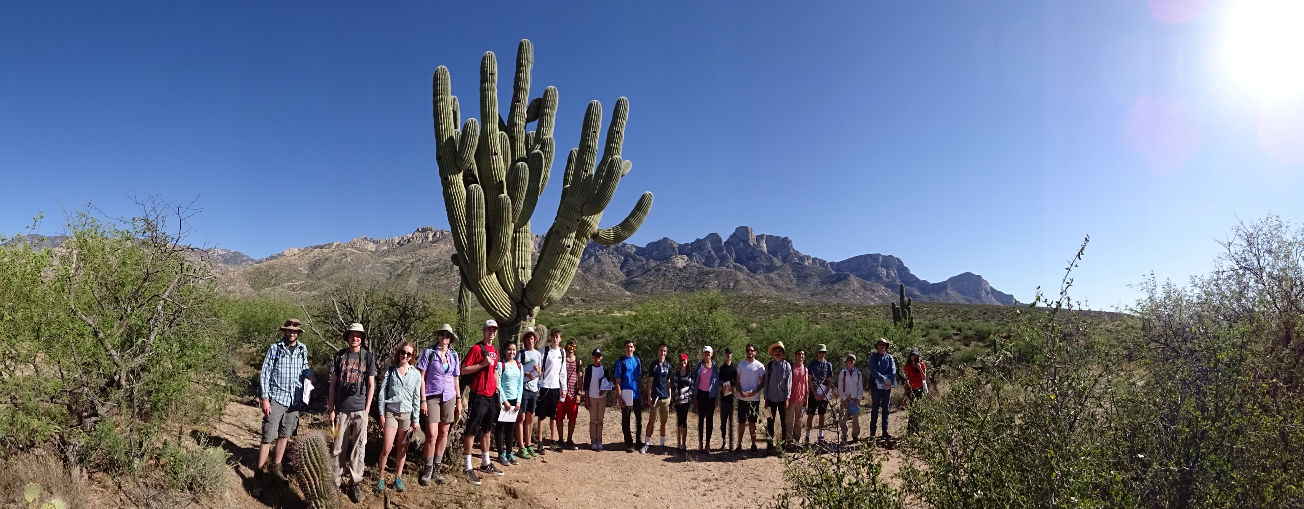
Notes:
Mary: While on the topic of ecosystems, despite numerous attempts to sell the idea, New Mexico does not have any
Mary: Saguaro cacti. But they are in Arizona, and we are the
Mary: Southwestern SAF, so okay with us if buy this scholk.

Slide 9
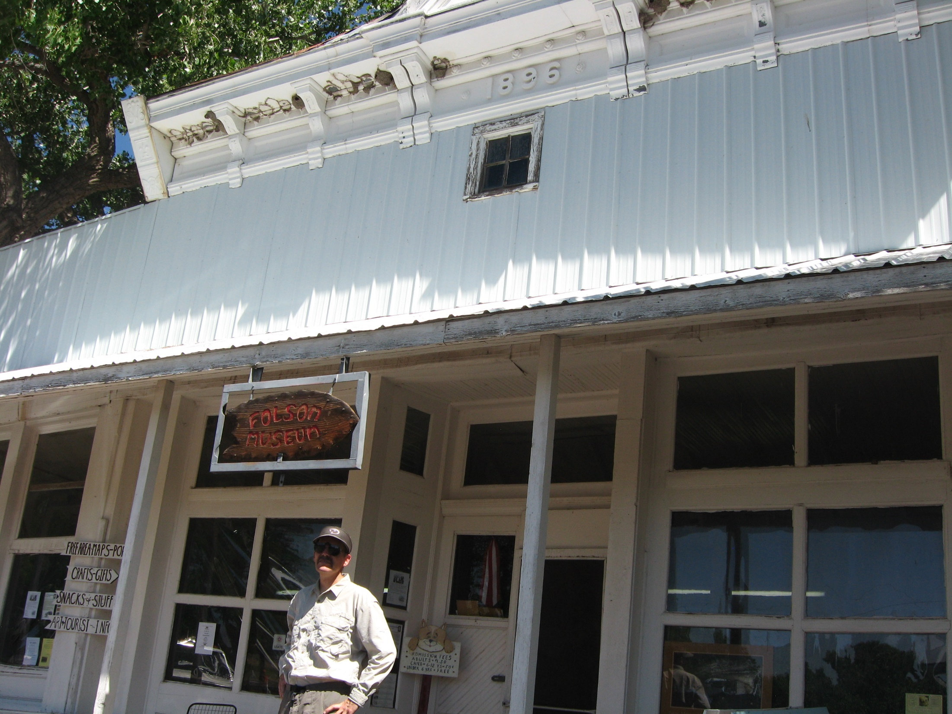
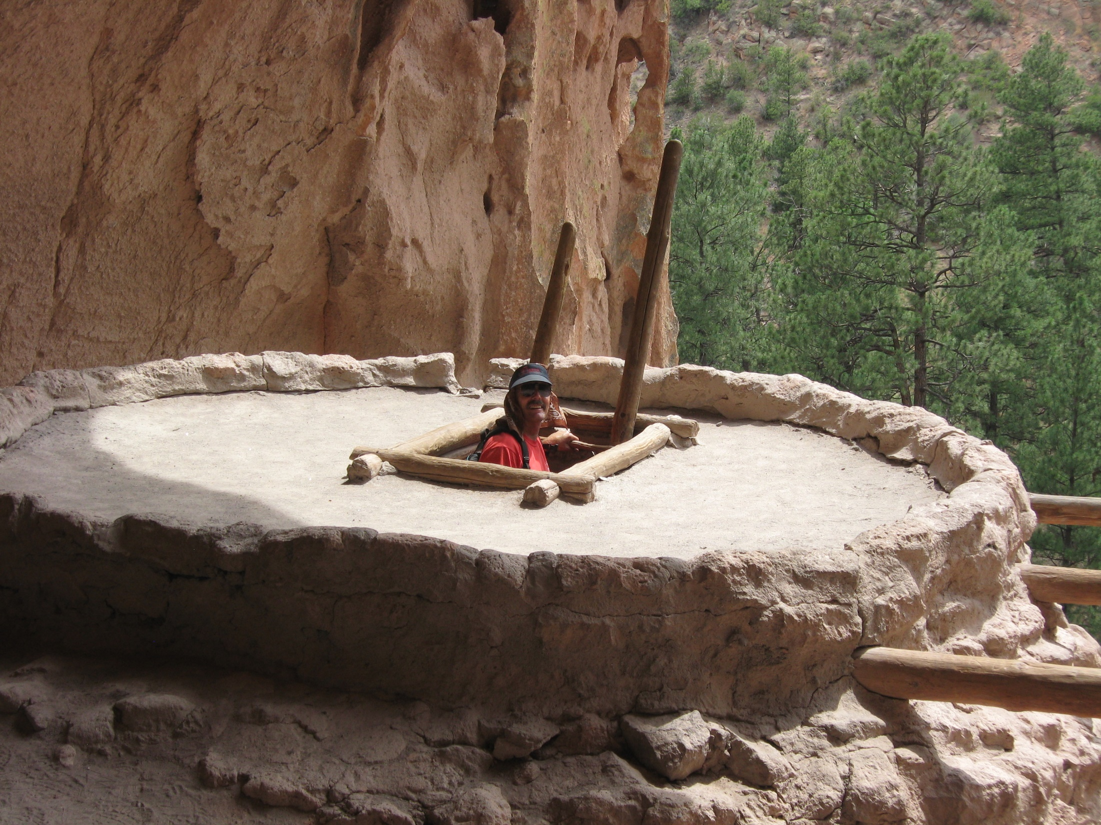
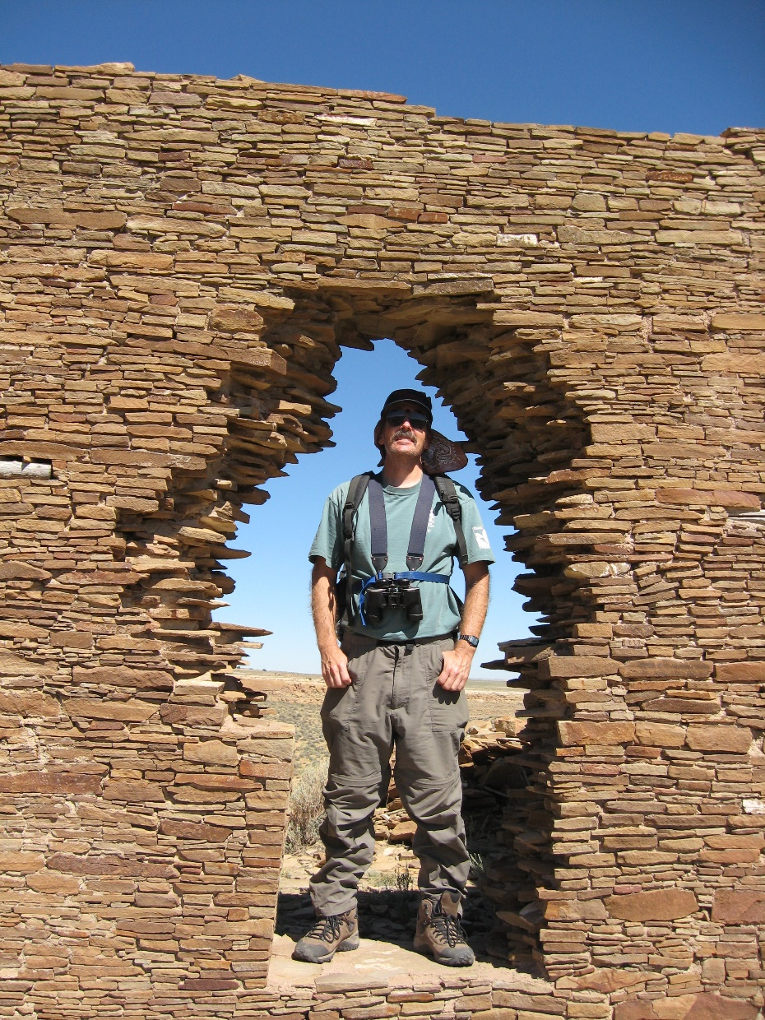
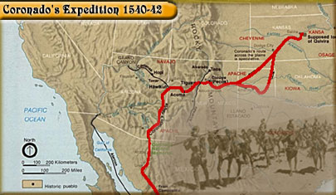
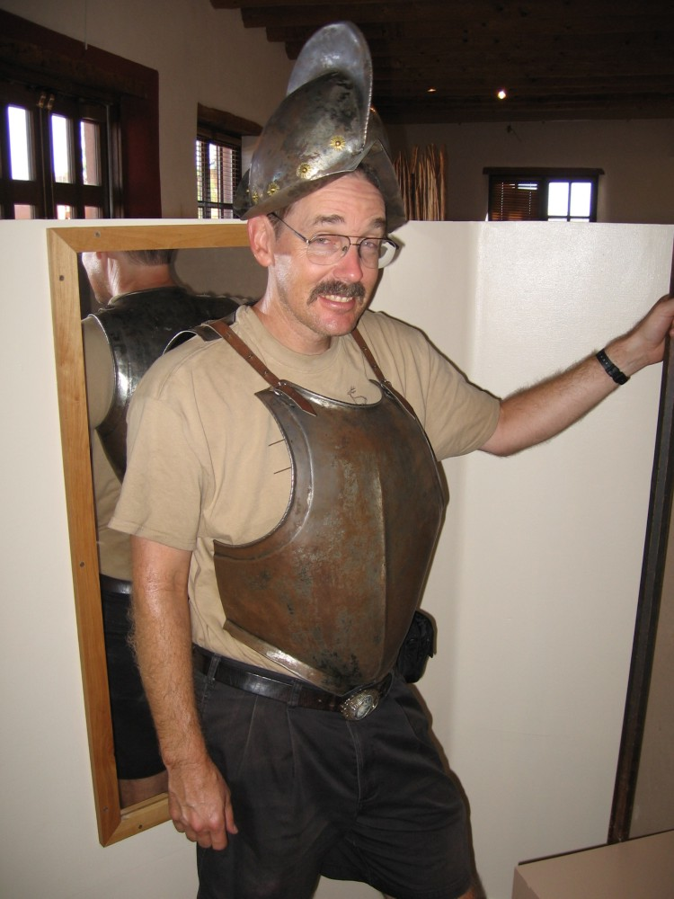
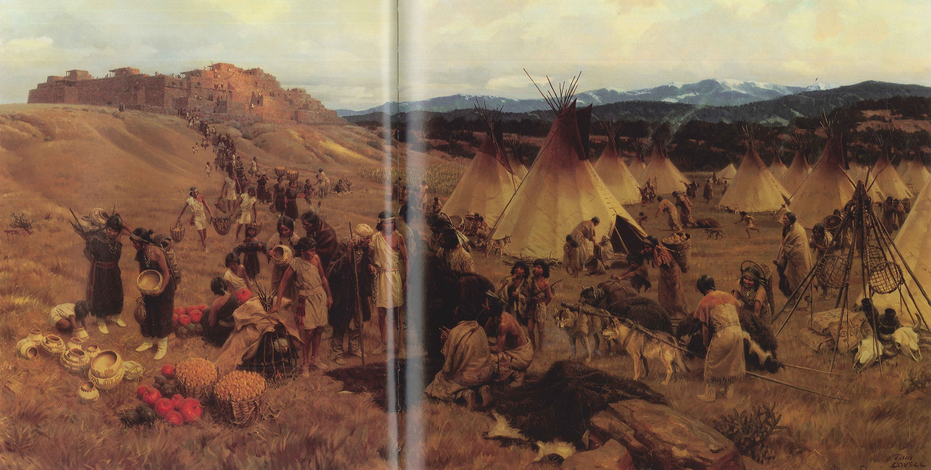
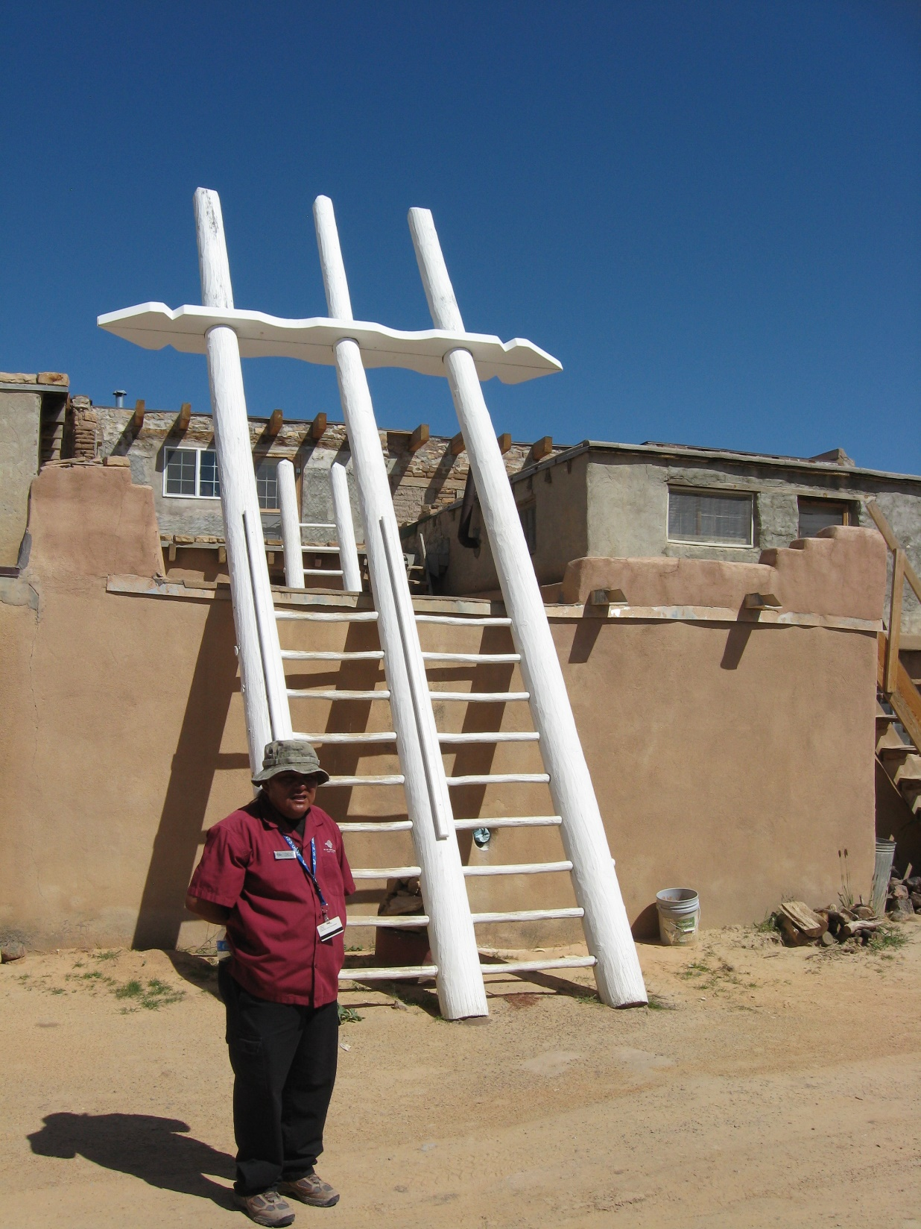
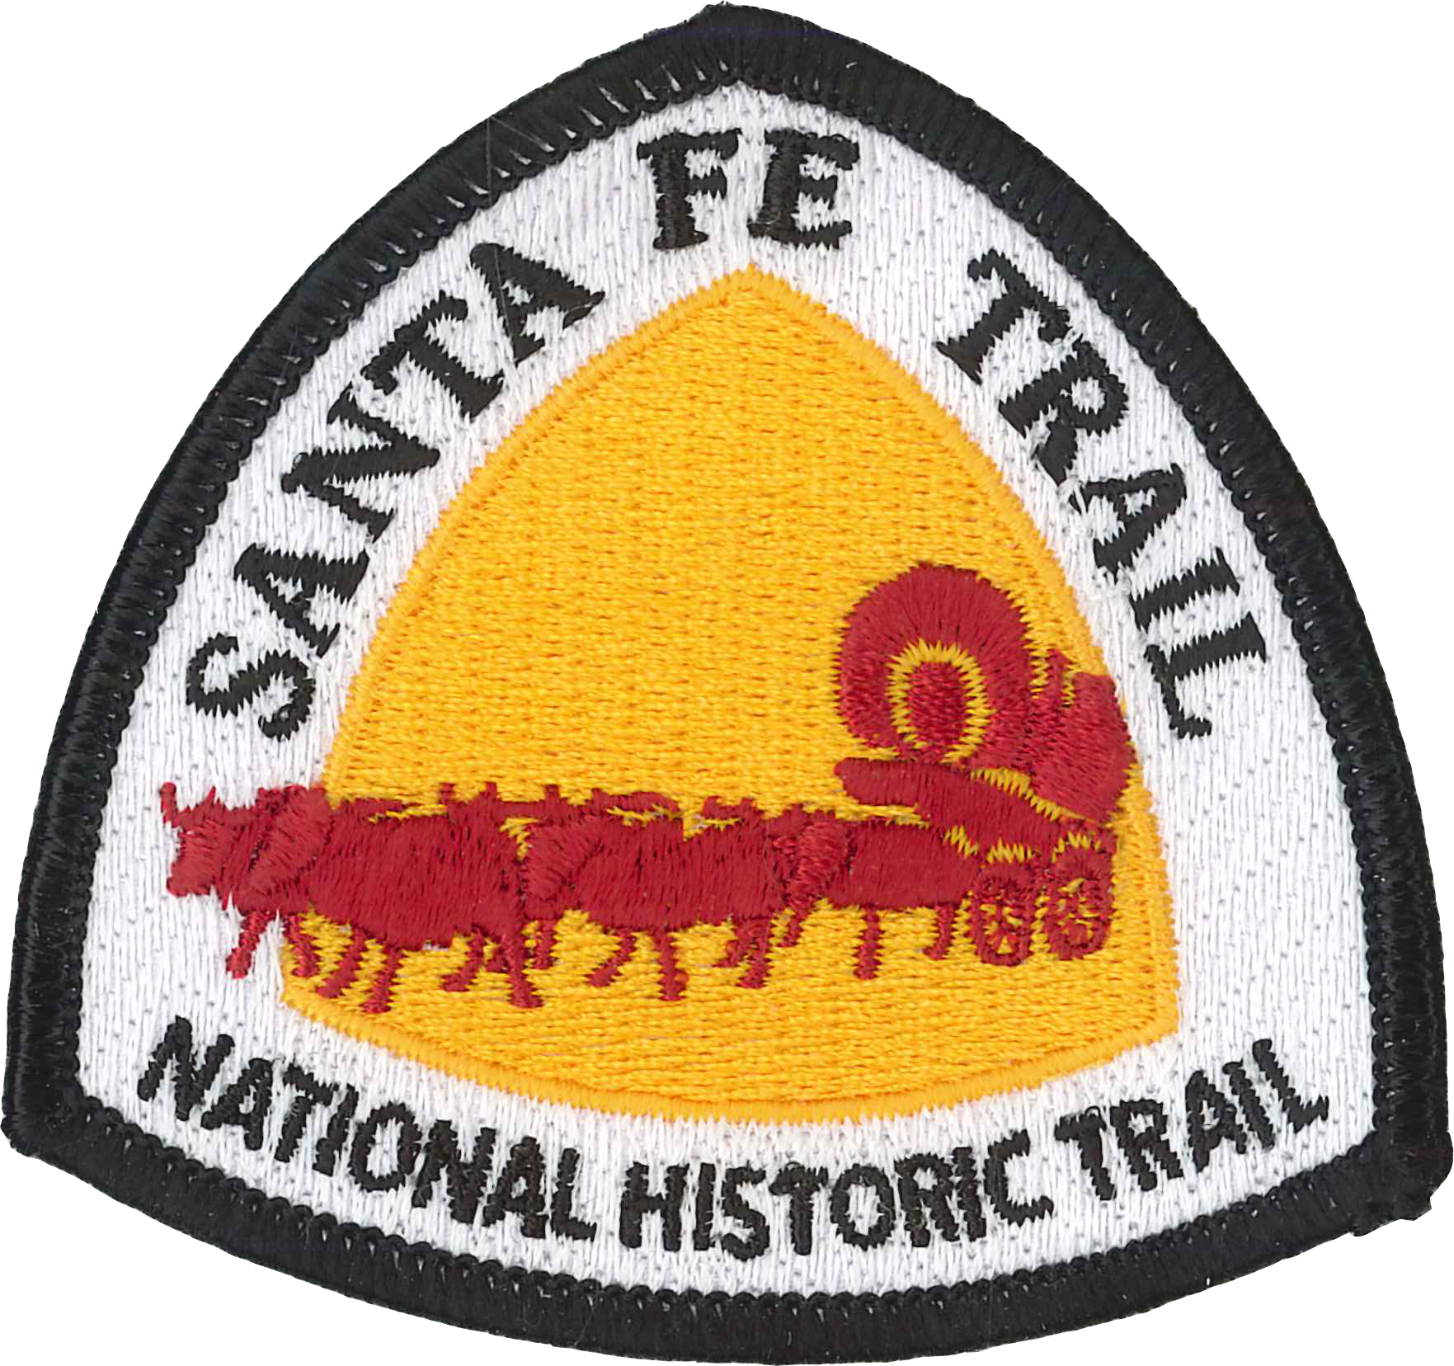
Pecos-Plains People meeting How to remove streaks in Photoshop?
Notes:
Paul: the American Southwest has been inhabited by humans for over 10,000 years,
Paul: beginning with cultures known as Clovis and Folsom,
Paul: followed by a lengthy period known as Archaic,
Paul: which slowly changed into more sedentary communities of Ancestral Puebloans
Paul: and then into the modern Pueblos of today.
Paul: Other indigenous societies, such as Navajo, Apache, and Ute as well as many Plains groups, have lived here for centuries.
Paul: Spanish arrived in 1540, with Mexico assuming jurisdiction in 1823 and then the US in 1848.
Paul: All of these ethnicities still reside in New Mexico, making for rich diversity of cultures and land management philosophies.

Slide 10
Notes:
Mary: Although New Mexico is not known as a large producer of forest products,
Mary: The forest industry is our tool to manage forests for ecosystem health
Mary: Water is one of our most important forest benefits.
Mary: Wildlife is often the key economic driver for forest management activities.
Mary: And fire management is one of our most common forest management activities.

Slide 11
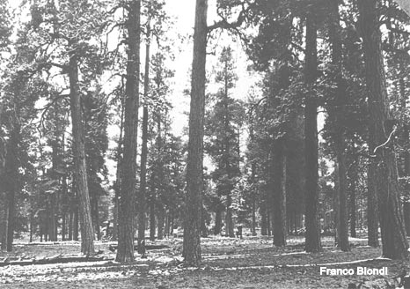
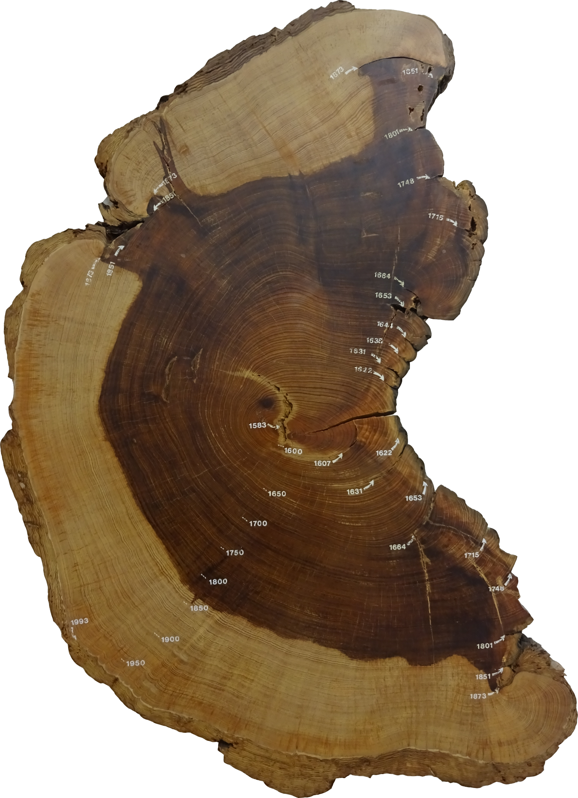
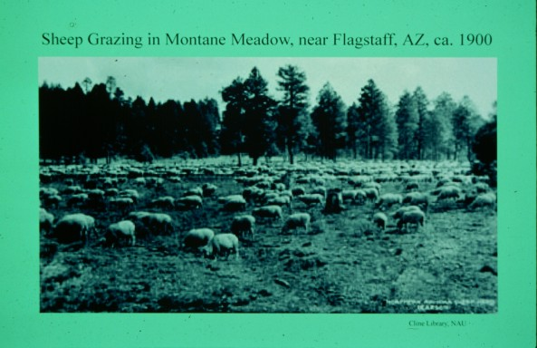
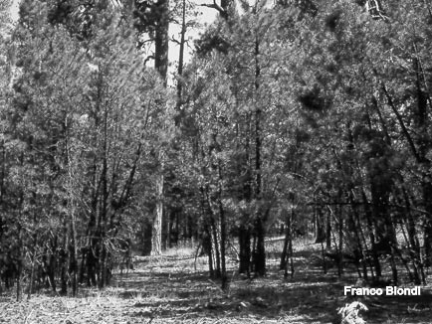
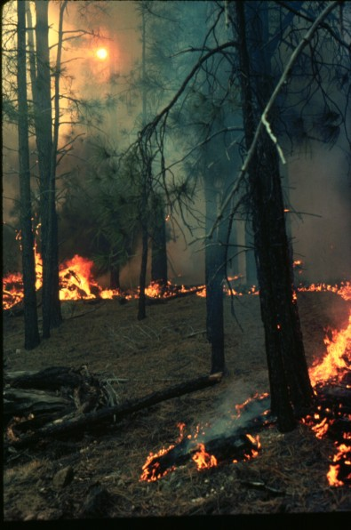
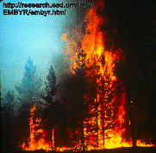
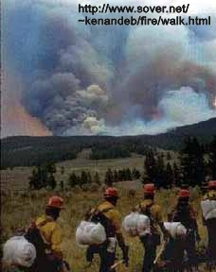
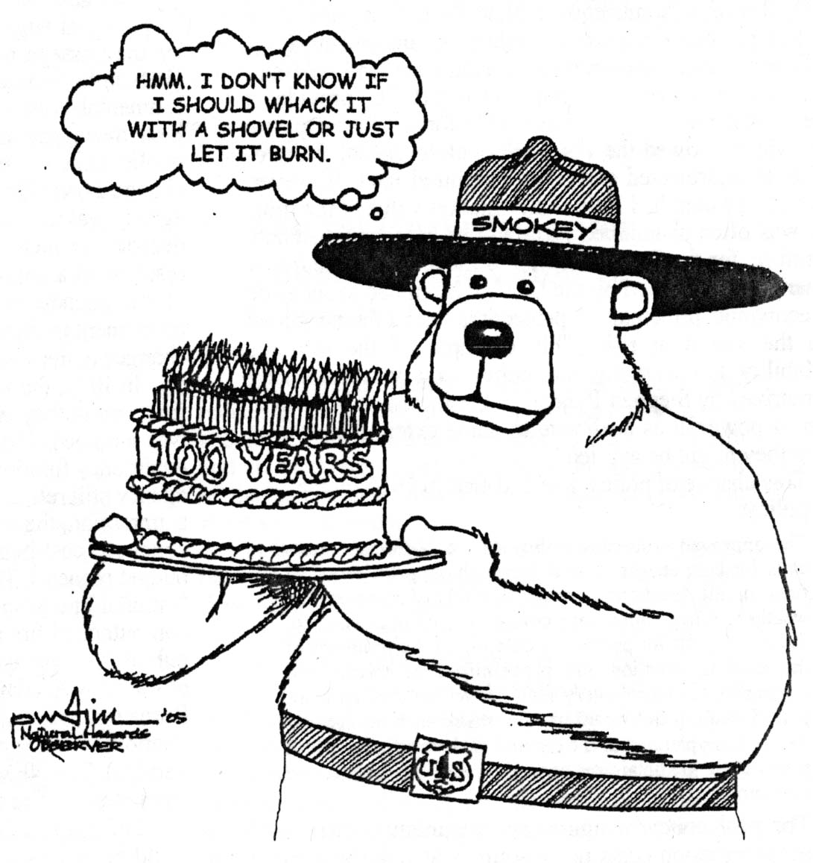
Notes:
Paul: In fact the key to understanding our southwestern forests is understanding the impacts of fire exclusion.
Paul: This story is often told best by the trees themselves speaking in the language of tree rings and fire scars.
Paul: In over xxx,xxx samples studied in the SW, xx% of fire scar samples show 1878 or 1890 as the last fire year.
Paul: This century plus exclusion of fire can roughly be attributed to two major landscape activities…
Paul: Initially it was the introduced of livestock in such large numbers that fine fuels (grasses) were no longer present to carry landscape scale fires.
Paul: Yet, as our technology developed to responsibly manage range lands to retain grasses, our firefighting technology was also becoming more effective.

