Slide 1
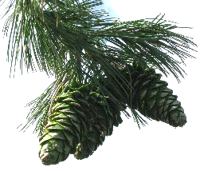
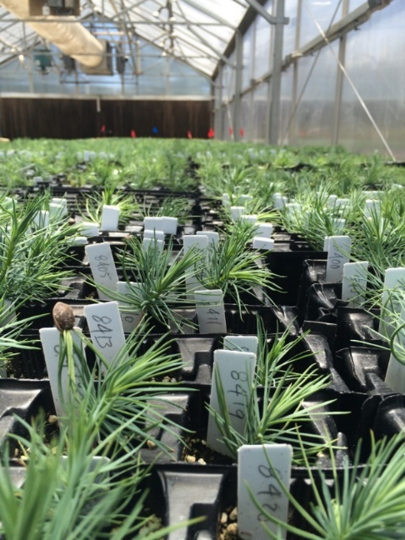

White pine blister rust resistance screening and durability monitoring: Pinus strobiformis
Silviculture and applied forest health lab
PI: Dr. Kristen Waring
School of Forestry
Northern Arizona University
^{Kristen.waring@nau.edu}

Slide 2

A collaborative effort
Principal Investigators: Kristen Waring, Richard Sniezko
Collaborators: Jeremy Johnson, Antonio Castillo, Betsy Goodrich, James Jacobs, Nicholas Wilhelmi, Greg Reynolds, Mary Lou Fairweather, Bill Hornsby,
Bureau of Indian Affairs, USDA Forest Service, Mescalero Apache Tribe
Staff and volunteers: Al Hendricks, Emily Boes, Brianna McTeague, Evan Heck, Doug Savin; tree climbers; silviculture lab grad student volunteers

Slide 3
Funding
USDA Programs:
  Gene Conservation
  Special Technology Development
NAU Programs:
  Technology Research Initiative Fund
National Science Foundation:
  Macrosystems Biology
Grant Nos. EF-1442597, 1442456, 1442486

Slide 4
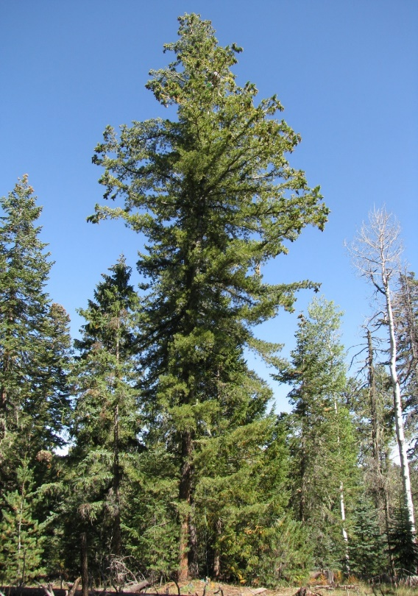
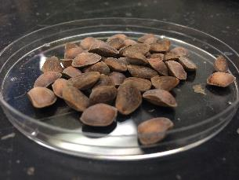
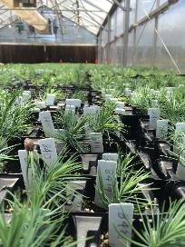
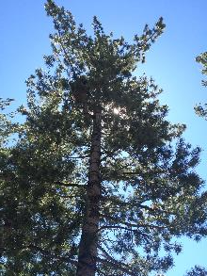
Pinus strobiformis
southwestern white pine
Looney & Waring 2012, 2013; Goodrich & Waring 2016; Goodrich et al 2016, 2018; Shirk et al. 2018

Slide 5
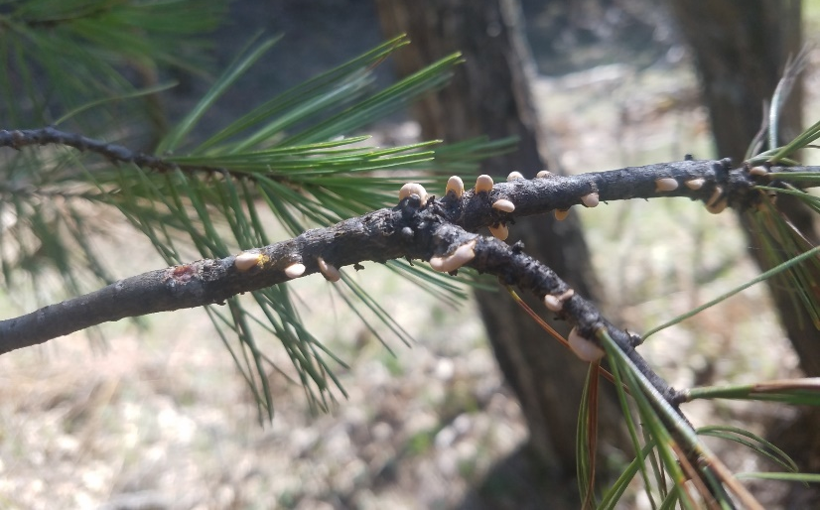
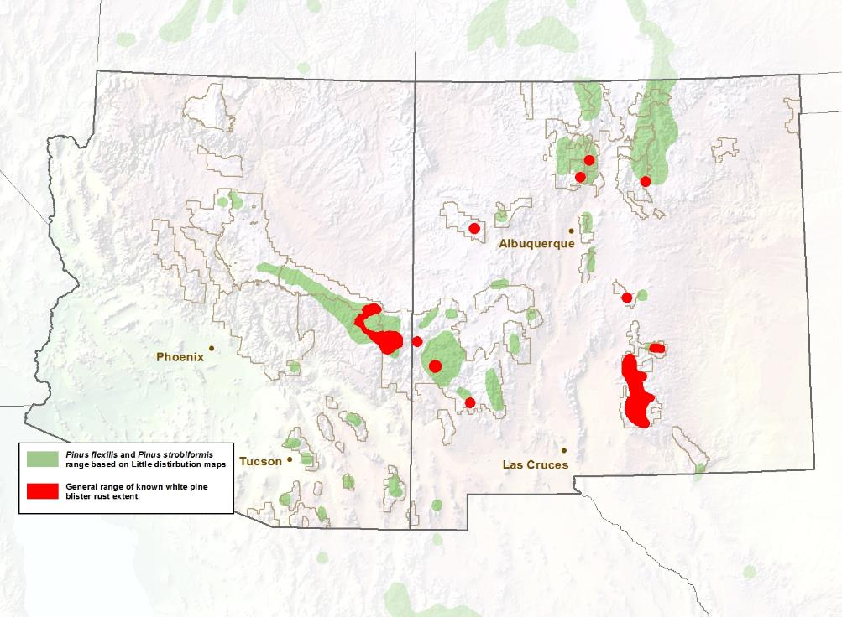
Invasive disease:
White pine blister rust
Where and how much genetic resistance?
Conklin et al 2009; Fairweather & Geils 2010; Looney et al. 2015

Slide 6
US collection sites
Cones, seeds, foliage, increment cores
In 2016, additional foliage + increment core sites
2015: sites across range in Mexico

Slide 7
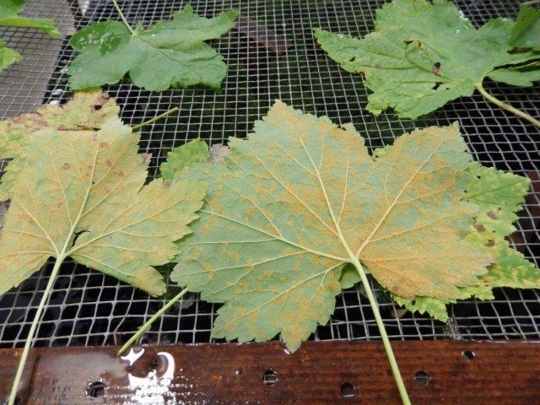
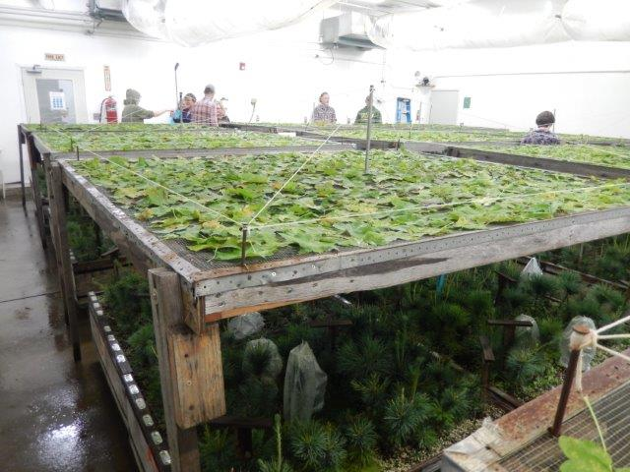
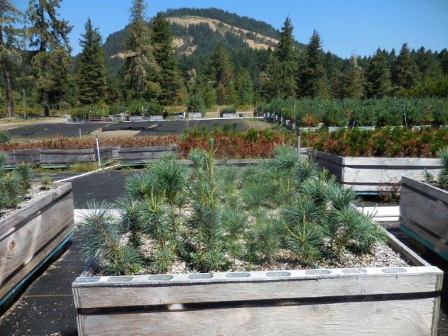
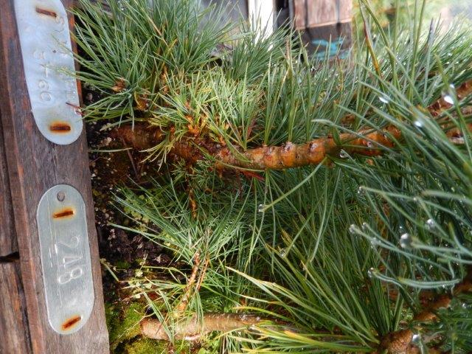
Genetic resistance testing
Disease resistance
Cankers
Dorena Genetic Resource Center, OR

Slide 8
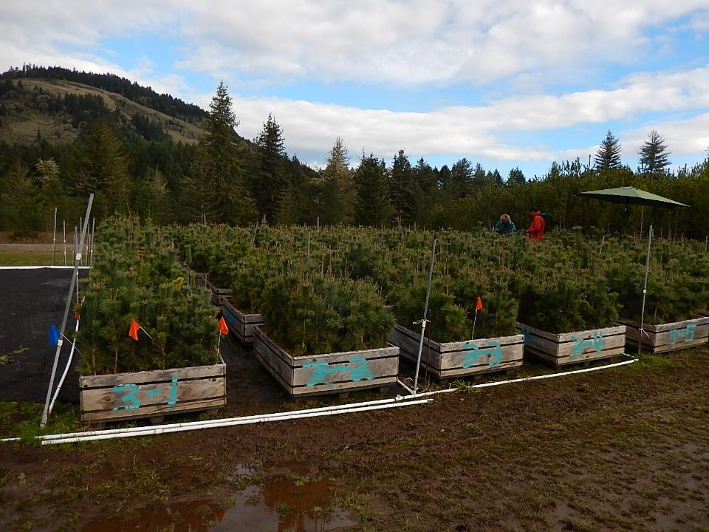
Disease resistance
SY 2014 seedlings, Fall 2016
Since 2014:
  449 families
  Entire range of SWWP

Slide 9
Types of disease resistance
Disease resistance
Major gene resistance (MGR): confers immunity
  Weakness: can be overcome by pathogen mutations
Multigenic / quantitative disease resistance
  Strength: long-term durability
Low frequency across the landscape

Slide 10
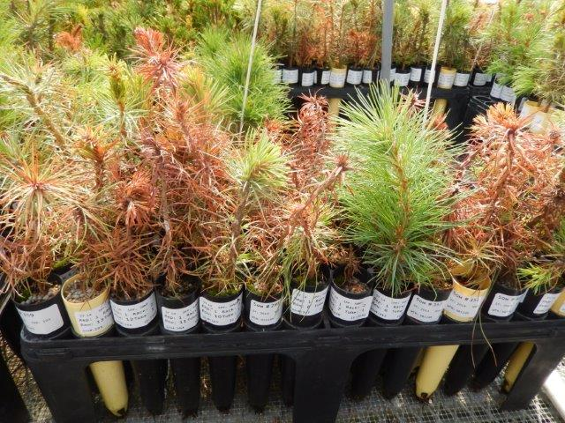
Disease resistance
MGR trial, SY2014

Slide 11
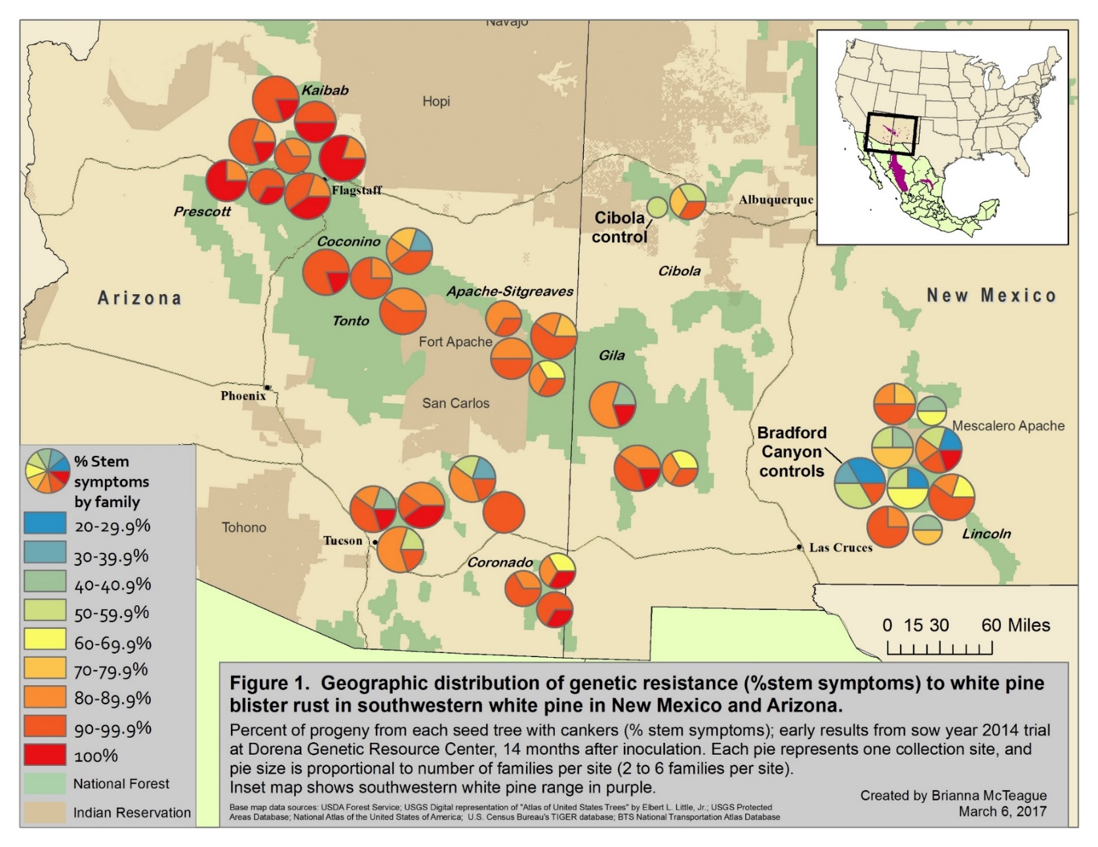
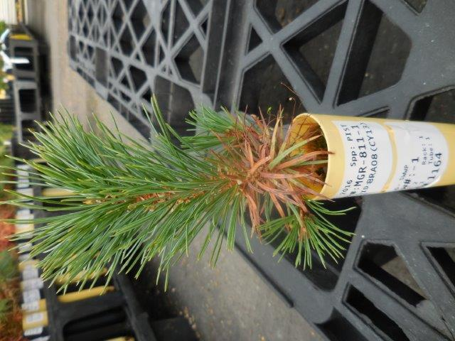
Preliminary results: % stem symptoms
Disease resistance
Dorena Genetic Resource Center, Unpublished data

Slide 12
Field Durability Trials
Disease resistance
Disease monitoring & detection
Two sites (Arizona & New Mexico)
Examine stability and durabilty of resistance
Monitor for potential virulence to MGR
Room for additional trees (monitoring, research)

Slide 13
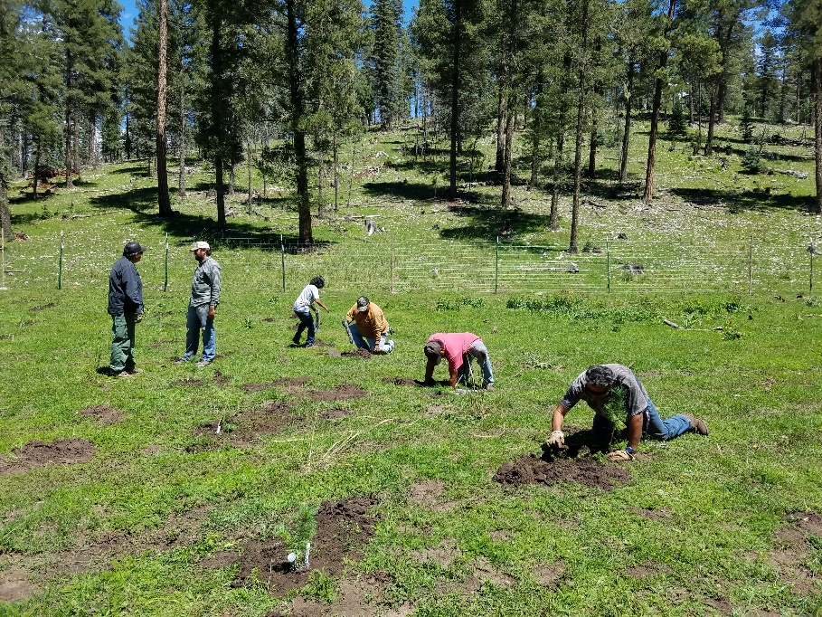
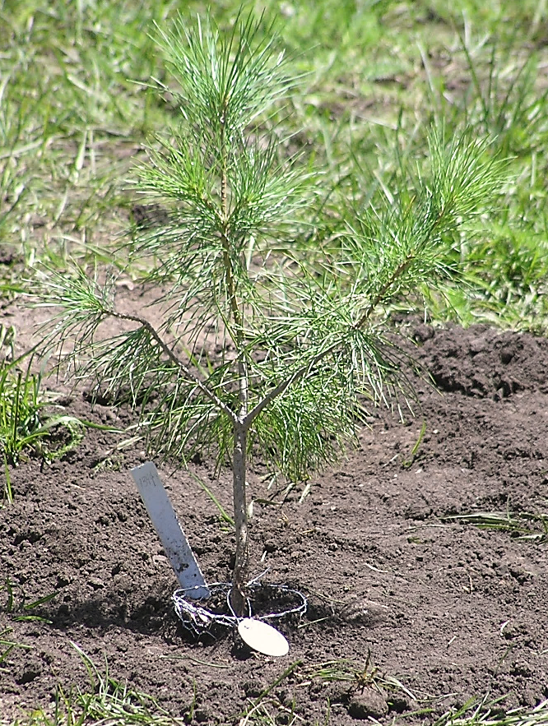
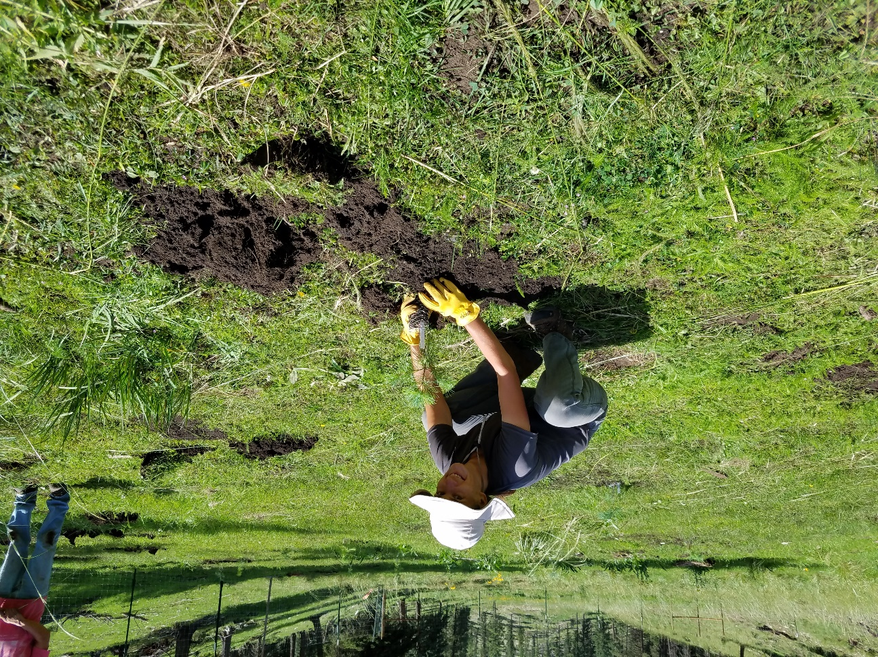
New Mexico site
Disease resistance
Disease monitoring & detection
Mescalero Apache Tribal land
Site development + planting: 2017
  Collaborative effort between NAU, USFS, Mescalero Apache Tribe, BIA
~200 seedlings (Goodrich families)
Need to begin regular monitoring
  Lack of funds

Slide 14
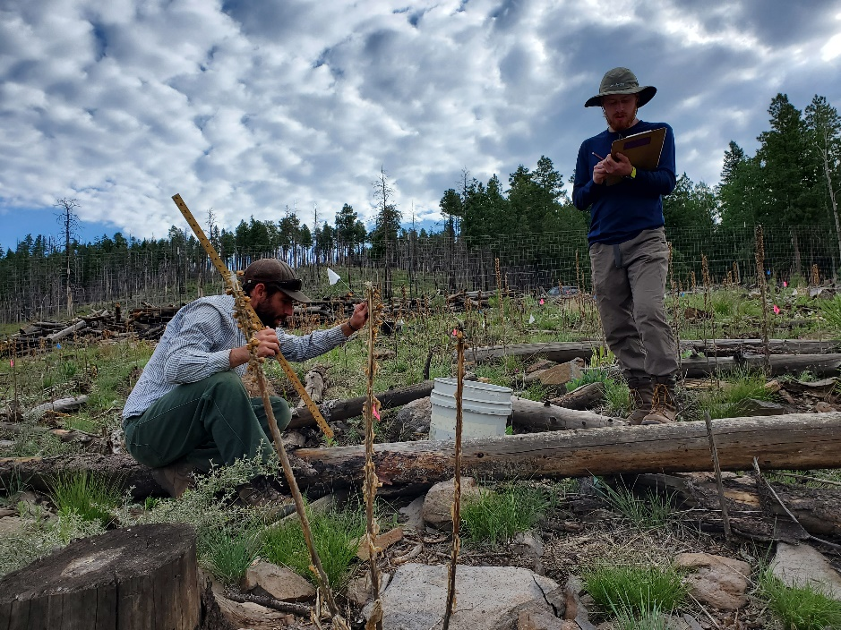
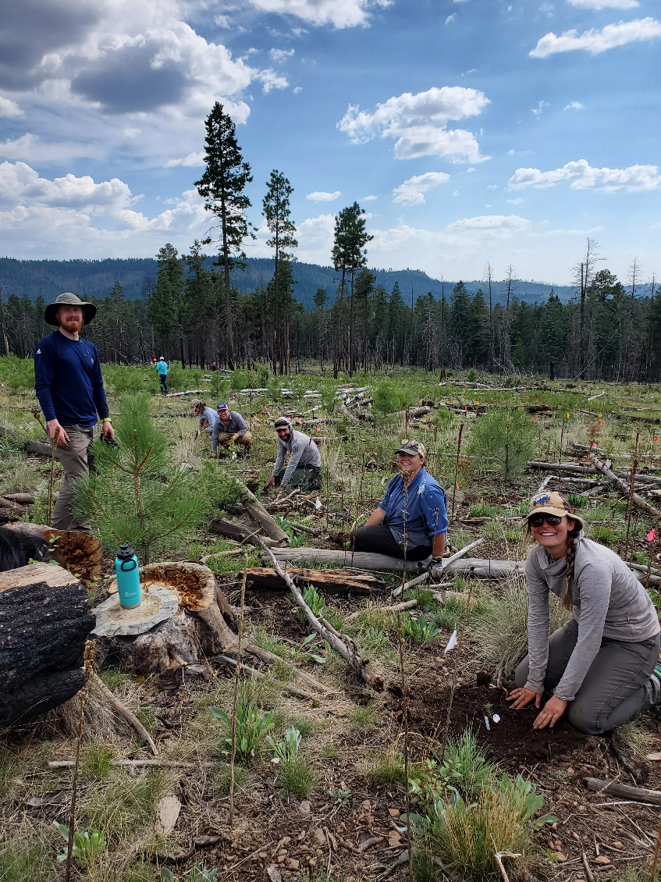
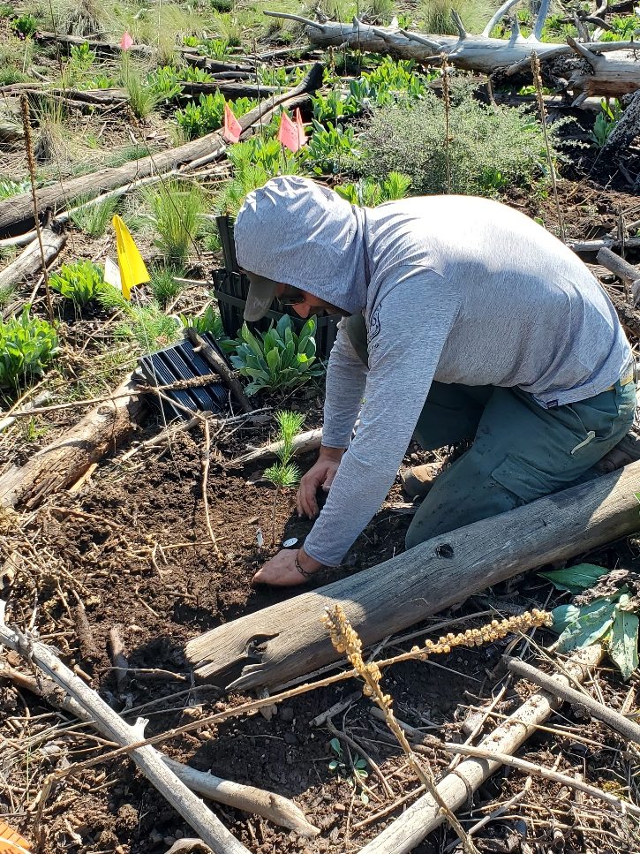
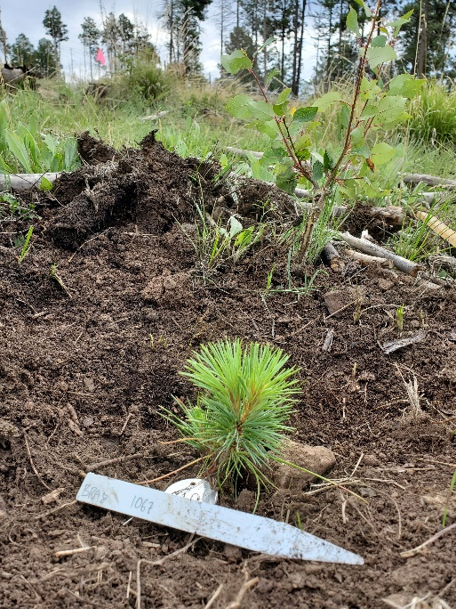
Arizona Site
Disease resistance
Disease monitoring & detection
Apache-Sitgreaves National Forest
Wallow fire (2011, >500,000 ac)
Outplanting: August 2020
  Very dry summer (‘nonsoon’)

Slide 15
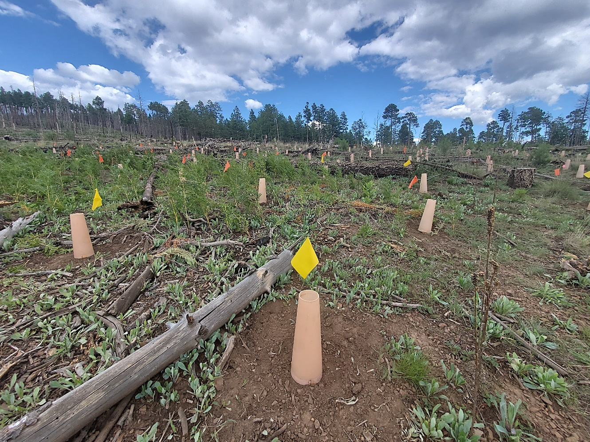
Arizona Site
Disease resistance
Disease monitoring & detection
123 ‘demo’ – family rows
970 randomized

Slide 16
Ongoing / Future work
Resistance screening:
  Continue monitoring families in testing
  Add new families
    About $1000 per family to screen
Durability gardens
  Monitor plantings
  Add new plantings
  Link with other southwestern white pine research
Ultimate goal: managers will be able to outplant resistant stock

Slide 17
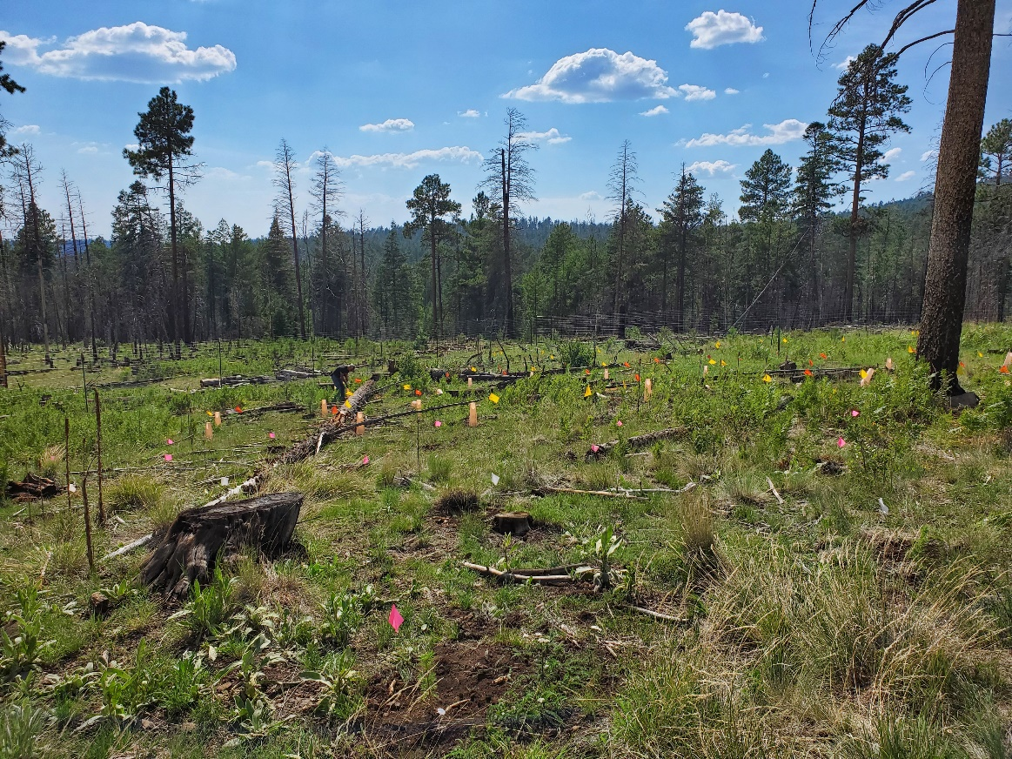
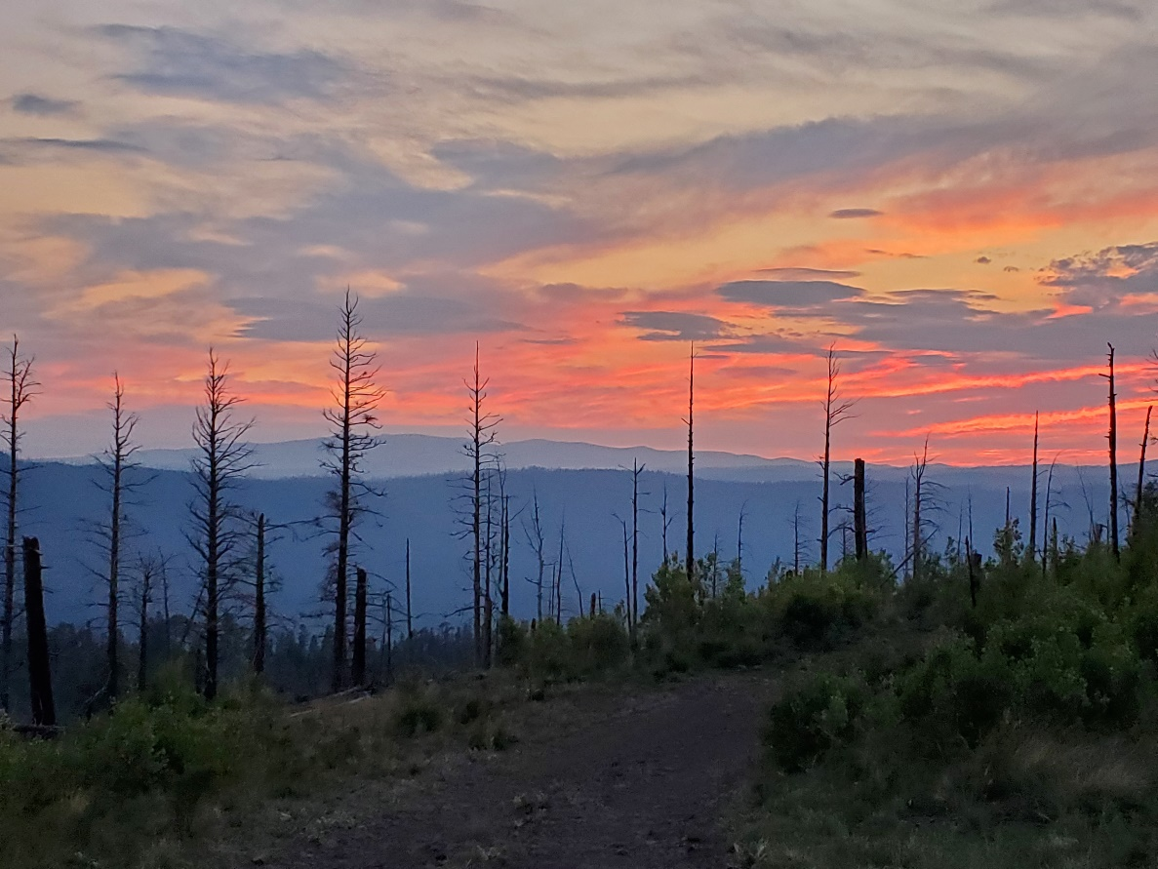
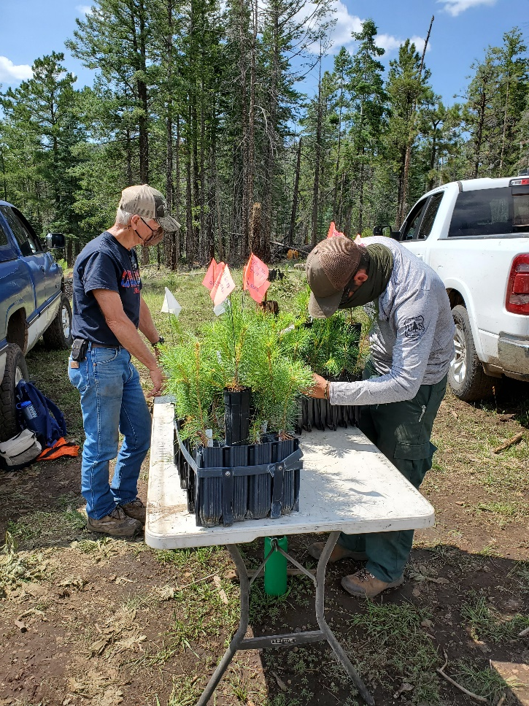
Arizona Site

